Slide 1
Unit 4: Envisioning Southeast Asia
Lesson 7: Southeast Asia, film, and empire

Slide 2
A note to users of this presentation
This presentation was developed as complementary materials for teachers running this lesson. It follows the lesson plan.
It includes content from the lesson plans and the introductory essays for teachers’ lectures. It also introduces some of the activities suggested for students.
You are welcome to customize this presentation to adjust the lesson to their curriculum and to your students. You can change images, add/remove activities, and of course delete this slide, etc. The Teacher’s Guide (https://sharedhistories.asia/teacher/) provides guidance on how to adjust the lessons.
We wish you a successful lesson!
The Southeast Asian Shared Histories project was developed by UNESCO Bangkok with funding from the Republic of Korea.

Slide 3
Key Questions
How do films and movies portray the history of empires?
How do local film industries in Southeast Asia contribute towards the creation of new national cultures and independence movements?

Slide 4
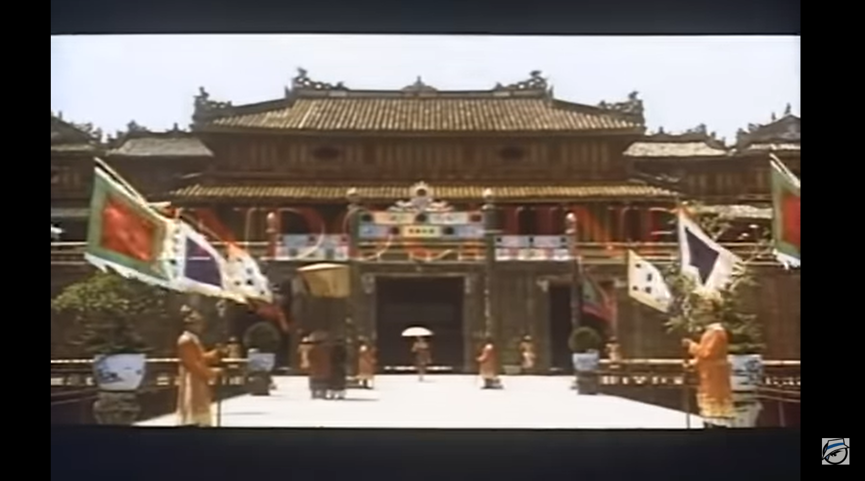
Movie trailer of Indochine
https://www.youtube.com/watch?v=FxMoREEix6Q

Slide 5
What do you think of or feel when you watch this movie trailer?
What type of relationships between Southeast Asians and Europeans do you see?
What type of relationships do you see between men and women?
Who or what characters seems to be in control?
Does there seem to be conflict?

Slide 6
This movie shows several dimensions of European colonialism in Southeast Asia:
political domination
complicated relationships between Europeans and Southeast Asians
violent conflict.
Film provides an interesting entry point into understanding the history of imperialism and empire in Southeast Asia.

Slide 7
Films: political and / or economic vehicles
The emergence of colonial control coincided with the development of film as one of the dominant media of popular culture
  Imperial powers created film boards, celebrated their accomplishments, and chronicled the cultures of the people they controlled through film.
  Local South-East Asians began forging national cultures
  Yet, many film promoters focused on film that could make large profits.
This lesson focuses on the first 2 categories.

Slide 8
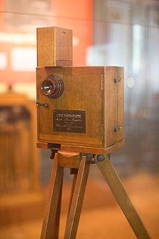
A brief history of the movie industry
  1890: Motion picture cameras invented
  1897: First film studio built
  1906: First permanent theatre showing only films
  1906: First feature length film using multi-reel film
  1923: First talking movie

Slide 9
The rise of film coincided with the period of most intensive colonization in Southeast Asia
  Motion picture cameras invented
  First talking movie
1750
1800
1850
1900
1950
Great Britain in Burma
France in Cambodia
Netherlands in Indonesia
France in Laos
Great Britain in Malaysia
Spain and USA in the Philippines
Great Britain in Singapore
France in Viet Nam

Slide 10
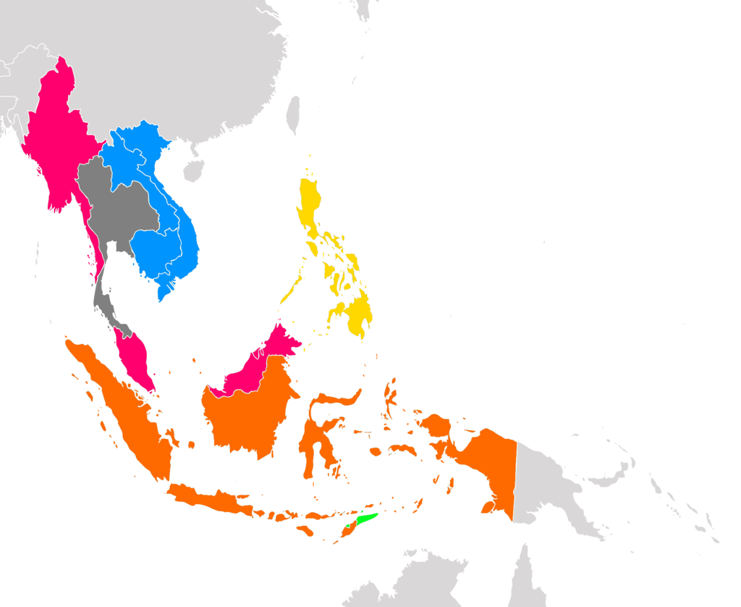
Colonial power over South-East Asia
Colonial powers
France
Netherlands
Portugal
Spain
United States of America
United kingdom
  Burma: 1824-1948;
  Cambodia (Indochina): 1887-1947;
  Indonesia: 1800-1949;
  Laos (Indochina): 1887-1947;
  Malaysia: 1874-1957;
  Philippines: 1521-1898 (Spanish), 1898-1946 (United States);
  Singapore: 1819-1959;
  Thailand: not officially colonized;
  Vietnam (Indochina): 1887-1947.

Slide 11
The domination of American movies
  “American films are shown in Manila…and their lure leads hundreds of emigrants straight to Hollywood. The ambition of every boy in the Philippines seems to be come to this wonderful place where their screen heroes live.”
Bruno Laskar, American sociologist
Drama, action, and spectacle of exotic locations made American films popular.
→ In the Philippines, colonized by the USA
→ And also in the rest of the region
1926: 29 movie houses in French Indochina → 75% of films shown were American and known as “Film America”.
In prewar Singapore, 70% of films shown were American versus only 16 % for British.

Slide 12
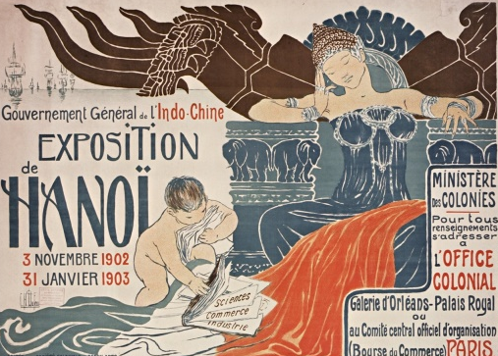
Example of cinematographic companies
      Mission Cinématographique de l’Indochine
      Patronage Laïque Cochinchinois
        Oﬃces in Hanoi and Saigon;
        5contract with the French administration to produce a minimum of 2,700 meters (8,860 feet) of ﬁlm per year;
        152 diﬀerent ﬁlms in distribution through the Paris-based Indochinese economic aﬀairs oﬃce by 1927;
        In addition to producing photographic and documentary footage, Indochine Films was also charged with showing French propaganda ﬁlms in towns and villages throughout Indochina.
        French educational initiative based in Saigon
        Archive of 840 ﬁlms, approximately 5,000 recreational screenings;
        Many of these films were American westerns and comedies along with some European ﬁlms
        However, also at least 1,000 ﬁlms with educational lessons or lessons about hygiene

Slide 13
Discussion
?
Why do you think
colonial governments
wanted to make films?

Slide 14
Why do you think colonial governments wanted to make films?
Some findings
Profit and money making although not as the main incentive (unlike Hollywood)
    Showing the benefits of rule by colonial government
    Reinforcing the idea of racial hierarchy
    Communicating the idea of “progress” and “modern life”
    Documenting and controlling local cultures.

Slide 15
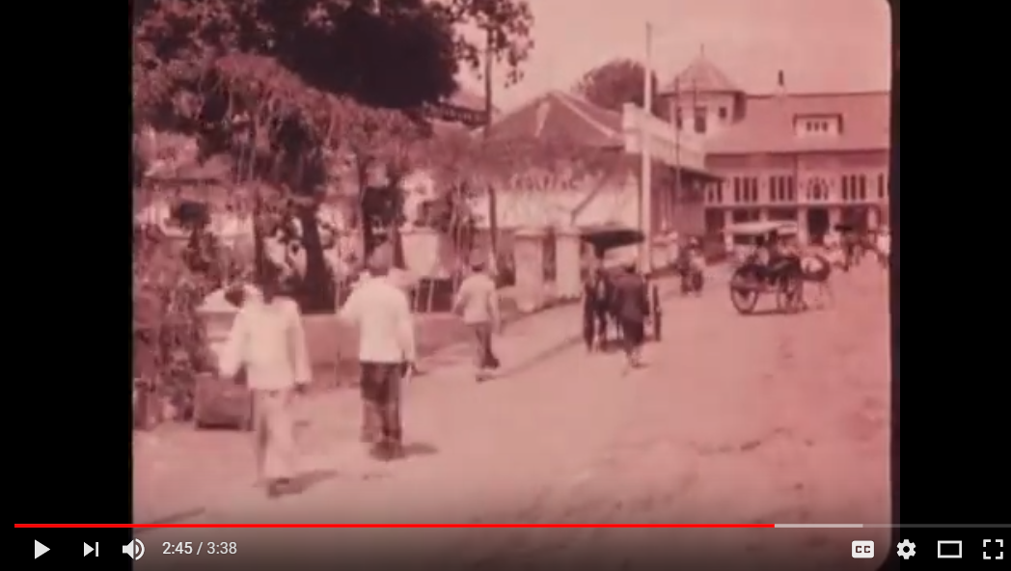
Group activity: Movie analysis
Trailer of J. C. Lamster’ film
https://www.youtube.com/watch?v=jrgt83wPGiM

Slide 16
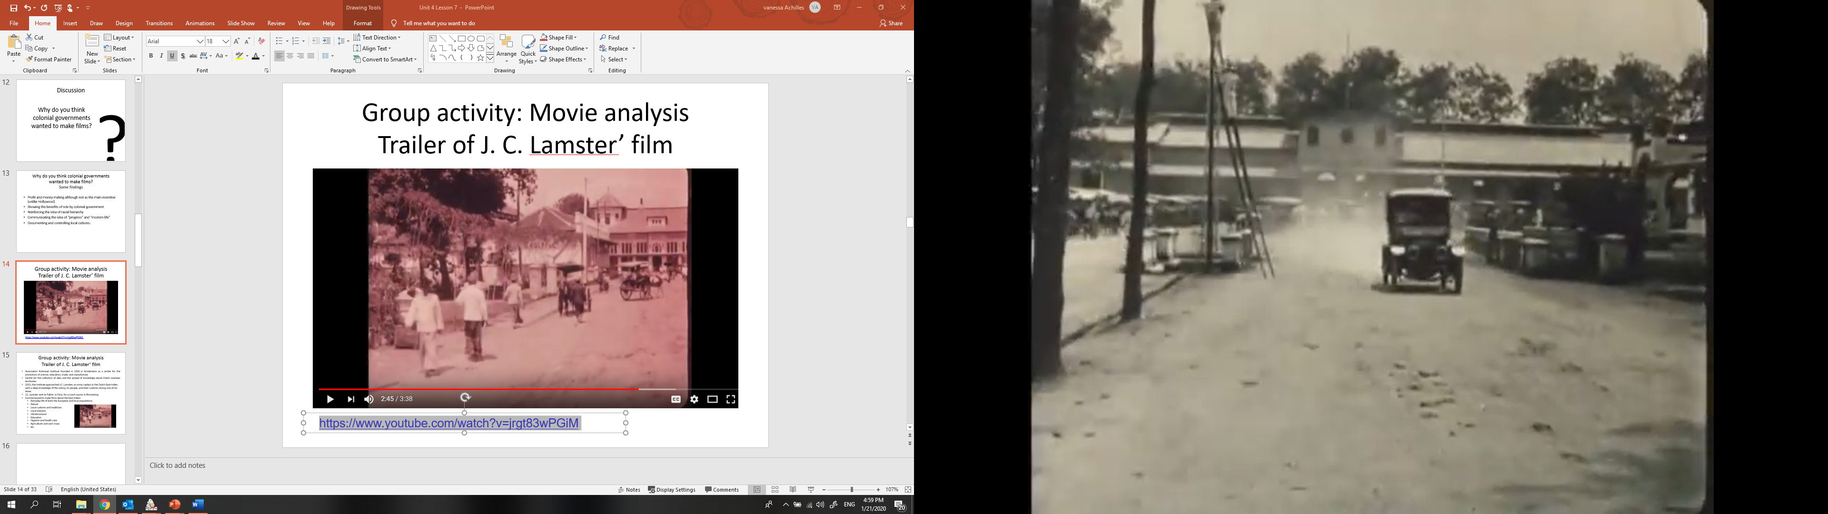
Group activity: Movie analysis
Trailer of J. C. Lamster’ film
Association Koloniaal Instituut founded in 1910 in Amsterdam as a centre for the promotion of science, education, trade, and manufacture.
Centre for the collection of data and the spread of knowledge about Dutch overseas territories.
1911, the Institute approached J.C. Lamster, an army captain in the Dutch East-Indies with a deep knowledge of the colony, its people, and their customs during one of his leave.
J.C. Lamster sent to Pathé, in Paris, for a crash course in filmmaking.
Commissioned to make films about the East Indies:
  Everyday life of both the European and local populations
  Nature
  Local customs and traditions
  Local industry
  Infrastructures
  Education
  Hygiene and health care
  Agriculture and cash crops
  etc.

Slide 17
Group activity: Movie analysis
Guiding questions
In groups of 4, watch the movie and answer the questions listed in the handout.
Please describe
  Types of transportation shown in film
  Types of buildings shown in film
  Clothes of Indonesians
  Portrayal of Indonesians
Did you think this film did a good job of showing Indonesian culture?
Why do you think there are so many roads and railroads shown on this film?
Do you think this film would hold the attention of audience? Why or why not?
Do you think this film would be helpful in establishing Dutch control in Indonesia? Why or why not?

Slide 18
Group activity: Movie analysis
Some findings
    Most of the film focuses on transport, railroads, roads, cars, horse-drawn transports, etc.
    Farming and trees often shown
    View of local Indonesians is often quite obscure, hard to see people
    Focus on transportation and agriculture is meant to show how Dutch improve lives of Indonesia
However, it is not really a film about Indonesians; little room for inclusion of Indonesian perspectives.
This movie helps us reflect on the concept of “political imperialism” versus “cultural imperialism.”
This illustrate that colonial authorities took film seriously as a way to represent local cultures, to define what constituted “progress” and “modern life,” and to control SE Asian nations.
Even fun and entertainment could be important sources of power for imperial regimes.

Slide 19
Discussion
?
How can one define and characterize colonial film?
How do colonial films represent race and culture?
Do colonial films allow any inclusion of local, Southeast Asian voices?
Are colonial films likely to make as much of an
impact as Hollywood or popular films?

Slide 20
Local ans global dimensions in contemporary movies
  All movies try to portray a particular place and time.
  Much as in J.C. Lamster’s work, they use technology or language or cities to show that sense of time and place.

Slide 21
Group activity: Movie analysis (part 2)
In groups of 3-4
Identify the following aspects of a movie you have recently seen:
    Technology
    Type of place (countryside, city, specific nation)
    Language used
Try to identify local and global themes in these movies
Are these elements similar or different from what was shown in J.C. Lamster’s film?

Slide 22
Conclusion
Colonial period: most movies are foreign to Southeast Asia mostly produced by Americans.
Messages and influence of these films can, in part, help to reinforce the control of the colonial regime.
Colonial authorities took film seriously as a way to represent local cultures, to define what constituted “progress” and “modern life,” and to control Southeast Asian nations.
Even fun and entertainment could be important sources of power for imperial regimes.
Nowadays, contemporary films still borrow heavily from their precursors.

Slide 23
Unit 4: Envisioning Southeast Asia
Lesson 7: Southeast Asia, film, and empire
Period 2

Slide 24
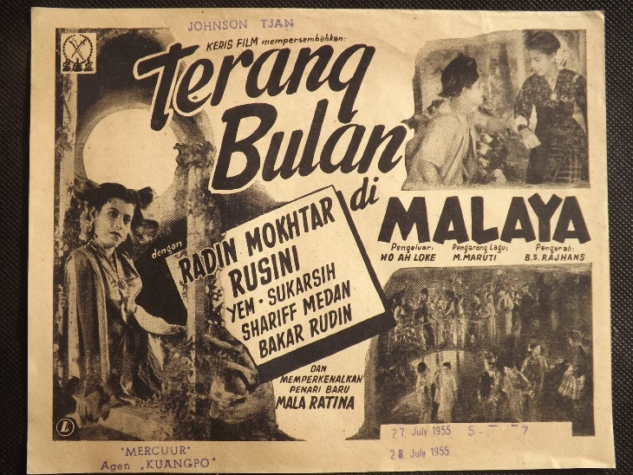
Local and national films
Colonial period: Not all films were made by Hollywood or colonial governments
Beginning of a local film industry by local people (often Chinese or Indians living in Southeast Asia)
Local films still influenced by Hollywood and Western productions
Beginnings of various national cultures can be seen
Often play a large role in nationalist movements

Slide 25
Group Work
Movie poster analysis
      Groups of 3-4 students
      What aspects of Hollywood or Western film culture do you see in these posters?
      What aspects of local Indonesian culture are shown in these films?
Do you think these film posters illustrate a positive or negative view of life in Indonesia? Why? Provide examples.
      Do you think there is a good balance of local Indonesian and global Western influences in these movie posters? Why or why not?

Slide 26
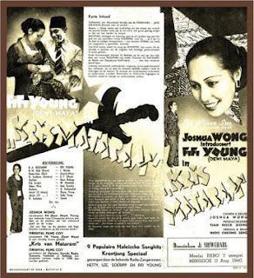
Kris Mataram
1940 film
directed by a Chinese Indonesian, Njoo Cheong Seng
a romance about a central Javanese aristocrat

Slide 27
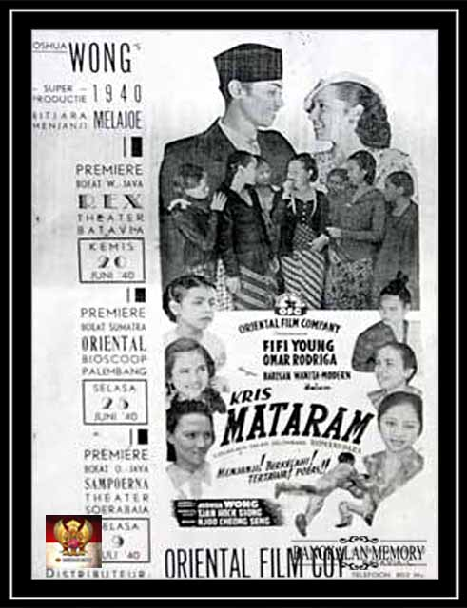
Kris Mataram

Slide 28
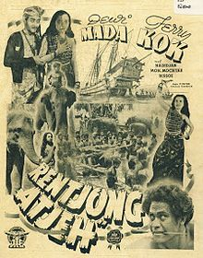
Rentjong Atjeh
Produced in 1939
pirate action movie

Slide 29
Group Work
Some findings
    There are some recognizably Indonesian features in both posters:
      Poster mentions that the film is “spoken and written in Malay” (Bitjara Menjanji Melayu)
      Main actress, Fifi Young, is often wearing traditional Javanese dress known as lurik kebaya
      The men are wearing songkok/kopiah Malay hats
      The font style is Javanese
      Poster mentions that the film included 9 popular keroncong songs, a popular Indonesian style of music
      Javanese keris is itself associated as strong symbol of Javanese culture
      In Rentjong Atjeh, there is also focus on local weaponry, the Acehnese rentjong
      Wearing of traditional garments such as batik
    However, there are also some Hollywood and Western features:
      Kris Mataram film has a mix of Dutch and Malay language
      Kris Mataram also shows Western romantic poses
      At the same time, Rentjong Atjeh poster shows a landscape that could just as easily be Hawaii or South Pacific or some type of generic exotic locale - a typical feature of Western style films
      The primitive nature of locals in Rentjong Atjeh is a typical feature of Western films about non-Western peoples
    Even if posters borrow a lot of negative imagery of non-Western peoples shown in Western films, it is also beginning to forge distinctive national cultures.

Slide 30
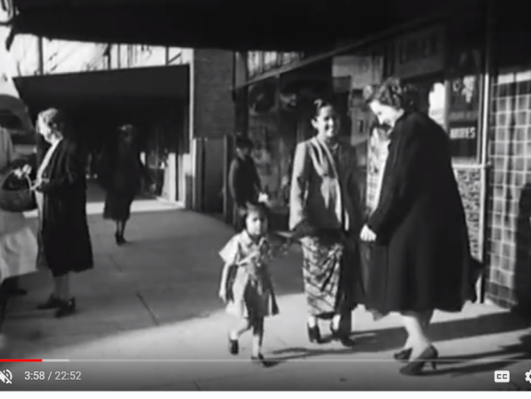
Group activity
Analysis of a nationalist film
  Indonesian Calling by Joris Ivens
  Produced in 1945-1946 by a Dutch documentary film maker, Joris Ivens, in Australia
  Joris Ivens, director of Indonesia Calling, was a Dutchman who was Netherlands East Indies film commissioner
  Yet made startling defence of Indonesian independence, will show how colonial cinema influenced national film cultures
Movie is filmed in Sydney, Australia.
Documents how trade union seamen and waterside workers refused to service Dutch ships (known as the "Black Armada") containing arms and ammunition to be sent to suppress Indonesia’s independence movement.
Gradually became a symbol of the defence of Indonesian independence even for those who had not seen the film.

Slide 31
Group activity
Analysis of a nationalist film
  Groups of 4-5 students
  Watch the video clip with extracts from the movie
  In your group, fill in the handout

Slide 32
Conclusion
Movies have been used for entertainment, economic as well as political purposes.
During the colonial period, movies were used by colonial power as well as by nationalist movement to carry on their respective messages.
Independently from their makers and objectives, movies often blended global and local features.
Nowadays, contemporary films still borrow heavily from their precursors.

