Slide 1
Unit 4: Envisioning Southeast Asia
Lesson 6: Popular Music in Southeast Asia: Between Global and Local Cultures
Period 1

Slide 2
A note to users of this presentation
This presentation was developed as complementary materials for teachers running this lesson. It follows the lesson plan.
It includes content from the lesson plans and the introductory essays for teachers’ lectures. It also introduces some of the activities suggested for students.
You are welcome to customize this presentation to adjust the lesson to their curriculum and to your students. You can change images, add/remove activities, and of course delete this slide, etc. The Teacher’s Guide (https://sharedhistories.asia/teacher/) provides guidance on how to adjust the lessons.
We wish you a successful lesson!
The Southeast Asian Shared Histories project was developed by UNESCO Bangkok with funding from the Republic of Korea.

Slide 3

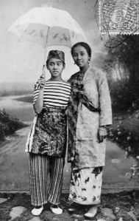
Miss Ribout Ka Doewa
Krontjong Dardanella
https://hajimaji.com/2011/02/07/miss-riboet-ii-indonesia/

Slide 4
Discussion
?
  What is Indonesian in this music?
  What is Western in this music?
  What do you think of or feel when you listen to this music? Does it seem old-fashioned? Relevant to your musical interests?

Slide 5
Discussion
?
  What is Indonesian in this music?
  Rhythm, melody
  What is Western in this music?
  The use of instruments such as cello, bass, and guitar; the German record label “Beka.”
  What do you think of or feel when you listen to this music? Does it seem old-fashioned? Relevant to your musical interests?

Slide 6
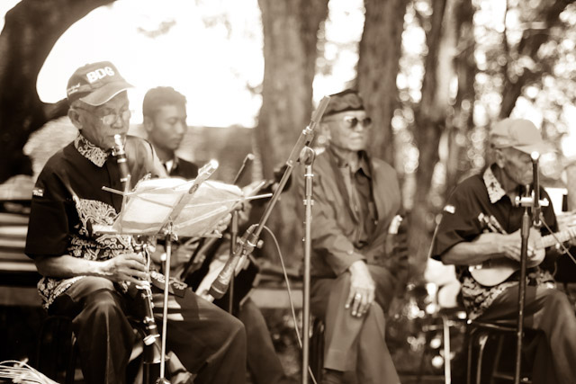
Keroncong
Keroncong first arrived in Indonesia in the 16th century. It was brought by Portuguese along with a guitar-like instrument.
Keroncong became popular on Java Island in the 19th century, mostly in the cities.
Each neighbourhood or kampong in places like Jakarta, the capital, had a keroncong with 5 instrumentalists and 1 singer/vocalist; the instruments usually were ukulele, melodic guitar, cello, violin, and flute.
Keroncong Merah Putih
© cocacolam
https://www.flickr.com/photos/49825684@N04/5068204360

Slide 7
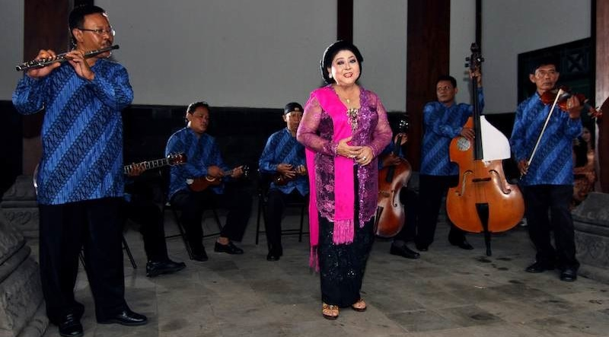
Keroncong
Keroncong = relaxing music with very slow songs, mostly love songs.
Usually thought of as “Western” music because of the European instruments (Guitar, Cello, Violin, Flute, etc.).
Borrowed local influences: use of gamelan, adaptation to local culture and taste.
It gained huge popularity because of technology, particularly, the gramophone, which made keroncong recordings widely available.
Competitions organized by – often foreign - gramophone companies (Ms Ribout was a winner)
© Midori
https://commons.wikimedia.org/wiki/File:Waldjinah_met_Orkes_Keroncong_Bintang_Surakarta_Tong_Tong_Fair2.jpg

Slide 8
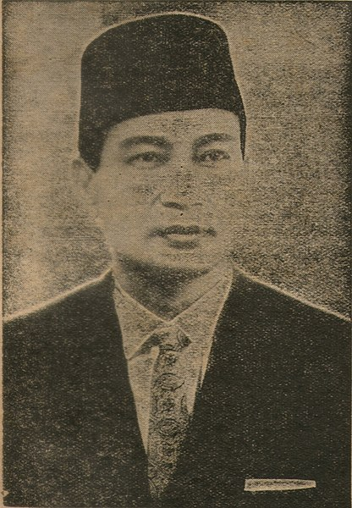
Keroncong
1930s and 1940: preferred musical genre for patriotic music that promoted Indonesian independence and nationalism.
Support of President Suharto: https://www.youtube.com/watch?v=4lVXtNMGvgI
Source: Government of Indonesia (uncredited) https://commons.wikimedia.org/wiki/File:President_Suharto,_1973_(black_and_white).jpg

Slide 9
Keroncong
Keroncong competitions = inspiration for Idol competititons.
Indonesian influences
Western influences
Keroncong

Slide 10
Discussion
?
Is pop culture “Western” or does it include aspects of local culture?
How does pop culture and music evolve over time?
How does pop culture affect national, regional, and individual identity?
How does technology and media affect understanding of global versus the Southeast Asian local?

Slide 11
This lesson will examine two types of
recent pop culture:
Idol competitions
K-Pop

Slide 12

Idol competitions
“Idol”: singing contests popular worldwide.
Amateur contestants are judged and eliminated by popular voting of a television audience
Britain’s Pop Idol (2001-2003)
American Idol (2002 – 2016)
American Idol: very popular around the world and Southeast Asia.
© RadioFan - https://commons.wikimedia.org/wiki/File:American_Idol_Experience_stage.png

Slide 13

Idol competitions in Southeast Asia
    Cambodia: 2015-Present
    Indonesia: 2004-Present
    Myanmar: 2015-Present
    Philippines: 2006 and 2008
    (Pinoy Idol)
    Singapore: 2004, 2006,
    and 2009
    Viet Nam: 2007-present
Source: https://id.wikipedia.org/wiki/Berkas:IDOL2018TOP12.jpg

Slide 14
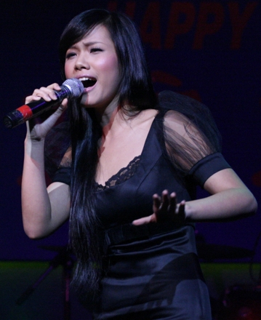
Idol competition
Asian Idol
6 countries - Singapore, India, Malaysia, Indonesia, the Philippines, and Viet Nam
December 2007 in Jakarta.
  Audience: 5000
  Viewers across the region: 300 million
  People casting votes: 2 millions
  First live television event to have been held simultaneously across the entire Southeast Asian region.
Importance of pop culture in tying together the wider Southeast Asian region.
Phương Vy, Viet Nam representative at the Asian Idol
http://www.wikiwand.com/en/Ph%C6%B0%C6%A1ng_Vy

Slide 15
Idol competition
?
Why it is called ‘Asian Idol’ rather than ‘Southeast Asian Idol’?
What may make the popularity of ‘Idols’ controversial?

Slide 16
Idol competition
Idols competitions are sometimes controversial.
    Global vs local
    American and Western “Imperialism”?
    Lack of local cultural influences and musical genres such as dangdut, etc.
    Making culture the same everywhere
    Dominance of English
    Still, does it provide chance for local expression?

Slide 17

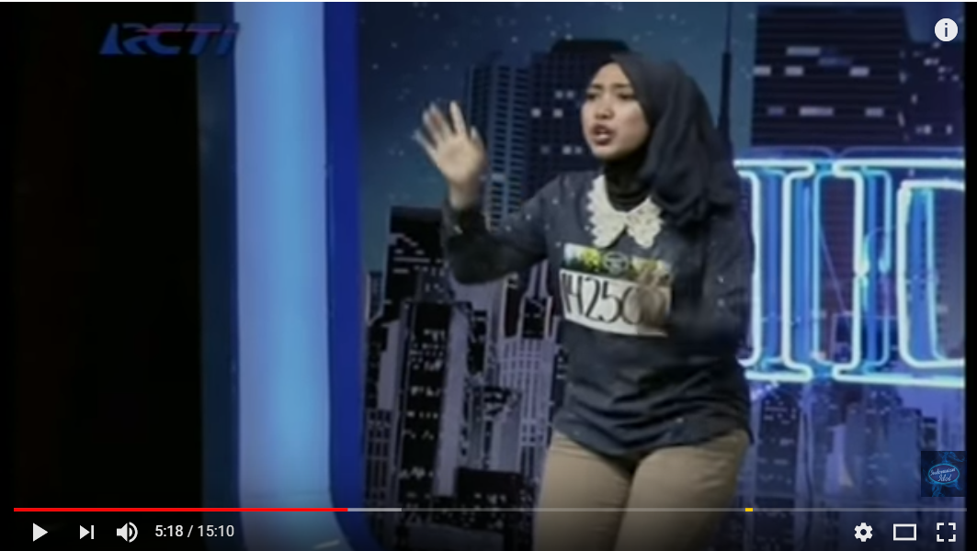
Group Activity
Small groups: 3- 4 students
Watch several videos of various “Idol” competitions (Myanmar, Indonesia, Viet Nam)
Fill in the form with the following questions
  Describe: logo style, set design, types of songs performed, colour schemes, clothes, language used)
  What are the similarities and/or differences between videos from different national competitions?
  What songs are performed in the various videos? Do you think there is anything in the performance of these songs that reflect various national cultures (Is there anything in Indonesian Idol that reflects Indonesian culture? Myanmar Idol that reflects Myanmar?]
  Do you think these competitions are too American or “Western”? Why?
  Do you think “Asian Idol” helps to create an Asian identity? Why or why not?
  Do you or would you like to watch/vote to watch Idol on television?

Slide 18
Group activity
Some findings
 | Global Culture | Local Culture
Myanmar Idol | Maps Clothes Instrument | Photograph of Buddhist temple Singing in Myanmar language
Indonesia Idol | No map American song | Clothing
Viet Nam Idol

Slide 19
Unit 4: Envisioning Southeast Asia
Lesson 6 Popular Music in Southeast Asia: Between Global and Local Cultures
Period 2

Slide 20
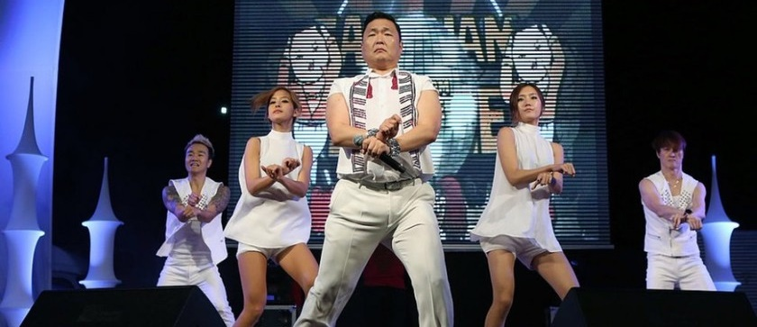


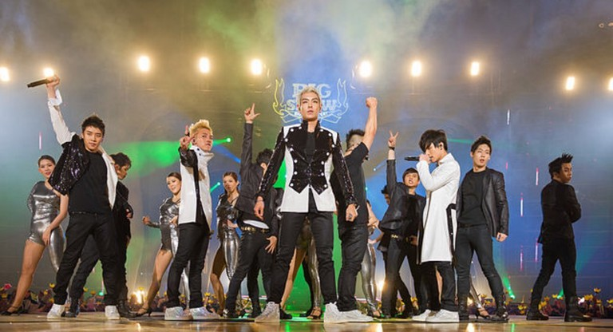
Who are they?
Who are they?

Slide 21
Who are they?
Psy
Rain
K-Pop Stars
BoA
Big Band

Slide 22
American and “Western” Pop Culture is not the only influence on Southeast Asian Pop Culture.
East Asia also has a big influence.
J-Pop might be the most famous example.
This class will focus on another example, K-Pop, the Korean Wave, or Hallyu.

Slide 23
How can one define and characterize the Korean Wave, or Hallyu, in Southeast Asia?
How did Korean culture become popular in Southeast Asia?
How are local elements and influences of Southeast Asian culture accommodated into K-Pop or the Korean Wave?
Do any international Western influences impact pop culture imports from Korea or other East Asian nations?
How does K-Pop contribute to identity formation in terms of individual, region, and nation?

Slide 24
Group activity
In groups of 4:
  2 students read the article: “Korean Wave in Southeast Asia”
  2 students read the article: “Southeast Asian millionaires to build Hallyu town in Thailand”
Fill in the Worksheet
  For questions A 1 to 9, collaborate to find the answers in the articles
  For questions B, C and D, get inspired from the articles to develop your own answer

Slide 25
  Music is one of the most popular Korean imports in Southeast Asian countries like Thailand.

Slide 26
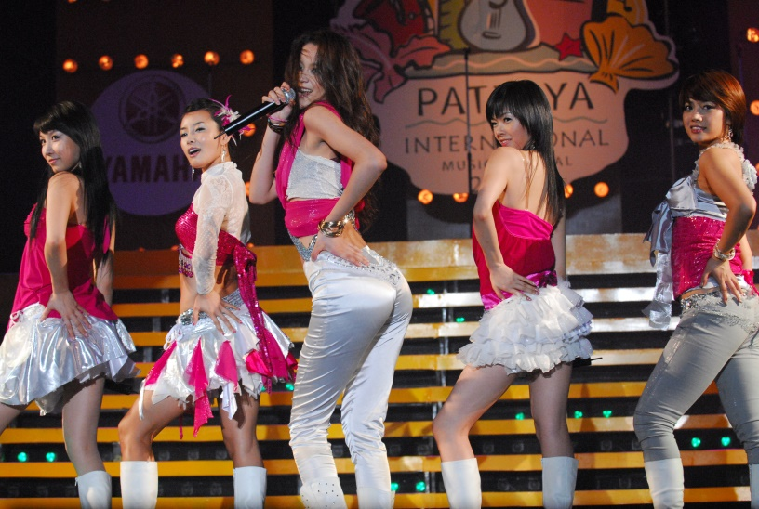
  Baby V.O.X.
Baby V.O.X. is five-member
South Korean female dance group
active from 1997 to 2006.
Baby V.O.X. released 7 albums and often performed internationally, including in places like Southeast Asia.
Baby V.O.X. first travelled to Thailand in 1999, they were unique, the first “girl group idol” band in Thailand to perform pop dance.
Baby V.O.X. made a special karaoke album with 11 tracks just for the Thai audience; it sold 30,000 copies at 199 baht.
Video: “Missing You” https://www.youtube.com/watch?v=aBHu38wdngQ
© Sry85 https://commons.wikimedia.org/wiki/File:Baby_Vox_Re.V.JPG

Slide 27
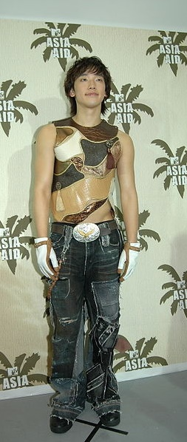
Rain
Rain is a singer-songwriter
7 albums: 6 in Korean, 1 in Japanese
His third album featured a duet with a famous Thai singer, Panadda Ruangwut, who first achieved fame by winning first prize in Thailand’s Star Search Contest.
Video “I Do” https://www.youtube.com/watch?v=z0VALRHcQ84
© Sry85 https://en.wikipedia.org/wiki/File:Rain_Korean_Singer.jpg

Slide 28
Discussion
?
        What is local or national about these pop-videos, and what is global?
        How do these videos reflect efforts to adapt pop culture imported from East Asia and Korea to local Southeast Asian contexts such as Thailand?
        What role did technology play in the spread of global forms of culture into local contexts?

Slide 29
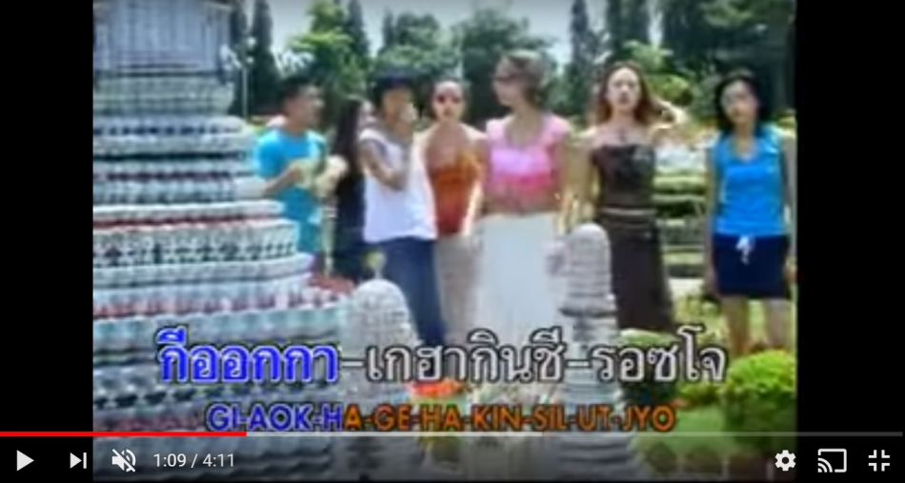
Baby V.O.X.
“Missing you”
  What are the singers doing in this video?
  What recognizable Thai features or Thai cultural features are shown in the video? What other features of daily life are shown?
  Do you feel the video does a good job portraying Thai culture?
  Does it help to bring together Thai and Korean culture?
  Are there any features that seem more global or American in nature?

Slide 30
Baby V.O.X. “Missing you”
  What are the singers doing in this video?
      Touring through Thailand
  What recognizable Thai features or Thai cultural features are shown in the video? What other features of daily life are shown?
  Buddhist temples
  Beaches
  Eating from street vendors
  Shopping at markets
  Playing billiards
  Elephants
  Petting cats
  Child playing on swings
  Theme park with miniature replicas of world landmarks
  Pool
  Do you feel the video does a good job portraying Thai culture?
  Does it help to bring together Thai and Korean culture?
  Are there any features that seem more global or American in nature?
  Theme parks,
  Pools
  Dress

Slide 31
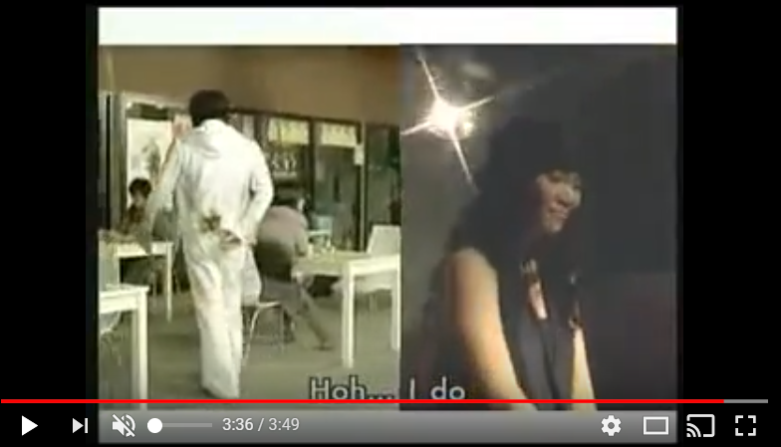
      Rain
      “I do”
What languages are used in this video and who are the two singers?
What are the nationalities of the two singers?
What technologies are used for the communication between the Korean and Thai singers?
What sort of activities, clothes, etc., do you see in the video?
Would you identify these as Thai, Korean, or neither?
Do you think singers decided to include some English in this video?
Do you think that this video is more a reflection of Korean pop, Thai pop, or American pop? Or is it an equal mixture?
Do you think technology helps bring these cultures together? How so?

Slide 32
      Rain “I do”
What languages are used in this video and who are the two singers?
  Korean English Thai
What are the nationalities of the two singers?
  Korean Thai
What technologies are used for the communication between the Korean and Thai singers?
  I-pod video camera (in 2005, no smartphones yet)
What sort of activities, clothes, etc., do you see in the video? Would you identify these as Thai, Korean, or neither?
  hip-hop break dancing
  just-married Korean couple
  older Korean couple
  disco ball
  Skateboarding
  various fashion choices
Do you think singers decided to include some English in this video?
Do you think that this video is more a reflection of Korean pop, Thai pop, or American pop? Or is it an equal mixture?
Do you think technology helps bring these cultures together? How so?

Slide 33
Research project
Pop Video
Objective: Planning (outline of a video) or taping (actual performance recorded on a smartphone) a video for your friend, girlfriend, boyfriend, etc., that represents your national culture and national pop culture.
Decide upon which languages should be represented;
What features of your national culture do you want to represent? (e.g. market, clothes, food, landmarks, religious places of worship, etc.)
What technologies would you use for your film?
What songs or other items of pop culture do you want to feature?
Explain how your choices will best portray your national culture to a friend or romantic partner in a different ASEAN. Try to include some element of your friend’s national culture, too.

