Slide 1
Unit 4: Envisioning Southeast Asia
Lesson 5: Contemporary Art of Southeast Asia

Slide 2
A note to users of this presentation
This presentation was developed as complementary materials for teachers running this lesson. It follows the lesson plan.
It includes content from the lesson plans and the introductory essays for teachers’ lectures. It also introduces some of the activities suggested for students.
You are welcome to customize this presentation to adjust the lesson to their curriculum and to your students. You can change images, add/remove activities, and of course delete this slide, etc. The Teacher’s Guide (https://sharedhistories.asia/teacher/) provides guidance on how to adjust the lessons.
We wish you a successful lesson!
The Southeast Asian Shared Histories project was developed by UNESCO Bangkok with funding from the Republic of Korea.

Slide 3
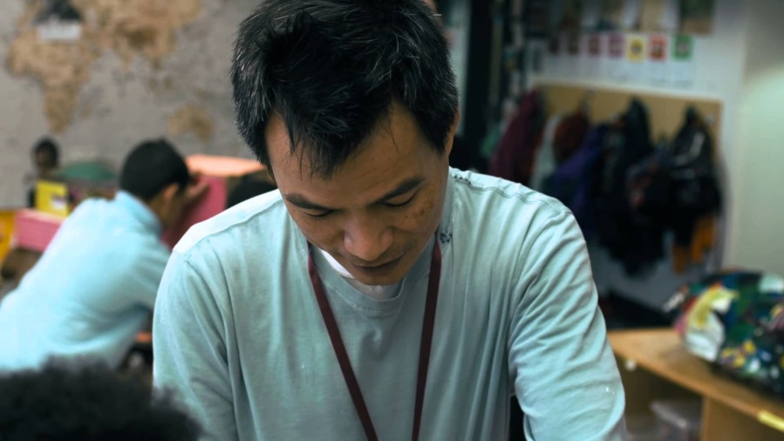
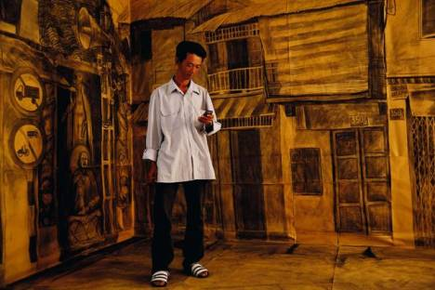
Bui Cong Khann
Born in 1972 in Danang, Vietnam, Bui Cong Khanh lives and works in Ho Chi Minh City, Vietnam.
Bui Cong Khanh’s work explores historical and contemporary issues in Vietnam.
As one of the first local artists to gain international recognition during the 1990s, Khanh has embraced painting and sculpture to express his fascination with the complex history of Vietnam.
More recently, his works are reflective of the dichotomy of his fast changing nation.
Deeply philosophical and reactive to the world around him, Khanh is one of Vietnam’s most intriguing artists.
Bui Cong Khanh’s work is in institutional collections (e.g. in museums) including the Queensland Art Gallery, Brisbane and the Koc Foundation, Istanbul.
Watch the first 1’23 of the youtube film and meet the artist https://www.youtube.com/watch?v=pZuh1RNe-T8
https://litviet.wordpress.com/category/bui-cong-khanh/

Slide 4
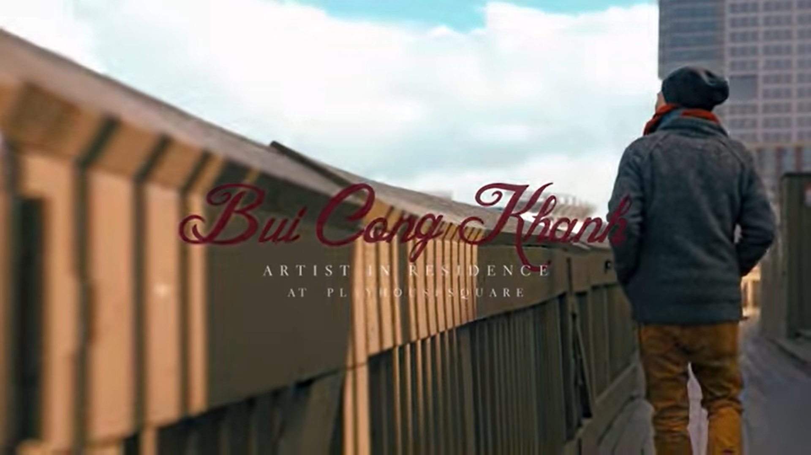
Bui Cong Khanh Artist Residency
https://www.youtube.com/watch?v=pZuh1RNe-T8

Slide 5
Discussion
?
Why does the artist like working with children?
Can one feel the art as the artist suggests? If yes, how ?
If you are asked to create an art piece which is supposed to tell a story of your city, what would you create?

Slide 6
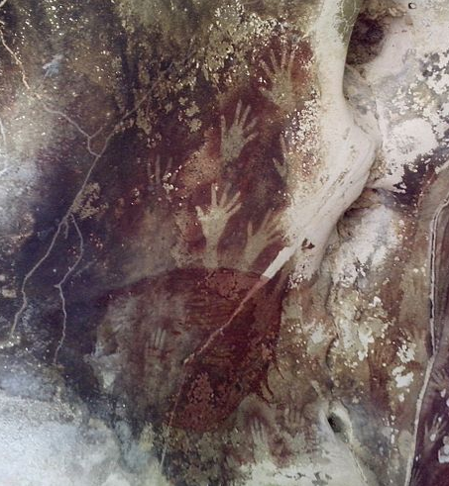
Cave paintings from the island of Sulawesi, Indonesia, around 40.000 years old
One of the oldest images in the world
Source: Cahyo Ramadhani, de.wikipedia.org/wiki/Datei:Hands_in_Pettakere_Cave.jpg

Slide 7
What is contemporary art?
Contemporary art is the art of today, produced in the late 20th century or in the 21st century.
Contemporary artists work in a globally influenced, culturally diverse, and technologically advancing world. Their art is a dynamic combination of materials, methods, concepts, and subjects that continue the challenging of boundaries that was already well underway in the 20th century.
https://en.wikipedia.org/wiki/Contemporary_art
The term contemporary art is loosely used to refer to art of the present day and of the relatively recent past, of an innovatory or avant-garde nature
http://www.tate.org.uk/art/art-terms/c/contemporary-art

Slide 8
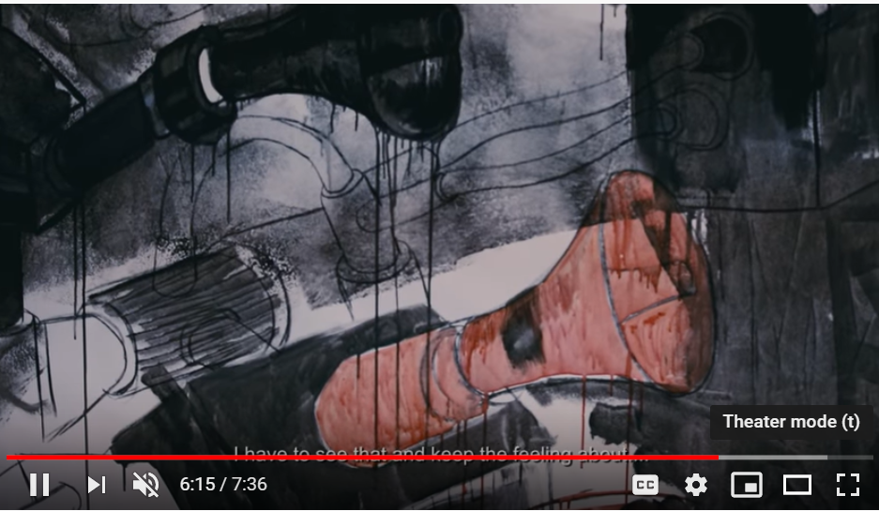
Group Work
Find similarities between Bui Cong Khann’s artwork and the Sulawesi cave painting.

Slide 9
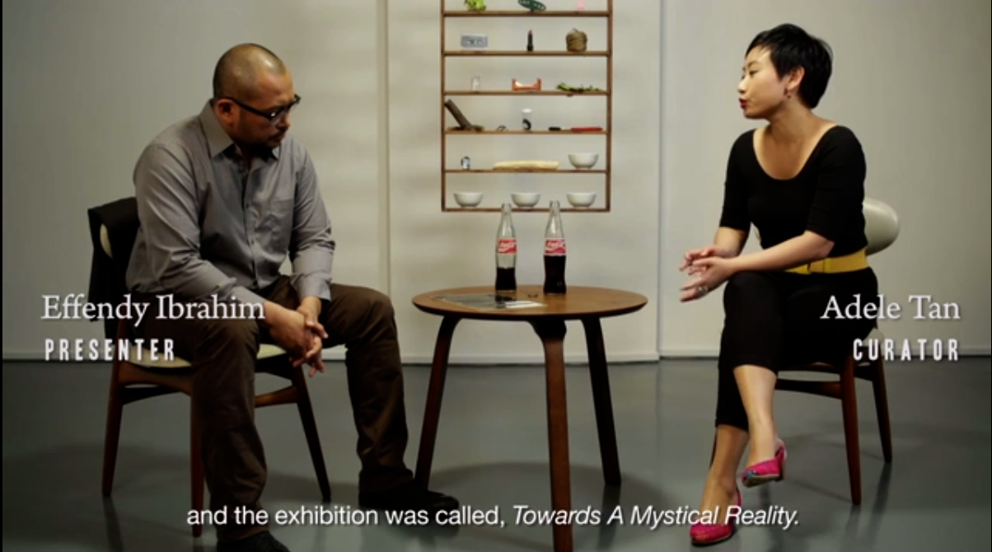
Redefining Art in South-East Asia:
The 1970’s and After

Slide 10
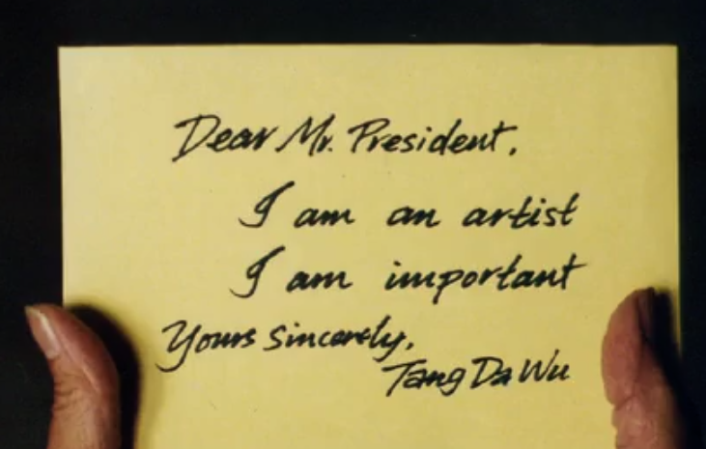
Class debate (option 1)
?
Can art be regional?

Slide 11
Class debate (option 2)
?
As you have observed art is always changing in both subject matter and technique.
Thinking ahead, what do you think art might look like in 2121 and what might it say?

