Slide 1
Unit 4: Envisioning Southeast Asia
Lesson 4: Cultural heritage of Southeast Asia
Why does cultural heritage matter to us?

Slide 2
A note to users of this presentation
This presentation was developed as complementary materials for teachers running this lesson. It follows the lesson plan.
It includes content from the lesson plans and the introductory essays for teachers’ lectures. It also introduces some of the activities suggested for students.
You are welcome to customize this presentation to adjust the lesson to their curriculum and to your students. You can change images, add/remove activities, and of course delete this slide, etc. The Teacher’s Guide (https://sharedhistories.asia/teacher/) provides guidance on how to adjust the lessons.
We wish you a successful lesson!
The Southeast Asian Shared Histories project was developed by UNESCO Bangkok with funding from the Republic of Korea.

Slide 3
Objective of the lesson
What are culture, heritage, cultural heritage, different types of heritage ?
Why should we value and protect cultural heritage (global and from Southeast Asia)?

Slide 4
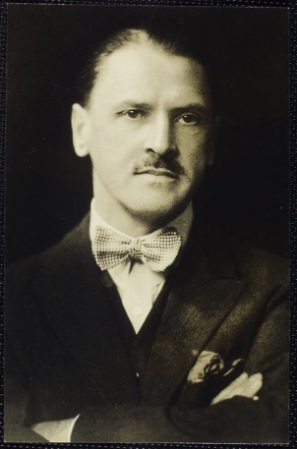
Let’s Talk About Culture
Let’s Talk about Heritage
Let’s Talk About Cultural Heritage
“Men and women are not only themselves; they are also the region in which they were born, the city apartment or the farm in which they learnt to walk, the games they played as children, the tales they overheard, the food they ate, the schools they attended, the sports they followed, the poets they read and the God they believe in”
Somerset Maughan
© Tucker Collection https://commons.wikimedia.org/wiki/File:Maugham_facing_camera.jpg

Slide 5
?
What does the word
culture
mean to you?

Slide 6
Culture can be defined in many ways
  Spaces shared by a society e.g. villages, cities, landscapes, seascapes, etc.;
  Arts (performing arts: music, dances; visual arts: painting, sculpture, etc.) and architecture (temples, houses, bridges, roads etc.) shared by a society;
  Knowledge shared by a society (language, crafts techniques, schools people attended, agricultural processes, health practices, etc.);
  Manners shared by a society (how people eat and drink, how people entertain, games children play, relationship between a mother and a child / men and women / husband and wife etc.);
  Values shared by a society (what is good / bad / funny)
  Rituals, ceremonies organized by a community

Slide 7
Culture as defined by UNESCO
“the whole complex of distinctive spiritual, material, intellectual and emotional features that characterize a society or social group. It includes not only arts and letters, but also modes of life, the fundamental rights of the human being, value systems, traditions and beliefs.”
Mondiacult, World Conference on Cultural Policies

Slide 8


An example from my heritage
Why is this item valuable to you?

Slide 9
Discussion
?
If someone wants to look after an object s/he values, and pass it on to her/his children, what must s/he do to protect it?

Slide 10
Heritage
Heritage is something that
we have gotten or that is left for us from the past,
we live with in the present
we pass on to future generations.
We may prefer to think of heritage as those places and objects we wish to keep.
These are cultural and natural places and objects that we value because they come from our ancestors, are beautiful, scientifically important and irreplaceable examples and sources of life and inspiration.

Slide 11
The diversity of heritage
Immovable Heritage:
Archaeological sites, historic cities, sacred worship places (temples, churches, mosques), etc.
Movable Heritage:
Objects such as coins, paintings, artefacts, botanical samples
Intangible Heritage:
Heritage that we cannot touch, see or define exactly and that come with the form of manners, knowledge and values

Slide 12

Group Work: Our South-East Asia intangible heritage
Can you think of 3 intangible cultural heritage shared by the people of Southeast Asia?
Write your answer on Post-it

Slide 13
World Heritage in South-East Asia
Sites of Outstanding Universal Value
“cultural or natural significance which is so exceptional as to transcend national boundaries and to be of common importance for present and future generations of all humanity.”

Slide 14
World Heritage in South-East Asia
Group work (option 1)
In groups of 4-5
Find 10 World Heritage sites in South-East Asia
Write the names and geographical locations of the sites
Indicate the type of heritage site they are

Slide 15
World Heritage in South-East Asia
Group work (option 2)
In 2 groups
Group 1 makes a list of the advantages of tourism for a regional Heritage site
Group 2 makes a list of the threats caused by tourism to regional Heritage site
In class
Discuss how the threats of tourism regional heritage sites could be reduced.

Slide 16
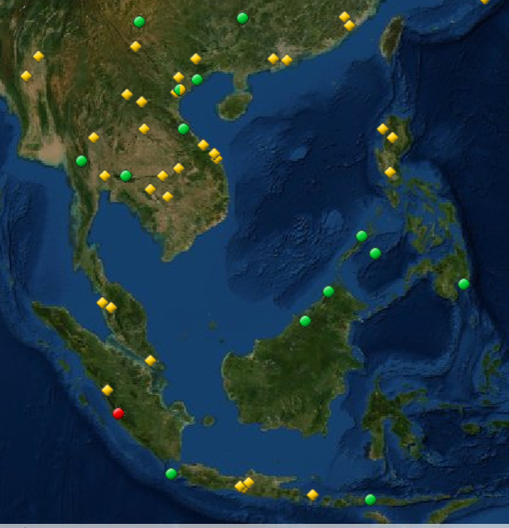
World Heritage in South-East Asia
Cultural and Natural sites listed as of 2019
Cambodia
Angkor
Temple of Preah Vihear
Temple Zone of Sambor Prei Kuk, Archaeological Site of Ancient Ishanapura
Indonesia
Borobudur Temple Compounds
Komodo National Park
Prambanan Temple Compounds
Ujung Kulon National Park
Sangiran Early Man Site
Lorentz National Park
Tropical Rainforest Heritage of Sumatra
Cultural Landscape of Bali Province: the Subak System as a Manifestation of the Tri Hita Karana Philosophy
Lao People's Democratic Republic
Town of Luang Prabang
Vat Phou and Associated Ancient Settlements within the Champasak Cultural Landscape
Megalithic Jar Sites in Xiengkhuang – Plain of Jars
Malaysia
Gunung Mulu National Park
Kinabalu Park
Melaka and George Town, Historic Cities of the Straits of Malacca
Archaeological Heritage of the Lenggong Valley
Myanmar
Pyu Ancient Cities
Bagan
Philippines
Baroque Churches of the Philippines
Tubbataha Reefs Natural Park
Rice Terraces of the Philippine Cordilleras
Historic City of Vigan
Puerto-Princesa Subterranean River National Park
Mount Hamiguitan Range Wildlife Sanctuary
Thailand
Historic City of Ayutthaya
Historic Town of Sukhothai and Associated Historic Towns
Thungyai-Huai Kha Khaeng Wildlife Sanctuaries
Ban Chiang Archaeological Site
Dong Phayayen-Khao Yai Forest Complex
Viet Nam
Complex of Hué Monuments
Ha Long Bay
Hoi An Ancient Town
My Son Sanctuary
Phong Nha-Ke Bang National Park
Central Sector of the Imperial Citadel of Thang Long - Hanoi
Citadel of the Ho Dynasty
Trang An Landscape Complex

Slide 17
The region includes a mix of cultural and natural sites.
Being World Heritage sites implies that these have value for their country as well as for the whole region / world.

