Slide 1
Unit 4: Envisioning Southeast Asia
Lesson 3: From fragmented to shared histories
Sepak takraw

Slide 2
A note to users of this presentation
This presentation was developed as complementary materials for teachers running this lesson. It follows the lesson plan.
It includes content from the lesson plans and the introductory essays for teachers’ lectures. It also introduces some of the activities suggested for students.
You are welcome to customize this presentation to adjust the lesson to their curriculum and to your students. You can change images, add/remove activities, and of course delete this slide, etc. The Teacher’s Guide (https://sharedhistories.asia/teacher/) provides guidance on how to adjust the lessons.
We wish you a successful lesson!
The Southeast Asian Shared Histories project was developed by UNESCO Bangkok with funding from the Republic of Korea.

Slide 3
?
What sport is this?

Slide 4
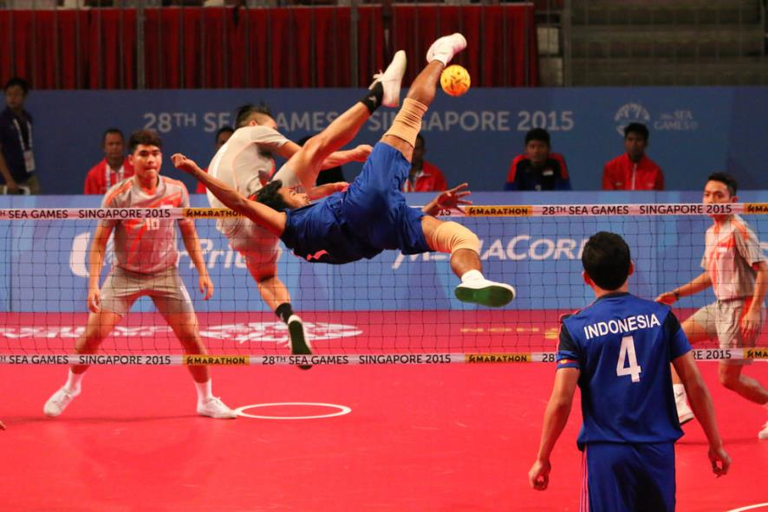
© Alson Ong https://www.flickr.com/photos/voxstock/18411325519

Slide 5

Sepak Takraw
Sepak takraw has evolved from traditional games played in various countries in the region that involved kicking a ball or something to keep it airborne.

Slide 6
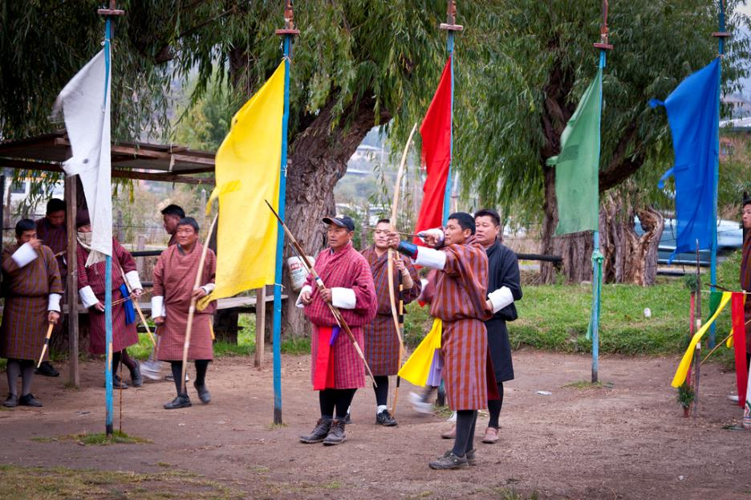
© Göran Höglund (Kartläsarn)m, https://www.flickr.com/photos/kartlasarn/7003135096

Slide 7
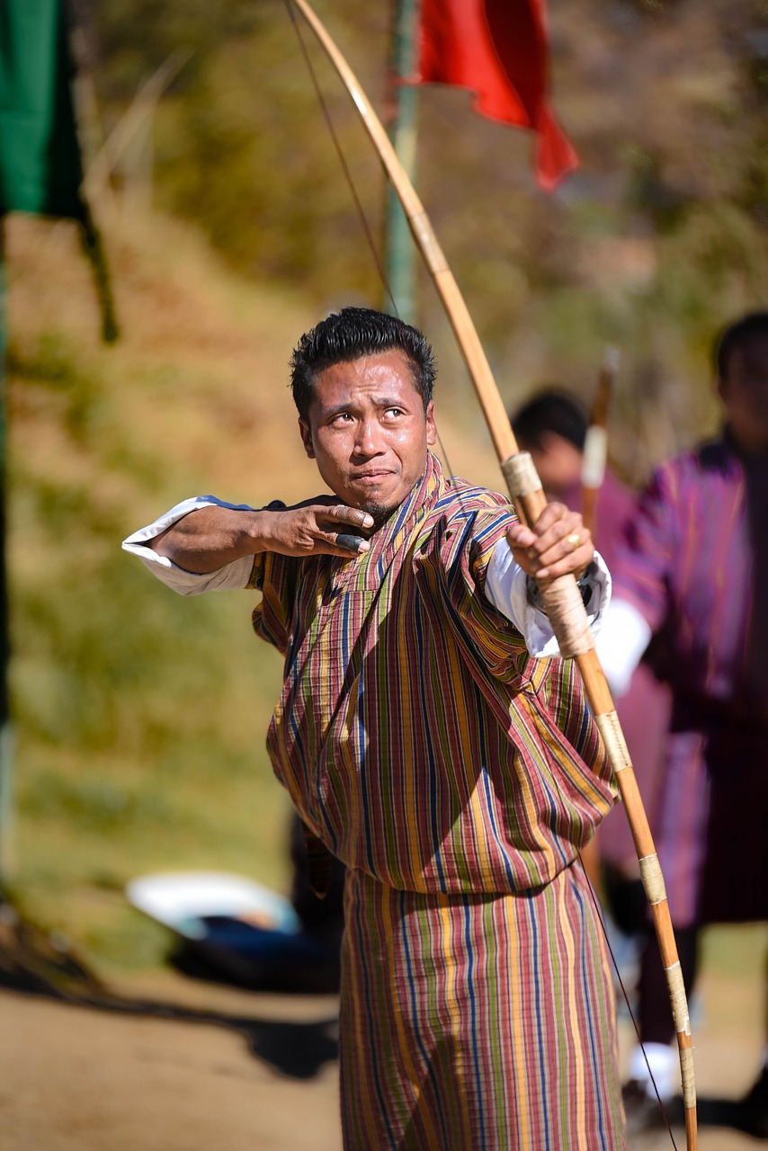
Source: saltonnz https://www.needpix.com/photo/download/1017589/bhutan-archery-tradition-culture-traditional-arrow-vintage-tribal-weapon

Slide 8

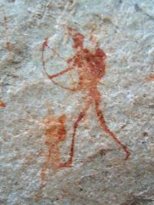
Archery
The bow and arrow are known to have been invented by the end of the Upper Paleolithic. For at least 10,000 years archery was an important military and hunting skill, and features prominently in the mythologies of many cultures.
Source: Sevilla Rock Art Trail, South Africa
https://commons.wikimedia.org/wiki/File:Sevilla_Rock_Art_9.JPG

Slide 9
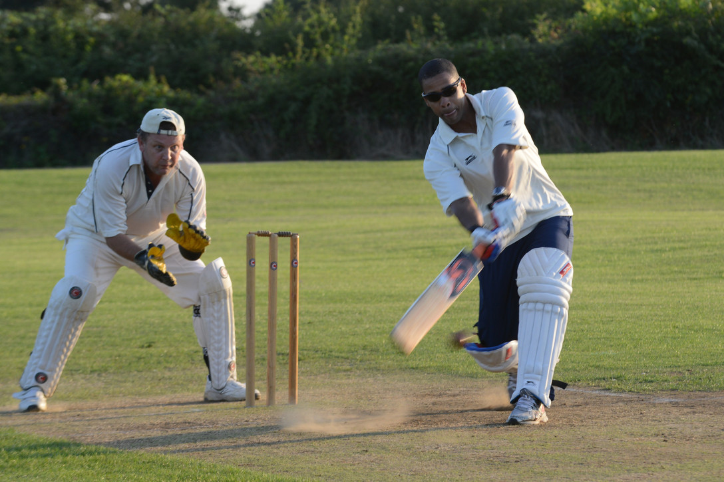
Source: Tech. Sgt. Chrissy Best, https://www.usafe.af.mil/News/Photos/igphoto/2000916633/

Slide 10

Cricket
The sport of cricket has a known history beginning in the late 16th century. Having originated in south-east England, it became the country's national sport in the 18th century and has developed globally in the 19th and 20th centuries. International matches have been played since 1844.

Slide 11
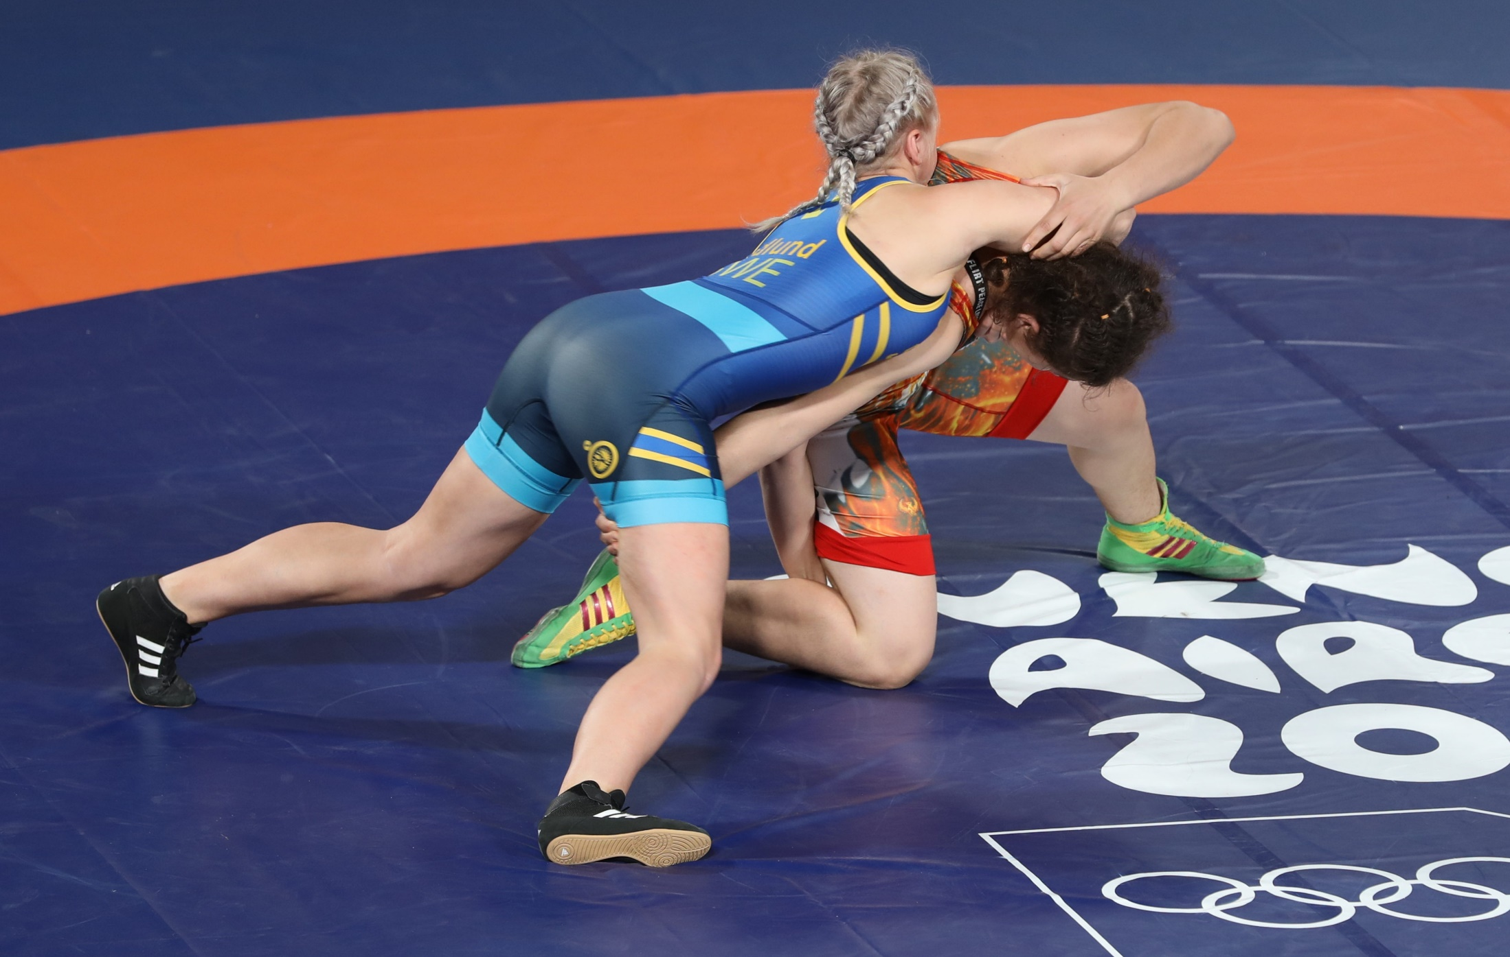
Source: Sandro Halank, https://commons.wikimedia.org/wiki/File:2018-10-13_5th_place_match_(Wrestling_Women%27s_Freestyle_73kg)_at_2018_Summer_Youth_Olympics_by_Sandro_Halank%E2%80%93017.jpg

Slide 12

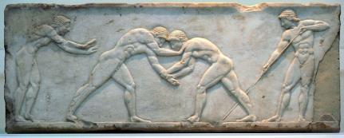
Wresling
Wrestling is one of the oldest forms of combat.
It is mentioned in the Iliad and depicted in 15,000-year-old cave drawings in France. Early Egyptian and Babylonian reliefs show moves still used today.
Popular in ancient Greece, wrestling held a prominent place in the Olympic Games.
Base of a funerary kouros found in Athens, built into the Themistokleian wall between circa 510 and circa 500 BC
Source: Fingalo, https://commons.wikimedia.org/wiki/File:07Athletengrab.jpg

Slide 13
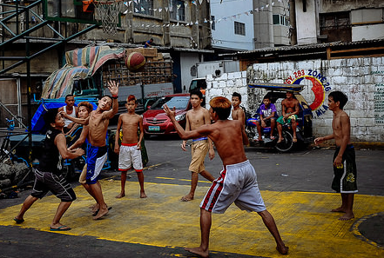
https://www.flickr.com/photos/marcingabruk/14482436185

Slide 14
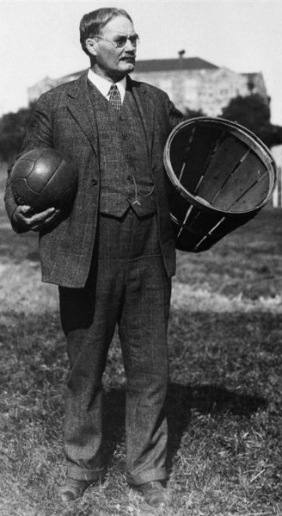
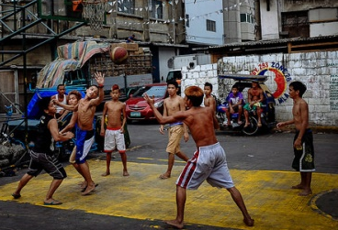
Basketball
  Basketball has a more explicitly ‘invented’ origin which one can be traced to the United States.
  In 1891, Dr. James Naismith invented what will eventually be known as basketball in response to the need to provide opportunities for exercise and past time for young men being trained for Christian mission at the Young Men’s Christian Association (YMCA).
  It was brought to its colony, the Philippines, in early 1900s and became very popular.
  Philippines dominated international basketball championship in Asia since up to the 1960s, and remains dominant in South-East Asia until today.
James Naismith with a basketball and a basket.
https://commons.wikimedia.org/wiki/File:Dr._James_Naismith.jpg

Slide 15
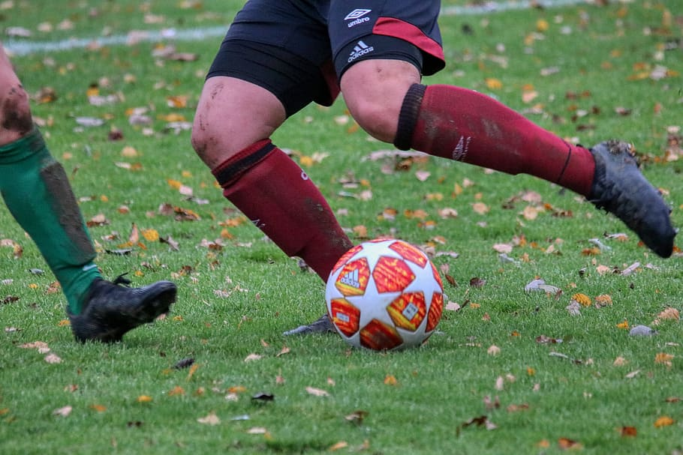
Source: https://www.pxfuel.com/en/free-photo-xgonf

Slide 16
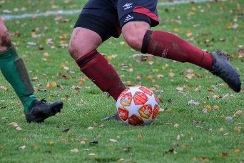
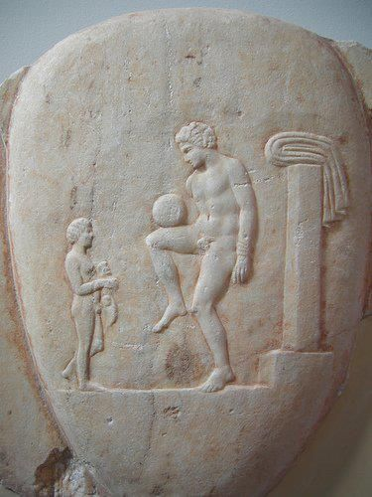
Football or soccer
  Football or soccer can trace its origins to the deep histories of various ancient civilizations- Aztecs, Mayan, Chinese, Japanese, Graeco-Romans, etc.
  ‘Modern’ soccer originated in the UK in the late 19th century gradually evolving from forms of ‘folk football’ played by common people. It spread in various parts of the world as part of the legacies of the British empire.
Part of a marble grave stele, found in Piraeus, 400-375 BC.
https://commons.wikimedia.org/wiki/File:Ancient_Greek_Football_Player.jpg

Slide 17
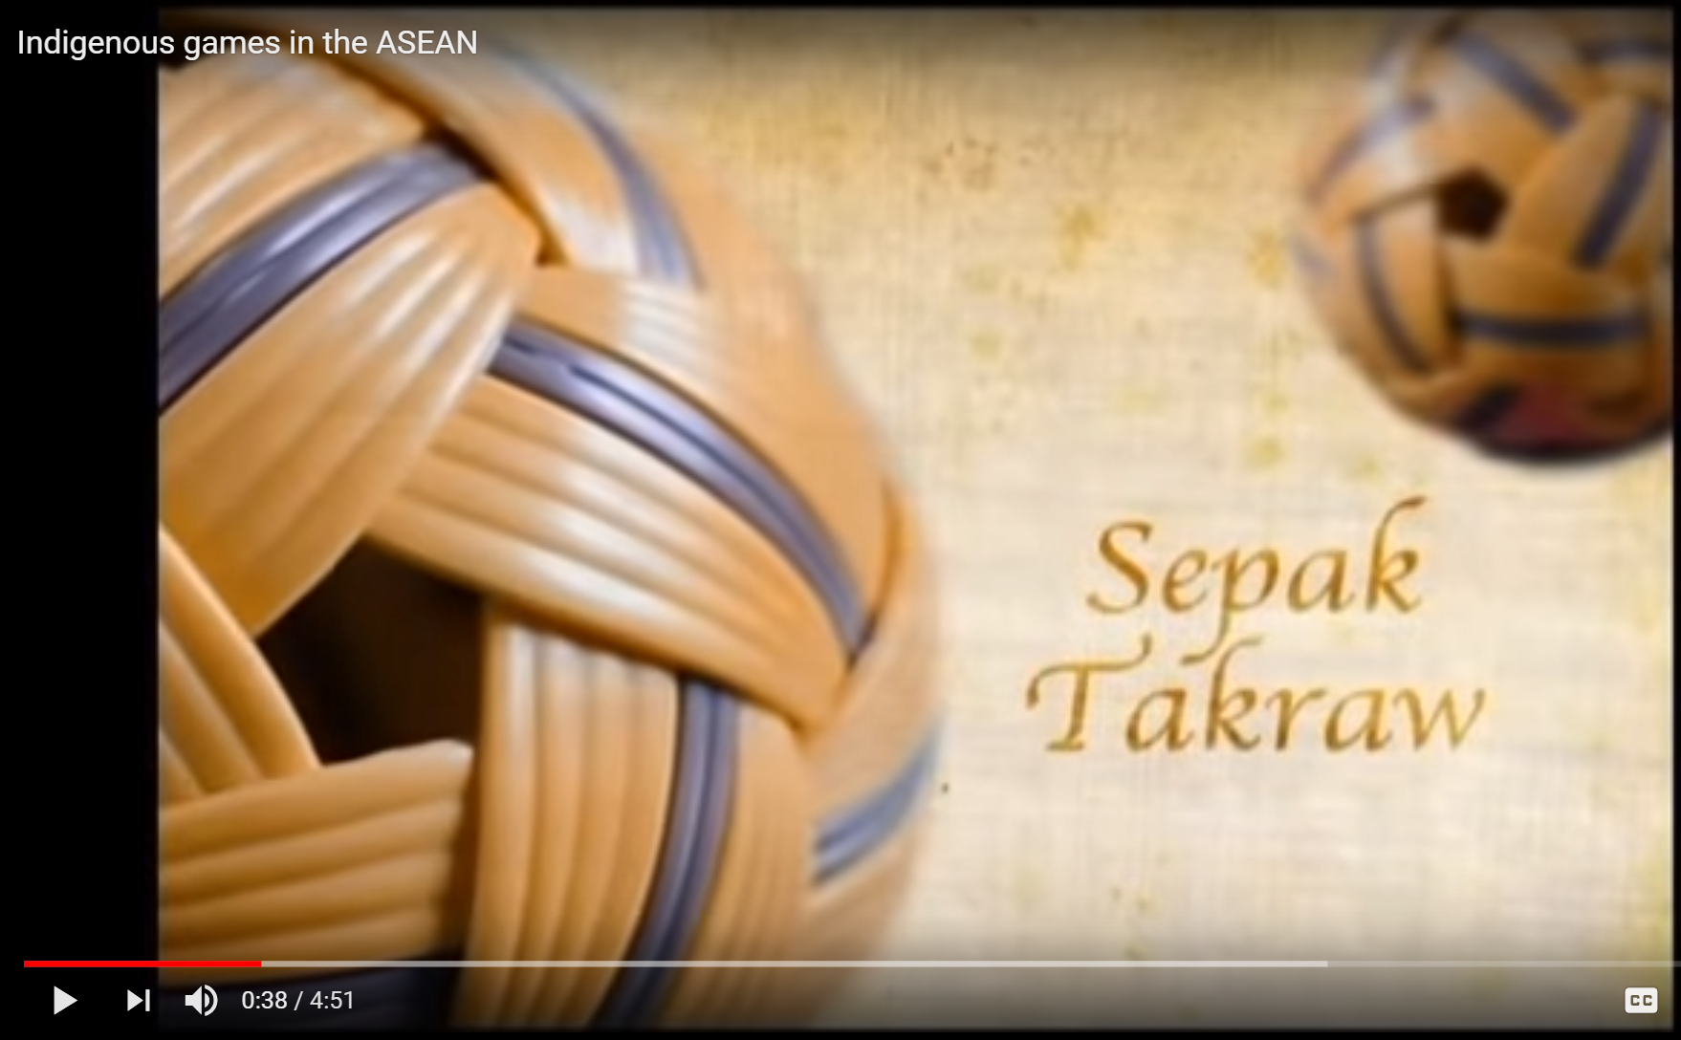
Video Clip: “Indigenous games of ASEAN” https://www.youtube.com/watch?v=WAeJNj8EvzM

Slide 18
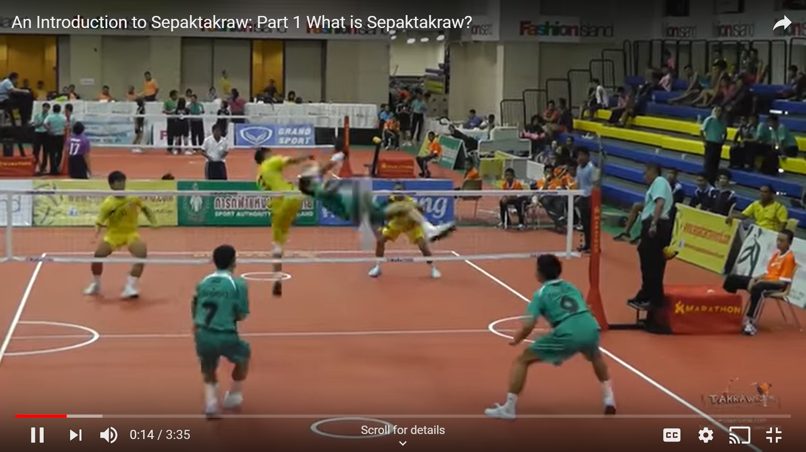
An introduction to sepak takraw
https://www.youtube.com/watch?v=Dw7Z9oASHeE

Slide 19
An introduction to sepak takraw
  What can you observe about the gameplay of sepak takraw?
  How is it different from other games that you know of?

Slide 20
Sepak takraw
Widely believed that sepak takraw is indigenous or native to the region.
Early versions of the sport being played in 16th century Thailand, at the Malaysian royal court in the 15th century, and even in the Philippines, Brunei, Myanmar, Indonesia and Laos as far back as the 11thcentury.
May have originated from ancient practices outside of the region, such as China (Yet, there is nothing closely similar to the modern, competitive sport sepak takraw that one can find to have developed in China, or elsewhere).

Slide 21
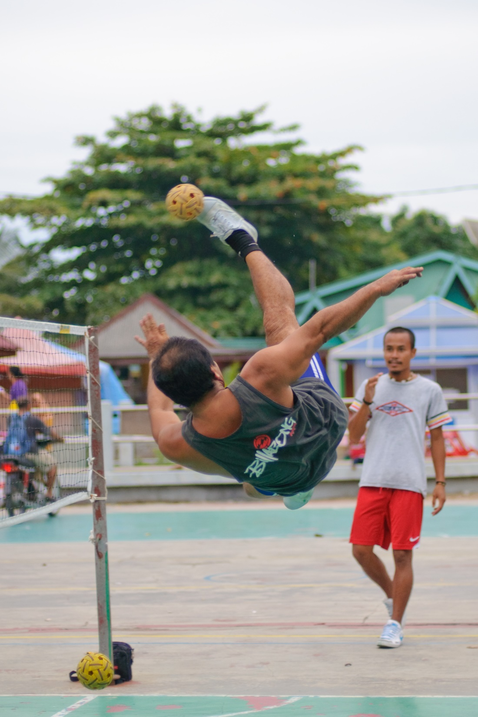
Sepak takraw has evolved from traditional games played in various countries in the region that involved kicking a ball or something to keep it airborne.
It is called
sipa in the Philippines
sepak raga in Malaysia sipak rago in Indonesia
chin lone in Myanmar
© Adis Wahab
https://www.flickr.com/photos/adibwahab/7193776908/in/photostream/

Slide 22
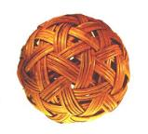
Sepak
to kick in Malay
Takraw
basket, here woven rattan ball in Thai

Slide 23
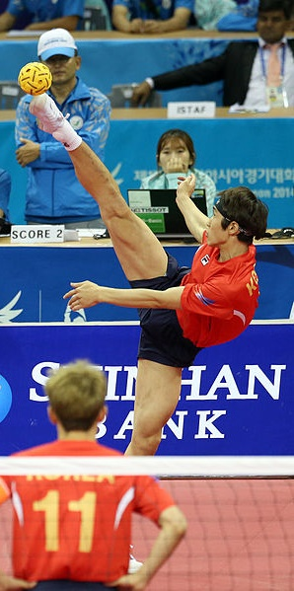
Sepak Takraw in the world
23 sepak takraw clubs in Europe
International Sepaktakraw Federation includes 31 national federations from Europe, South America, North America, Middle East, Australia and Asia
Since 1967: regular sport in the SEAP/SEA Games
Since 1990: medal sport at the Asian Games.
Efforts are underway to include Sepak Takraw in the Olympics.
Korea team during the 2014 Asian Games
© Korea Net, https://www.flickr.com/photos/koreanet

Slide 24
Sepak takraw is spreading all over the world
  Guess the rank of the non-Asian countries in the world that play sepak takraw.
Country | Sepak Takraw Association formed in
USA | 1996
Germany | 1990s
France | 2003
Australia | 1991
Canada | 1993
Switzerland | 2000

Slide 25
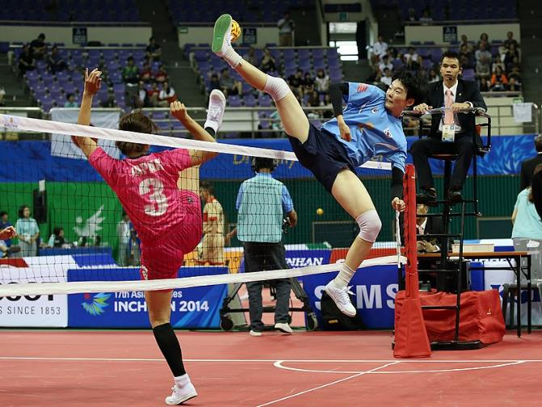
Women in sepak takraw
Now, a strong
compete at the highest level in regional and world competition.
Source: https://commons.wikimedia.org/wiki/File:Incheon_AsianGames_Sepaktakraw_09_(15291705581).jpg

Slide 26
Discussion
?
Is sepak takraw an indigenous game of Southeast Asia?
What makes it a Southeast Asian game?
Do you feel a sense of pride when the game is played in an international tournament?
Do you feel different when you see players from other countries playing a game that you are familiar with?

