Slide 1
Unit 4: Envisioning Southeast Asia
Lesson 2: The Southeast Asian Games
History, sports and community-building in Southeast Asia

Slide 2
A note to users of this presentation
This presentation was developed as complementary materials for teachers running this lesson. It follows the lesson plan.
It includes content from the lesson plans and the introductory essays for teachers’ lectures. It also introduces some of the activities suggested for students.
You are welcome to customize this presentation to adjust the lesson to their curriculum and to your students. You can change images, add/remove activities, and of course delete this slide, etc. The Teacher’s Guide (https://sharedhistories.asia/teacher/) provides guidance on how to adjust the lessons.
We wish you a successful lesson!
The Southeast Asian Shared Histories project was developed by UNESCO Bangkok with funding from the Republic of Korea.

Slide 3
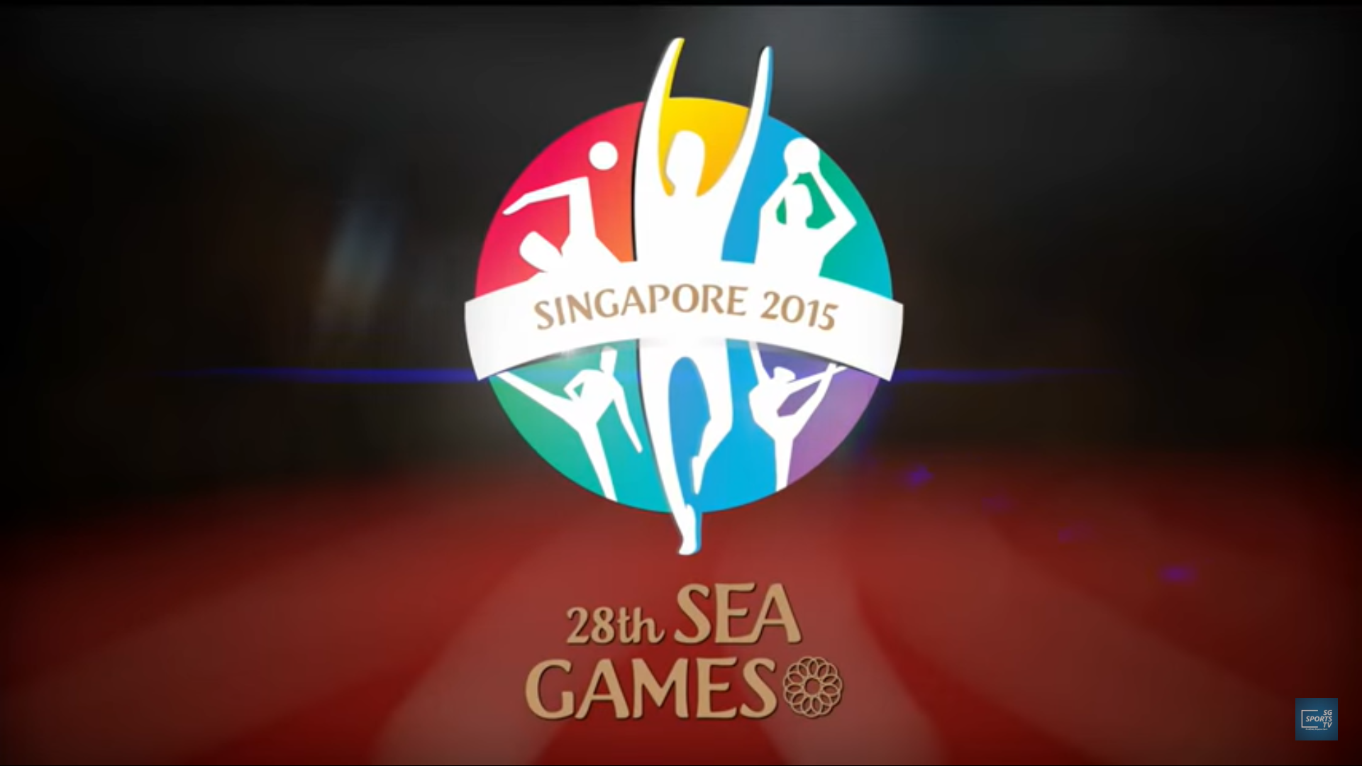
https://www.youtube.com/watch?v=2KM1_2Qloao

Slide 4
Objective of the lesson
  How and why did the SEA Games come about?
  How and why did it evolve through time?
  How do international sports competitions like SEA Games affect individuals and nations, particularly their sense of identity?

Slide 5
In South-East Asia, community-building or regional-identity making has usually been associated with political institutions such ASEAN (1967), the Association of South-East Asia (ASA, 1961).
However, the role of sport competitions cannot be underestimated.

Slide 6
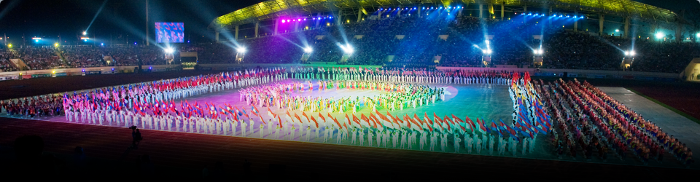
Multi-sports competitions held every two years among countries in South-East Asia.
Popularly known as the SEA Games.

Slide 7
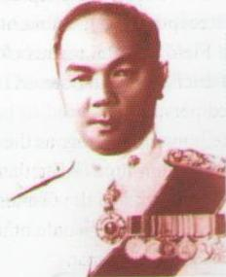
The creation of the SEAP Games
“South-East Asian Peninsular Games”
Idea originated from Luang Sukhum Nayapradit, a high-ranking official in Thailand’s National Olympic Committee in 1958.
Need for a regional competition that would help uplift the capabilities of athletes in the region, while promoting interaction and goodwill among participating countries.
Inspired by the Olympic Games and Asian Games: the “Little Asian Games”
Source: SEA Games Federation Office.
\https://www.google.com/url?sa=i&url=http%3A%2F%2Fwww.seagfoffice.org%2Fseagf.php%3Fp%3Dreport&psig=AOvVaw39cRxHuBslXRaLxelVqql8&ust=1579636761432000&source=images&cd=vfe&ved=0CAIQjRxqFwoTCNDi4NL7kucCFQAAAAAdAAAAABAD

Slide 8
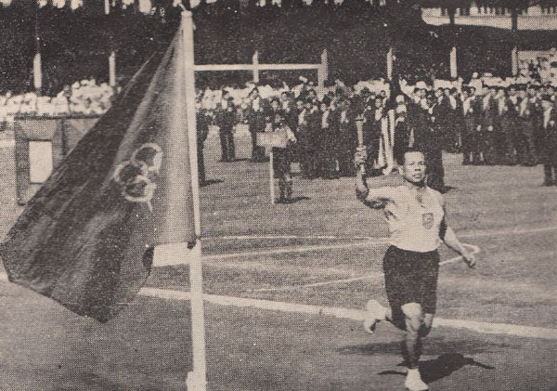
Original members of the sports federation: Thailand, Burma, Laos, Cambodia, Malaysia and South Vietnam.
Singapore invited to participate in the inaugural games in Bangkok in 1959 when Cambodia, one of the original members, opted not to participate.
A historical photograph of the opening of the 1st SEAP Games, Bangkok, 1959
http://www.aseantourism.travel/articles/detail/southeast-asian-games-and-silat

Slide 9

A pillar of regional identity formation.
Preceded bodies such as ASA, Maphilindo and ASEAN
Regular venue for people-to-people interactions and friendly competition among countries in the region.
1961 Southeast Asian Peninsular Games commemorative first day cover issued by the Burma Post Office, 1961
http://www.seagfoffice.org/games.php?y=2

Slide 10
From SEAP to SEA Games
“Peninsular” = focus of membership to countries in the mainland and peninsular part of the region
Dropped in 1977 (to add Philippines, Indonesia and Brunei) → Southeast Asian Games or SEA Games

Slide 11
Objectives of the SEAP Games
Sports
Politics
Sports federation: community-building measure
  for sport development
  for political or diplomatic purposes.
Countries in the region acknowledged shared historical and cultural traditions and started to proactively promote interaction, friendship and solidarity through competitive sports.

Slide 12
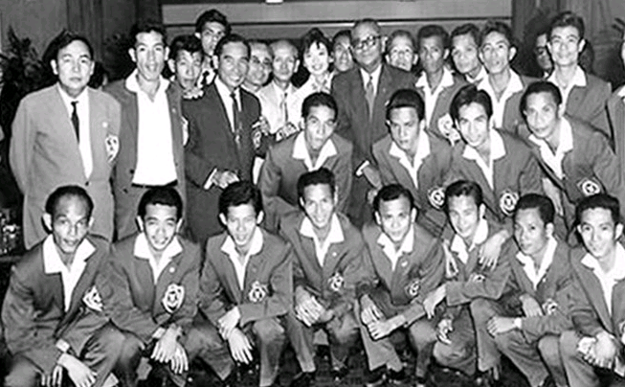
Objectives of the SEAP Games
Athletic Objective: Raising standards in sport
Athletic development level comparatively low
→ competition may increase the standard of performances.
"Our teams are not strong. Our standards are low“ - Luang Sukhum Nayapradit
“The SEAP Games will help countries improve their standards at future Olympic and Asian Games" - Lieutenant-General Praphat Charusathien, President of the Olympic Committee of Thailand
Members of the Republic of Vietnam won the gold medal at SEAP Games in 1959 in Bangkok, Thailand.
https://commons.wikimedia.org/wiki/File:%C4%90%E1%BB%99i_tuy%E1%BB%83n_VNCH.png

Slide 13
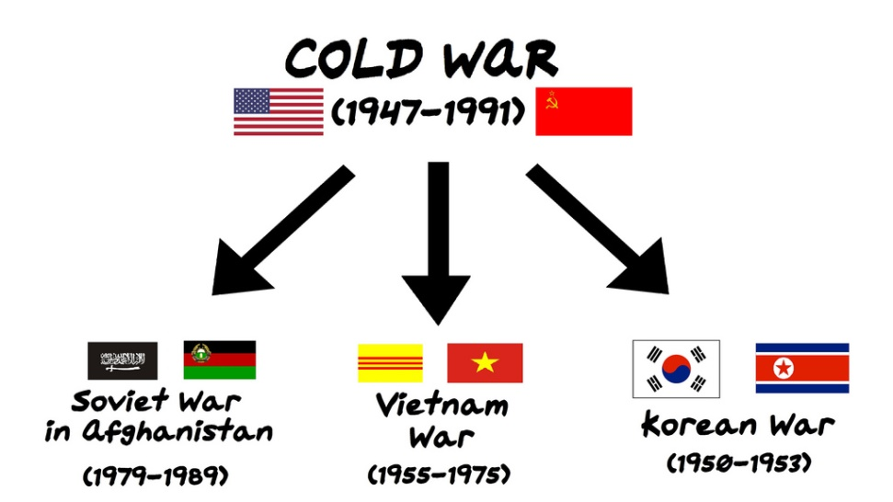
Objectives of the SEAP Games
Political Objective: Forging stronger ties with neighbours
Cold War: state of political conflict between the groups led by the former Soviet Union (USSR) and by the United State of America (USA).
Ideological division → intense competitions between them (in science and technology, educational system, arts, and sports) to demonstrate the superiority of the economic-political system they wished to promote for the rest of the world.
No explicit exclusion of communist states such as North Vietnam, but implicit aspiration to organize SEAP between non-communist countries in the region.

Slide 14
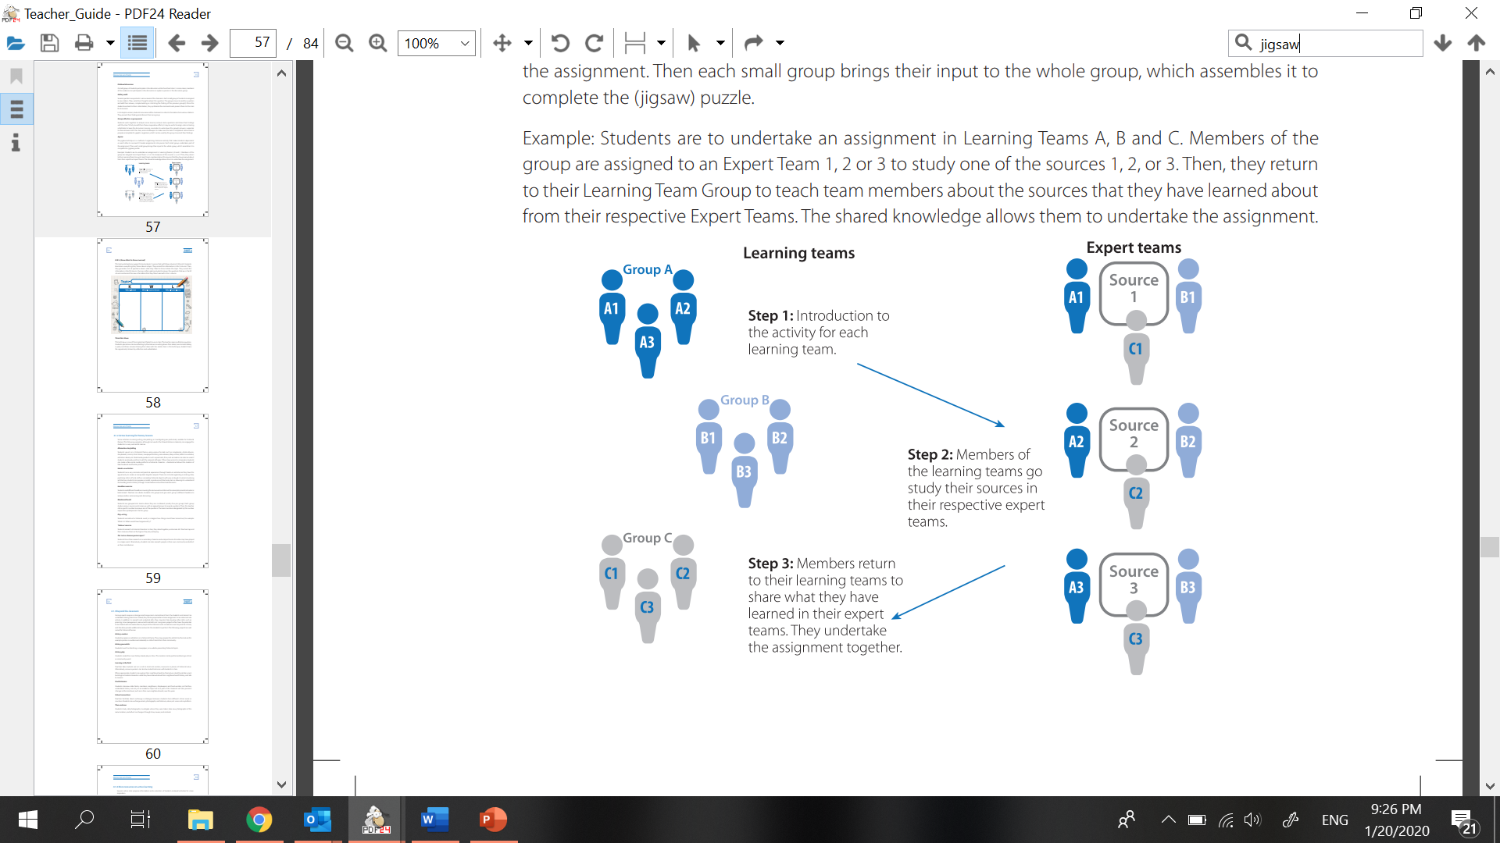
Jigsaw activity
20 mn
10 mn
How did the SEAP Games come about?
Why did the SEAP Games become the SEA Games? What were the factors that led to the expansion of the membership of the Games?
In what specific ways have the SEA Games contributed to the building and strengthening of community spirit among countries and within the region?

Slide 15
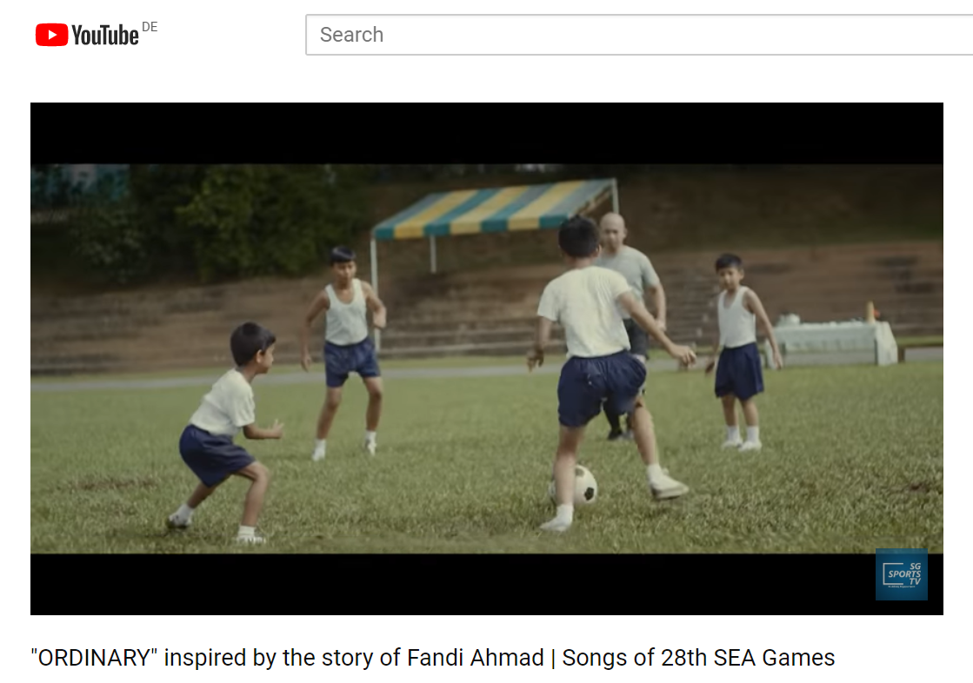
https://www.youtube.com/watch?v=W2uNwiZsFHs

Slide 16
Conclusion
Sport and international sports competitions: more than entertainment or leisure.
Stimulate the sense of identification and pride → identity-formation among individuals
SEA Games: recurrent people-to-people interaction among various countries in the region. Such → gradual process of regional identity-formation.
Reinforced the idea that there was a regional grouping and that such a grouping was important.

