Slide 1
Unit 4: Envisioning Southeast Asia
Lesson 1a. Introduction to ASEAN

Slide 2
A note to users of this presentation
This presentation was developed as complementary materials for teachers running this lesson. It follows the lesson plan.
It includes content from the lesson plans and the introductory essays for teachers’ lectures. It also introduces some of the activities suggested for students.
You are welcome to customize this presentation to adjust the lesson to their curriculum and to your students. You can change images, add/remove activities, and of course delete this slide, etc. The Teacher’s Guide (https://sharedhistories.asia/teacher/) provides guidance on how to adjust the lessons.
We wish you a successful lesson!
The Southeast Asian Shared Histories project was developed by UNESCO Bangkok with funding from the Republic of Korea.

Slide 3
Objective of the lesson
Why was ASEAN formed?
Who were the members of ASEAN?
What are the aims of ASEAN?

Slide 4
South-East Asia is a region rich in diversity and yet there are commonalities within the region.
ASEAN, as a regional organization, creates commonalities among its member nations.
It is also a way by which countries in Southeast Asia came together to envision and create a common vision and future for the region.

Slide 5
What does it stand for?
ASEAN

Slide 6
What does it stand for?
ASEAN
Association of
South
East
Asian
Nations

Slide 7
What does it mean?
Some definitions
Association
an organized body of people who have an interest, activity or purpose in common
South-East Asia
a geographical subdivision of Asia that includes the countries of Brunei Darussalam, Cambodia, Indonesia, Lao PDR, Malaysia, Myanmar, the Philippines, Singapore, Thailand, Timor Leste and Viet Nam.
Nations
a large group of people with common characteristics such as language, traditions, customs, habits and ethnicity. It has also been defined as a cultural-political community that has become conscious of its unity and interests
Other definitions are possible too!

Slide 8
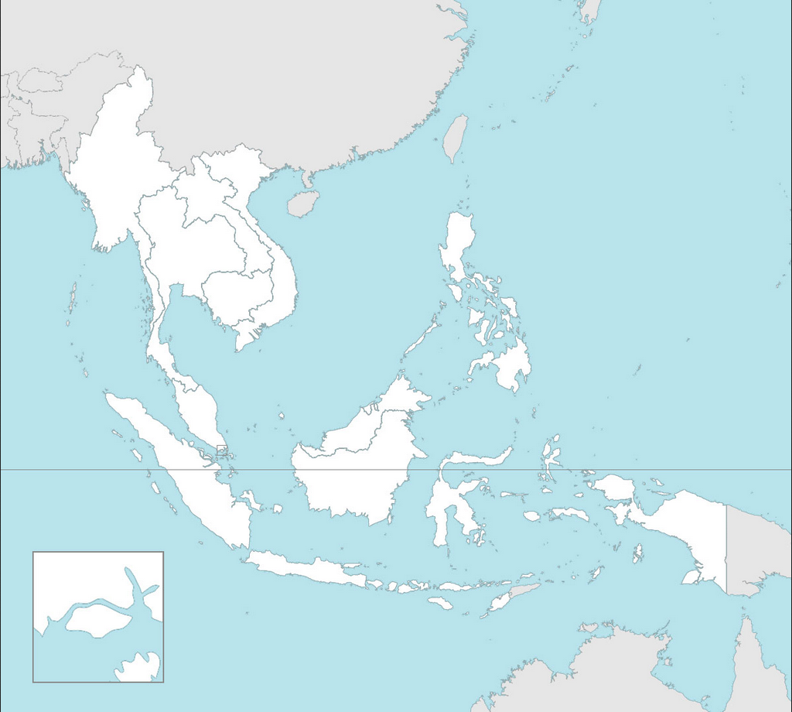
Activity: Map activity
10 small groups:
Write the name of the countries of Southeast Asia
What countries are members of the ASEAN?

Slide 9
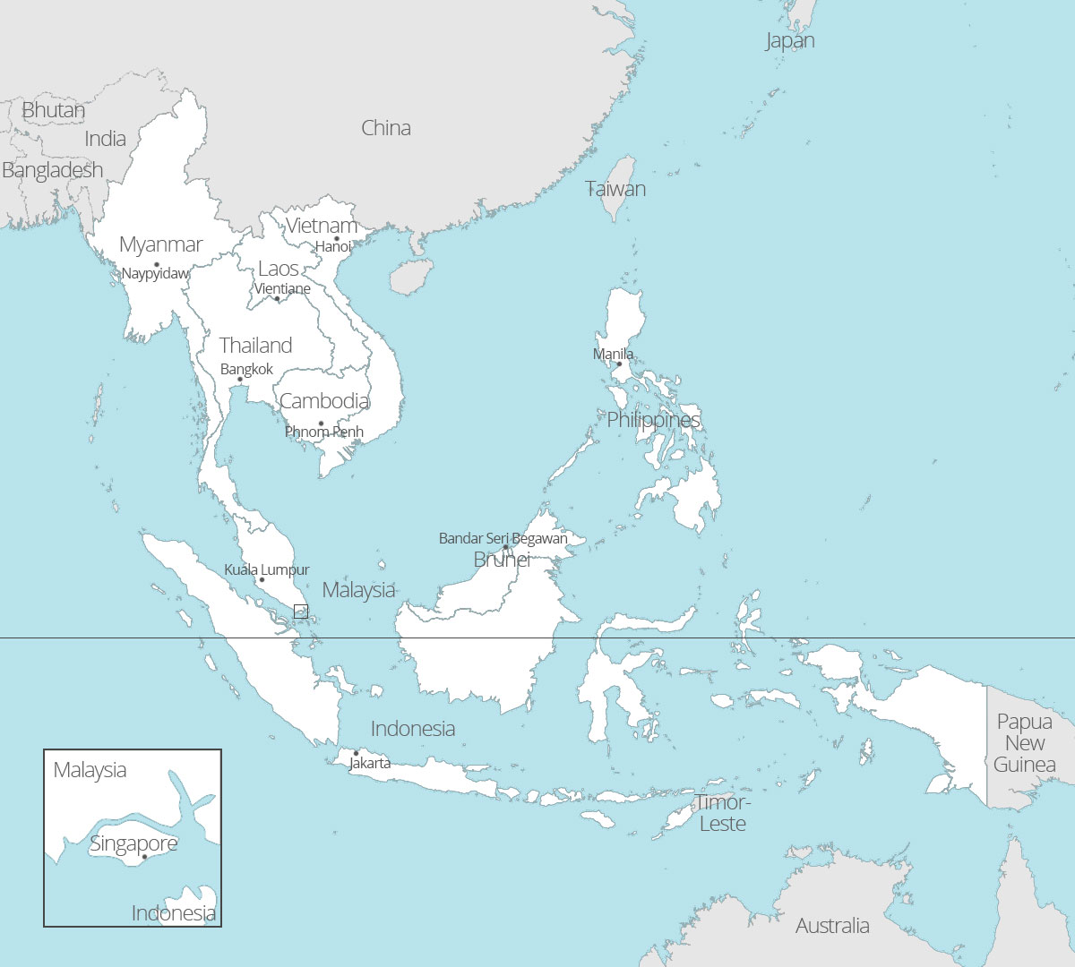

Slide 10
Group work: Country Experts Activity
10 groups
Research one of the ASEAN countries
Present a poster of your findings
Country X
Territorial Size:
Population:
Official Language(s):
Capital City:
Currency:
Head of State:
Head of Government:
Type of Government:
When did it become a member of ASEAN?:
Draw a picture of the country’s flag below:
What do the colours represent?
What do the [objects on the flag] represent?
What else can you say about the flag?

Slide 11
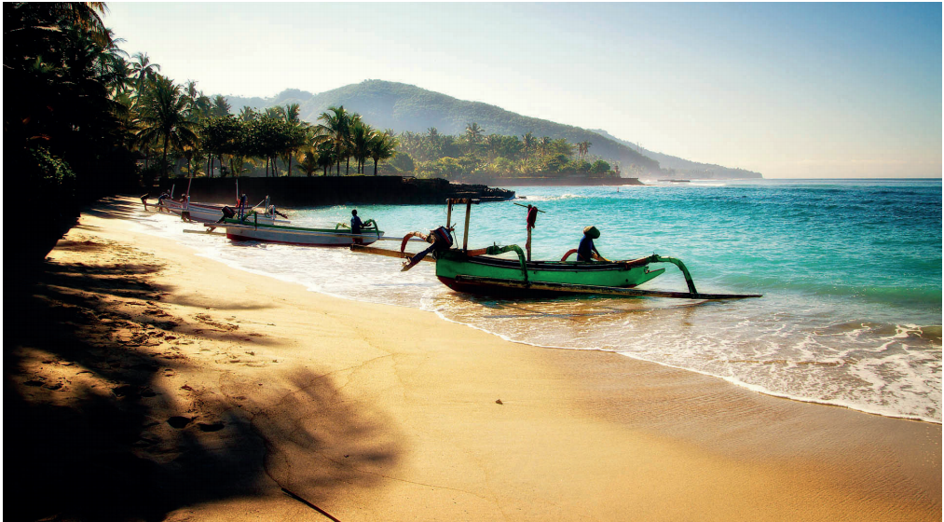
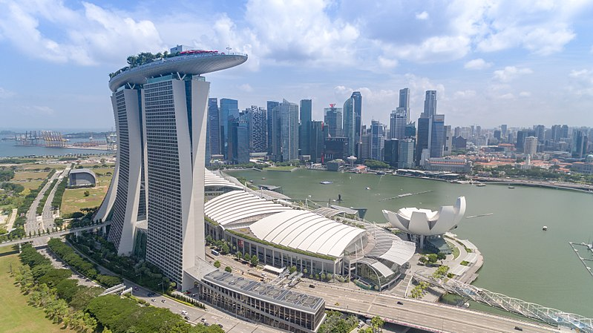
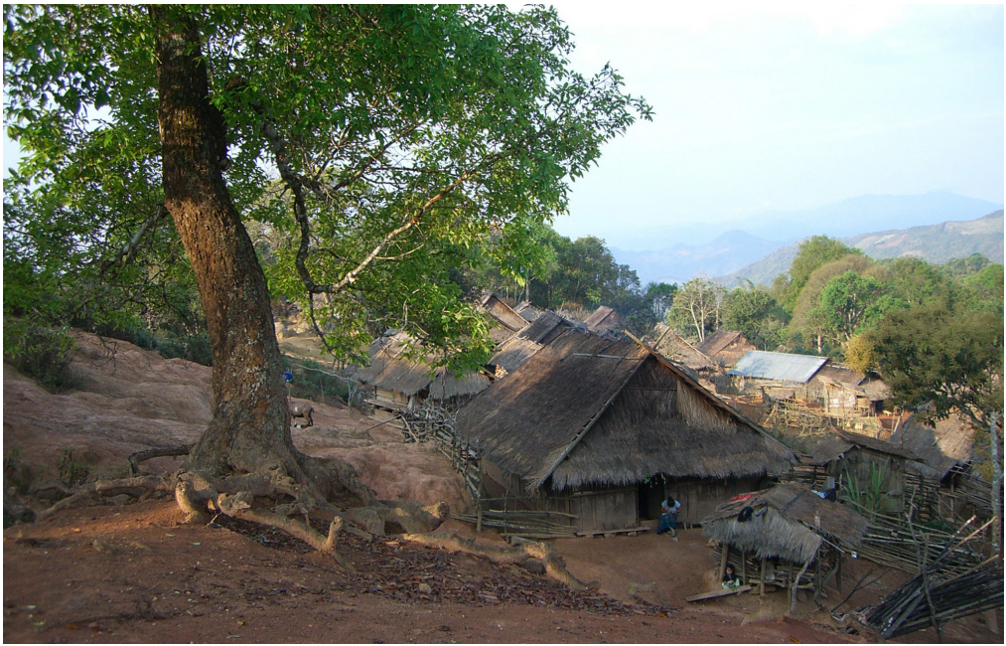
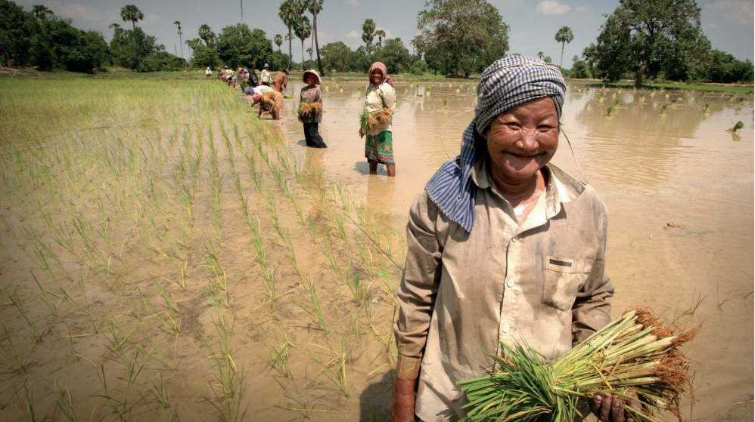
Southeast Asia is a very diverse region

Slide 12
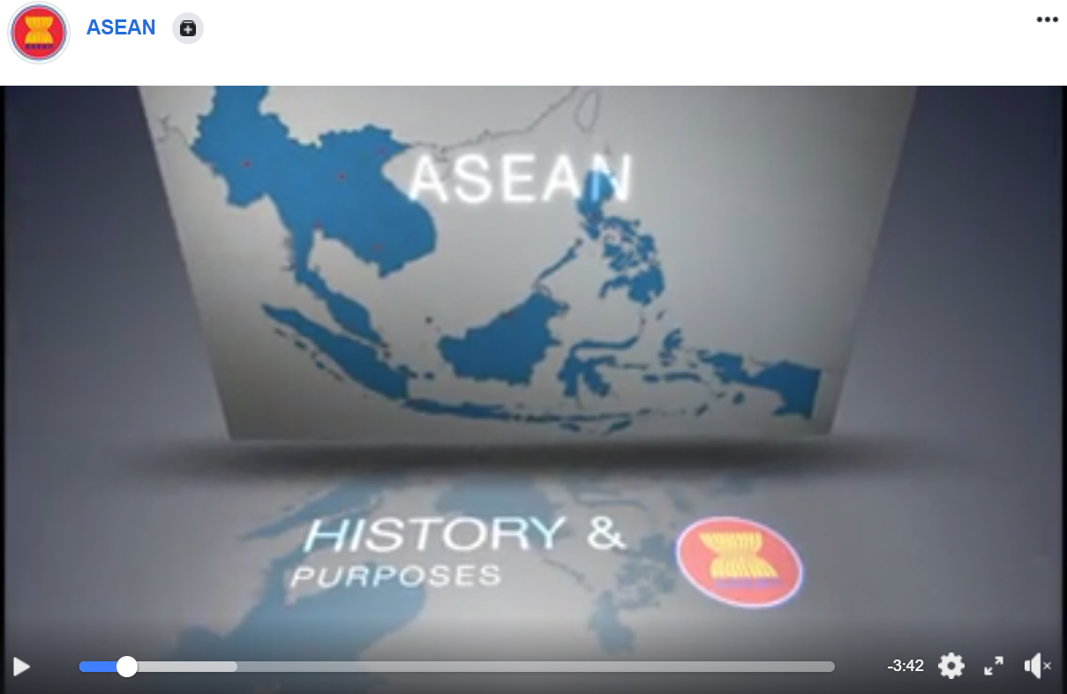
ASEAN: History and purposes
https://www.facebook.com/watch/?v=10151116122588854

Slide 13
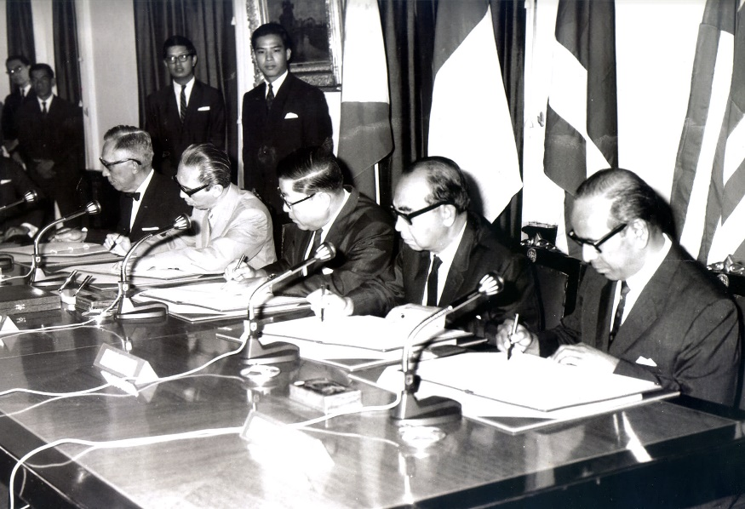
ASEAN: History and Purpose
The Foundation
VIDEO
ASEAN formed on 8 August 1967 (Bangkok Declaration)
  to accelerate economic growth, social progress and cultural development
  to promote regional peace and stability through justice and rule of law.
Today: 10 member states
  equality of partnership
  sense of belonging
  narrowing development gaps by adhering strictly to a process of consultation and consensus.
Source: ASEAN

Slide 14
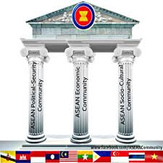
ASEAN: History and Purpose
ASEAN Charter
VIDEO
2008: signing of the ASEAN Charter
Closer cooperation in three pillars,
  ASEAN Political-Security Community: comprehensive security with rule of law, human rights and good governance through shared responsibility and a dynamic outwardly looking mindset
  ASEAN Economic Community: mobilizes resources to inclusively increase economic well-being and welfare and reduce social disparities
  ASEAN Socio-Cultural Community: people-oriented and socially responsible human development to achieve enduring solidarity and build greater understanding and good neighborliness
ASEAN has set a Vision 2020 towards realizing the ASEAN Community and the ASEAN Economic Community by 2015.

Slide 15
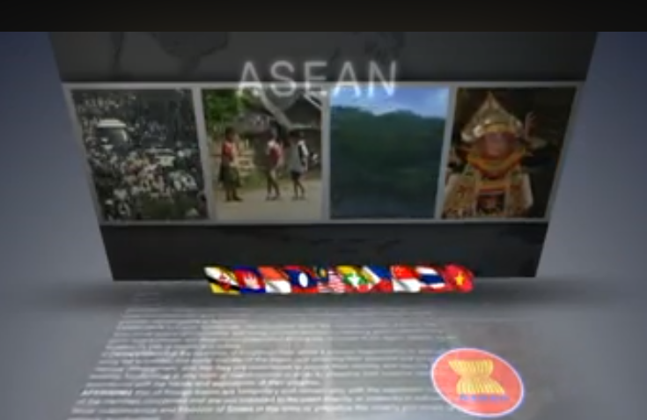
ASEAN: History and Purpose
External relations
VIDEO
Numerous bilateral and multi-lateral agreements
Numerous ASEAN committees and consultative bodies to listen to the peoples of ASEAN and support member states’ aspirations.

Slide 16
Group activity
?
Why was ASEAN formed?
Why did leaders in Southeast Asia think that ASEAN was necessary?
What kinds of conflicts were present in Southeast Asia in the 1960s?
Were there any other models of regional cooperation that ASEAN could follow?

Slide 17
Unit 4: Envisioning Southeast Asia
Lesson 1b: ASEAN as a regional organization

Slide 18
Objective of the lesson
What are the aims of ASEAN?
How has ASEAN helped in forming a shared identity in South-East Asia?
What do you think ASEAN of the future will look like?
Common past
Creating commonalities for the future.

Slide 19
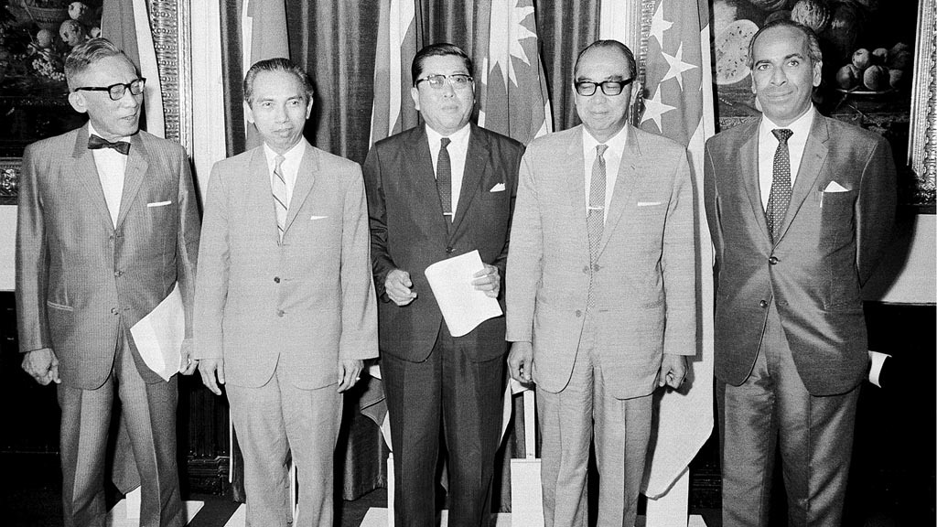
The Bangkok Declaration
Group activity
  What are the aims of ASEAN?
  How does ASEAN hope to achieve these aims?
  What kind of platforms does ASEAN plan to use platforms to achieve its aims?
The Founding Fathers
The five Foreign Ministers who signed the Bangkok Declaration – Adam Malik of Indonesia, Narciso R. Ramos of the Philippines, Tun Abdul Razak of Malaysia, S. Rajaratnam of Singapore, and Thanat Khoman of Thailand
© https://aseancommunity.tumblr.com/post/162183488945/history-of-asean-the-founding-of-asean-on-8-august

Slide 20
ASEAN timeline
1967
1971
1978
1984
1995
1997
1999
2005
2007
2015
Members
ASEAN established
5 members
Brunei Darussalam joins ASEAN
Viet Nam joins ASEAN
Lao PDR and Myanmar join ASEAN
Cambodia joins ASEAN
ASEAN-European Community meeting
ASEAN + 3 meeting
ASEAN + 6 meeting
East Asia Summit
External Relations
Agreements
Declaration on the Zone of Peace, Freedom and Neutrality (ZOPFAN)
Southeast Asia Nuclear Weapon Free Zone Treaty
ASEAN Vision 2020
ASEAN Charter
ASEAN Community’s 3 Pillars

Slide 21
The ASEAN Charter
Group Activity
Chapter I: Purposes and Principles - Article 1: Purposes
  What are the Purposes of ASEAN
  as declared in the ASEAN Charter?
How are they similar to the Bangkok Declaration?
How are they different from the Bangkok Declaration?
  Why have the changes come about?

Slide 22
Conclusion
With increased membership in ASEAN, the diversity and complexity increased as well.
As a platform for creating shared identities and facilitating regional cooperation, ASEAN is a work in progress.
  External hindering factors to regional cooperation when national interests take precedence (e.g. competing territorial claims, transboundary haze issues etc.)
  Enhanced cooperation when facing a common threat (e.g. security, terrorism etc.).

