Slide 1
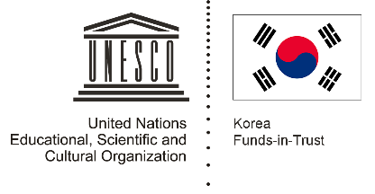

Unit 3: Rice and Spice
Lesson 3: Food, health and healing

Slide 2
A note to users of this presentation
This presentation was developed as complementary materials for teachers running this lesson. It follows the lesson plan.
It includes content from the lesson plans and the introductory essays for teachers’ lectures. It also introduces some of the activities suggested for students.
You are welcome to customize this presentation to adjust the lesson to their curriculum and to your students. You can change images, add/remove activities, and of course delete this slide, etc. The Teacher’s Guide (https://sharedhistories.asia/teacher/) provides guidance on how to adjust the lessons.
We wish you a successful lesson!
The Southeast Asian Shared Histories project was developed by UNESCO Bangkok with funding from the Republic of Korea.

Slide 3
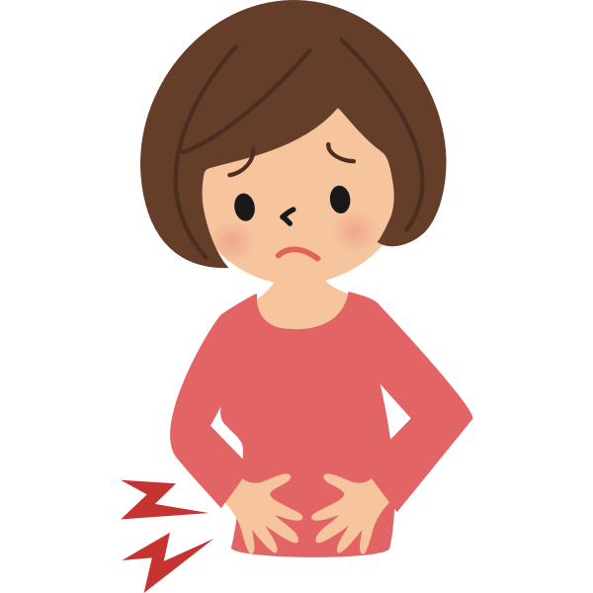
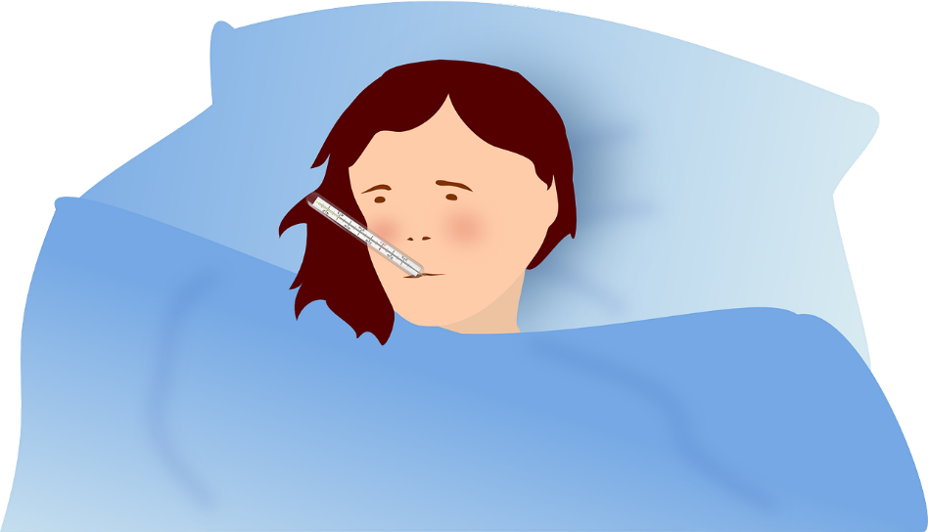
What do you usually do when you suffer from small ailments such as a sore throat, toothache, flatulence, and so on?
  Do they you straight to a Western doctor or a pharmacy?
  Would your parents/grand-parents recommend natural remedies with herbs, spices and other foodstuff that can be found easily in their kitchens or backyards?
  Would you avoid or take more in eating certain foods in order to alleviate the symptoms?

Slide 4
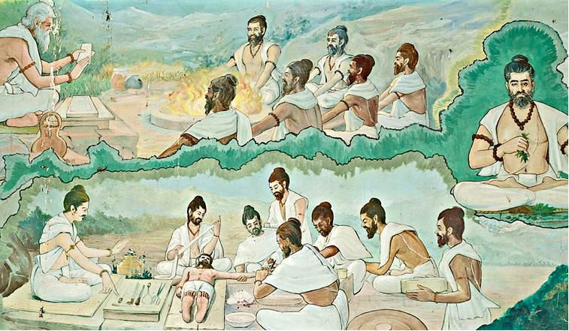
Humoral systems
Many indigenous health systems based on food and diet can be linked back to humoral systems that travelled from India, Arabia and China.
Source: http://ayurvedadosha.org/what-is-ayurveda#axzz4D3MLUPEh

Slide 5
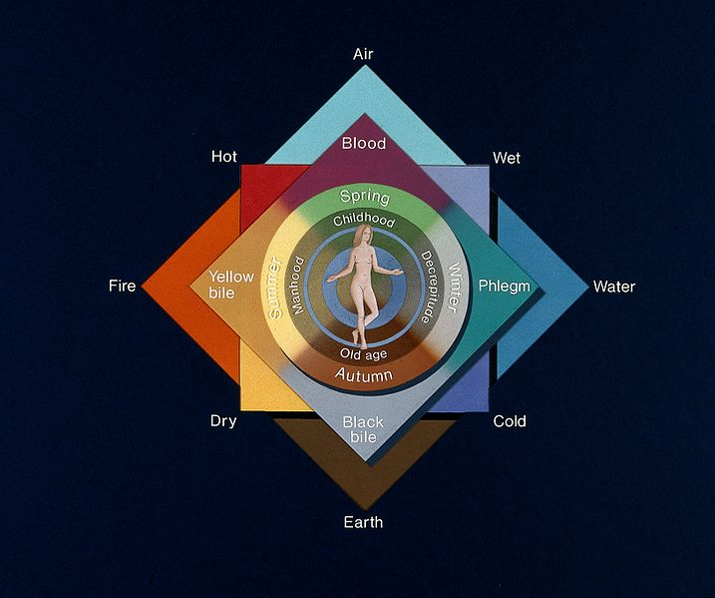
Humoral systems
Humoral systems view humans as having a unique constitution composed of earth, fire, water and wind.
Source: https://commons.wikimedia.org/wiki/File:The_four_elements,_four_qualities,_four_humours,_four_season_Wellcome_V0048018.jpg

Slide 6
A quest for a balanced system
Diseases and foodstuffs are either hot or cool
humans’ constitutions can be altered by diet when necessary.
A central view of all humoral systems is the quest for a balanced system – not hot / not cold
  cool diseases should be cured with warm foods or exposure to heat
  hot diseases should cured with cool foods or a reduction in temperature.

Slide 7
In Southeast Asia
Wind element (lom in Thailand, angin in Malaysia.
Blood, a hot humour, and phlegm, a cold humour, need to be kept in balance.
Illnesses and reproductive states upset the humoral balance and require special dietary attention.

Slide 8
Discussion
?
Are the humoral systems (hot/cold) observed in your families?

Slide 9
Exercice
HOT
HOT
COLD
NEUTRAL

Slide 10
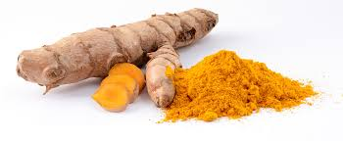
Turmeric
Food is also used in Southeast Asia for medicinal and ritual purposes.
Turmeric has long been used for religious and ceremonial purposes in India and is also widely used in Southeast Asia for medicinal and ritual purposes especially during childbirth and infancy
Source: https://commons.wikimedia.org/wiki/File:Curcuma_longa_roots.jpg

Slide 11
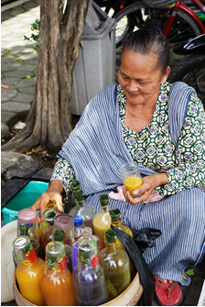
Traditional medicine
People are still using the traditional medicinal knowledge of our forefathers to achieve physical well-being.
Food is used as medicine in Indonesia.
Jamu: herbal medicine made from natural materials such as plant parts (roots, bark, flowers, seeds, leaves and fruits). Animal products (honey, royal jelly, milk and eggs) are sometimes added.
Source: https://en.wikipedia.org/wiki/Jamu

Slide 12
Knowledge transmission
Much knowledge of medicinal plants was transmitted inter-generationally in situ through walks in nature.
With urbanization, deforestation, access to Western healthcare, and other factors, these natural resources and rich traditional knowledge are rapidly disappearing.
Jamu still popular as a health supplement for the younger generation, but mostly in pill forms
Let’s preserve these traditions and knowledge because they are an integral part of our culture and heritage!

