Slide 1
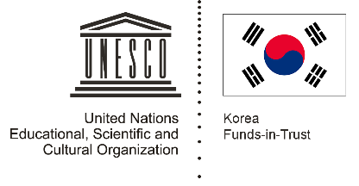

Unit 3: Rice and Spice
Lesson 7: Food cultures and the cuisines of Southeast Asia
What is the significance of spices and fermented fish products in Southeast Asian Cuisines?

Slide 2
A note to users of this presentation
This presentation was developed as complementary materials for teachers running this lesson. It follows the lesson plan.
It includes content from the lesson plans and the introductory essays for teachers’ lectures. It also introduces some of the activities suggested for students.
You are welcome to customize this presentation to adjust the lesson to their curriculum and to your students. You can change images, add/remove activities, and of course delete this slide, etc. The Teacher’s Guide (https://sharedhistories.asia/teacher/) provides guidance on how to adjust the lessons.
We wish you a successful lesson!
The Southeast Asian Shared Histories project was developed by UNESCO Bangkok with funding from the Republic of Korea.

Slide 3
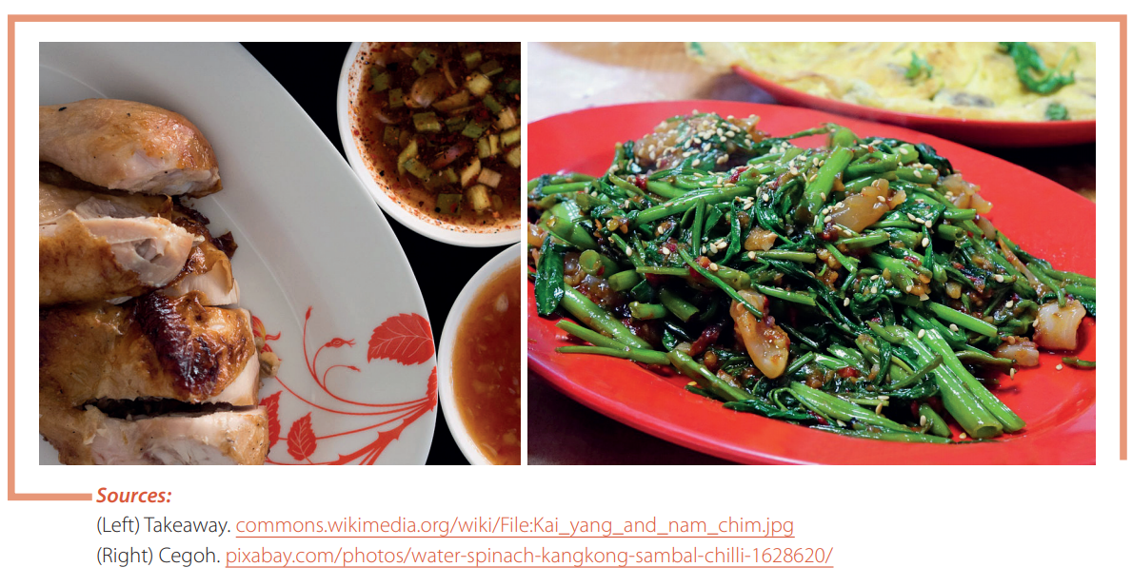
How would these dishes taste without the spices and the fermented fish products?

Slide 4
?
Think of what you had for dinner last night.
Write down the seasonings that were used?

Slide 5
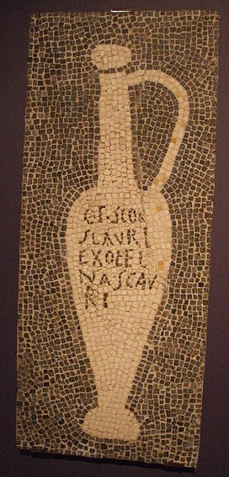
“Garum”
  Fermented fish products such as fish sauces, fish paste, or salted fish have been consumed since ancient times.
  One of the earliest records of fermented fish sauce was garum, a condiment that was used in the cuisines of ancient Greece, Roman and Byzantium.
  Due to limitations in transportation, people living inland could seldom eat fresh fish. Fermentation was a convenient and common preservation technique.
Mosaic of a garum amphora, Pompei. Source: https://de.wikipedia.org/wiki/Datei:Garum_Mosaik_Pompeji.JPG

Slide 6
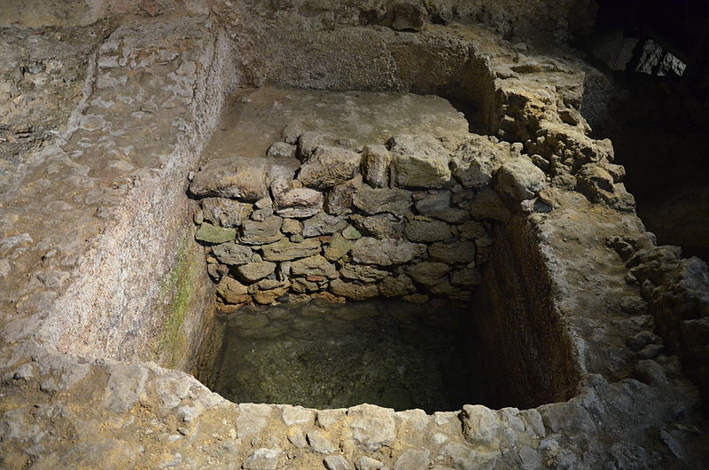
An ancient recipe for garum
Use fatty fish, for example, sardines, and a well-sealed (pitched) container with a 25-33 liter capacity.
Add dried, aromatic herbs possessing a strong flavor, such as dill, coriander, fennel, celery, mint, oregano, and others, making a layer on the bottom of the container
Then put down a layer of fish (if small, leave them whole, if large, use pieces) and over this, add a layer of salt two fingers high.
Repeat these layers until the container is filled. Let it rest for seven days in the sun. Then mix the sauce daily for 20 days. After that, it becomes a liquid.
The Roman garum factory of Olisipo, Lisbon, Portugal
Source: Carole Raddato, https://commons.wikimedia.org/wiki/File:The_Roman_garum_factory_of_Olisipo,_Lisbon_(15610062600).jpg

Slide 7
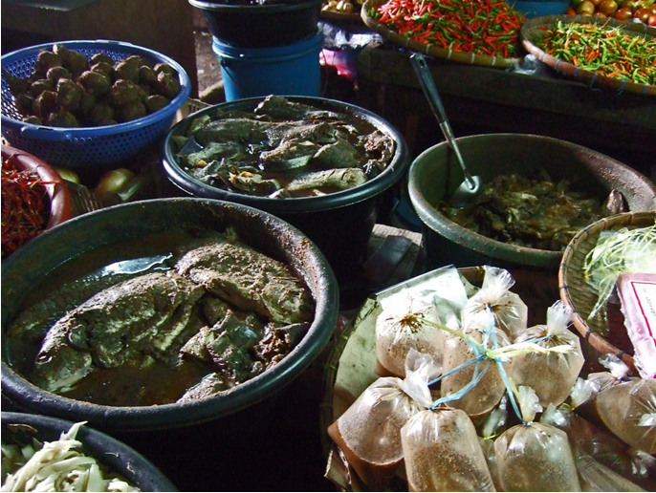
Fermented fish products in Southeast Asia
In Southeast Asian countries, a sauce or paste made from fermented fish or shell fish accompanies most rice meals. The fish are salted, dried, pounded, and packed with toasted rice and rice husk in jars for a month or more.
  Fish products that are fermented become “cooked” and are no longer considered raw.

Slide 8
Fermented products reflect the diversity of the region
  It is not known if the concept of fermenting fish as a preservation techniques spread from the ancient Rome and Greece to Southeast Asia through trade links or otherwise.
  Fish products are widely used in Southeast Asian cooking and almost every country in the region has its own version. This demonstrates the ingenuity of the local people in preserving much of the seasonally available fish so that they could add as much protein as possible to their diets.
  The popularity of fermented products also reinforces how rice is a staple food in the region. As eating large quantities of rice is a cheap source of amino acids and energy, a vital individual foodstuff that accompanies rice is either a salty side dish or a condiment that facilitates rice consumption.

Slide 9
High labor and time investment in preparation and presentation
Gender roles reaffirmed through food-related activities (shopping and main cooking by women, some dishes predominently prepared and consumed by men)
Outside influences
  China: noodles, stir-fried dishes, chopsticks
  India: curries, use of specific spices
  France: bread and coffee
  Central America through Portugal traders: chili

Slide 10
Group activity: Gallery Walk
In groups of 4, go through the gallery of sources.
What is the fermented fish product called locally?
How is it produced?
How is it used in cooking?
How do we know that these products are important?

Slide 11
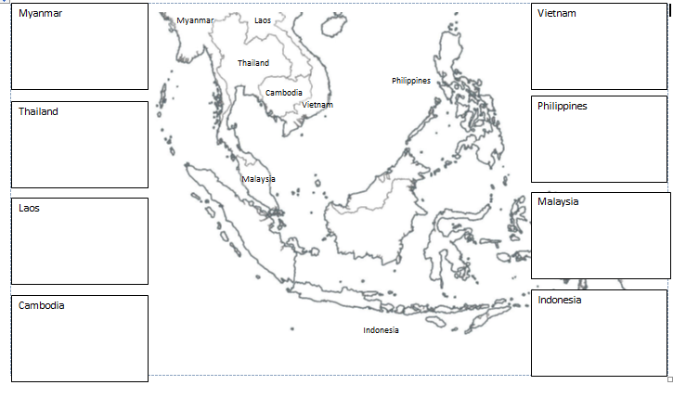
Group activity: Gallery Walk (option 1)
Take note in your document

Slide 12
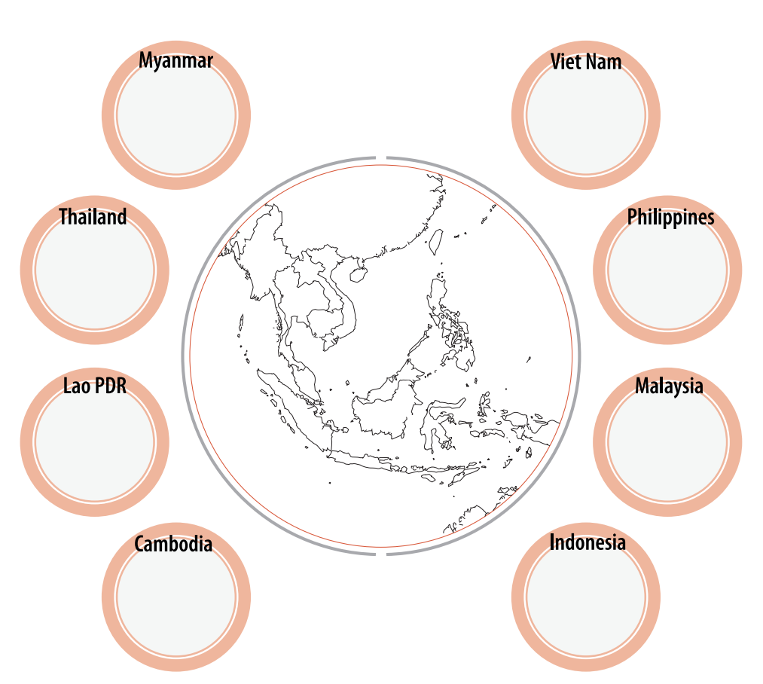
Group activity: Gallery Walk (option 2)

Slide 13
Fermented fish products are a shared element in culinary history and culture among all countries in Southeast Asia
Country | Fermented Food Product Category
 | Shrimp Paste | Fish Paste | Fish Sauce | Shrimp Sauce
Cambodia | kapi | prahok | tuk trey | nam tom
Indonesia | terasi udang | terasi ikan | kecap ikan
Laos |  | pa dek | nam paa
Malaysia | balacan |  | budu
Myanmar | ngapi seinsa | ngapitaungtha | ngagampyaye | pazunggampyaye
Philippines | bagoong alamarang dinailan guinamos |  | patis | alamarang patis
Thailand | kapi |  | nam pla budu thai pla | nam kapi
Vietnam | mam ruoc mam tom | mam mem | nuoc mam | nam tom

Slide 14
Keep learning
At home, talk with your family to learn more about the culinary traditions and heritage of your community.

