Slide 1
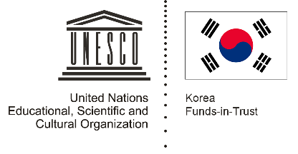

Unit 3: Rice and Spice
Lesson 1: Introduction to Rice Cultures: How significant is rice in the cultures of Southeast Asia?

Slide 2
A note to users of this presentation
This presentation was developed as complementary materials for teachers running this lesson. It follows the lesson plan.
It includes content from the lesson plans and the introductory essays for teachers’ lectures. It also introduces some of the activities suggested for students.
You are welcome to customize this presentation to adjust the lesson to their curriculum and to your students. You can change images, add/remove activities, and of course delete this slide, etc. The Teacher’s Guide (https://sharedhistories.asia/teacher/) provides guidance on how to adjust the lessons.
We wish you a successful lesson!
The Southeast Asian Shared Histories project was developed by UNESCO Bangkok with funding from the Republic of Korea.

Slide 3
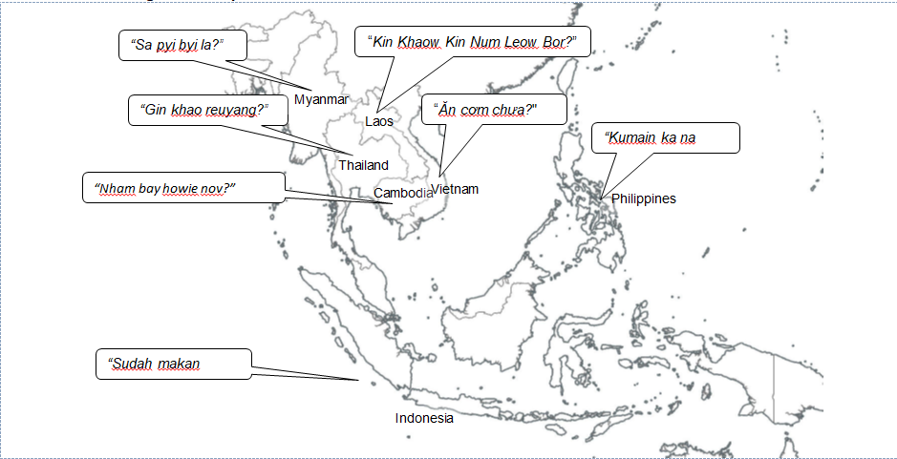
Rice is part of Southeast Asia culture
Greetings in some parts of South-East Asia

Slide 4
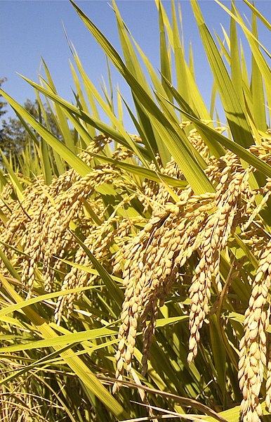
Rice
Specie native to Asia
Spread between 3000 and 2000 BC by people from China
Rice cultivation techniques varies between countries: a blend between Chinese techniques and local factors
Staple food for 80% of South-East Asia people
120,000 varieties (glutinous, non glutinous)
Cultivation from upland rain-fed to simple and sophisticated irrigation systems for paddy fields depending on terrain, climate and economic objectives
Source: https://commons.wikimedia.org/wiki/File:Rice_Plants_(IRRI).jpg

Slide 5
Rice helped build empires
  Angkorian empire was built, in large part, on an irrigation system that allowed the control and management of water, and by extension of rice production
  Empire and States powers are likely to have been supported by the capacity of their rulers to organize agriculture and rice cultivation.

Slide 6
Proverbs associated with rice in Southeast Asia
‘Believing in fortune telling is a waste of rice’. | Burmese proverb
‘Cook only as much rice as you have’. | Filipino proverb
‘Cold rice given wholeheartedly is better than newly cooked rice’. | Filipino proverb
‘Rice has become porridge’. | Indonesian proverb
‘Be a smart man, like drooping rice’. | Indonesian proverb
‘Don’t let an angry man wash dishes; don’t let hungry man guard rice’. | Khmer proverb
‘The immature rice stalk stands erect, while the mature stalk bends over’. | Khmer proverb
‘With water make rivers, with rice make armies’. | Khmer proverb.
‘Without rice, there is nothing left’. | Malay proverb
‘If you plant grass, you won’t get rice’. | Malay proverb
‘Rice depends on paddy fields, fish depend on water’. | Thai proverb
‘Don’t buy buffaloes during the planting season, don’t buy new clothes during the New Year’. | Thai proverb
‘Once the rice is pudding, it's too late to reclaim it’. | Vietnamese proverb
‘Try to seize the bowl of rice but forget the whole table of food’. | Vietnamese proverb

Slide 7
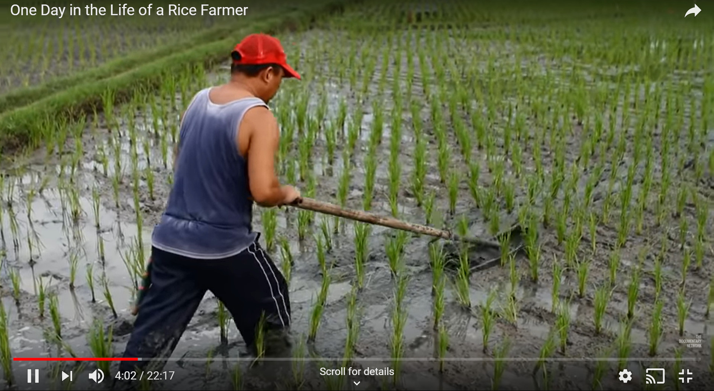
Video
One Day in the Life of a Rice Farmer
https://www.youtube.com/watch?v=s_kLkOOV3CE

Slide 8
Video
One Day in the Life of a Rice Farmer
Farming rice is a laborious process
There are several parties involved in rice cultivation.
There is an extensive process involved in rice farming, from cultivation to sale.
Rice cultivation requires social coordination and organization

Slide 9
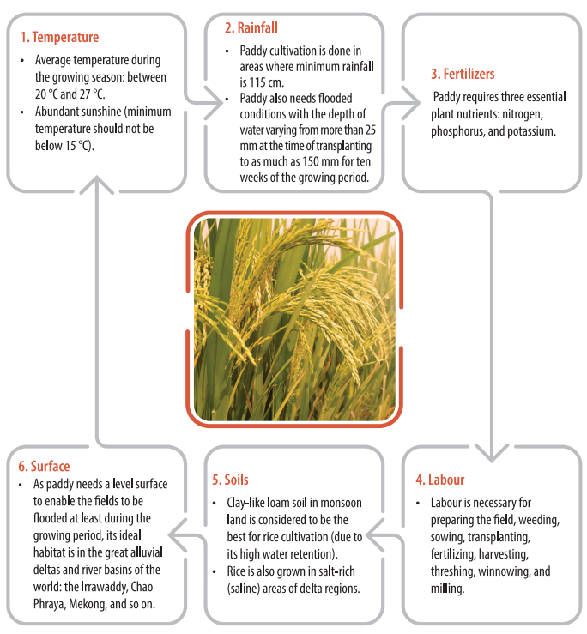
Conditions suitable for rice cultivation

Slide 10
Rice is grown is 4 types of ecosystems
Irrigated rice environment | Rainfed lowland environment | Rainfed upland environment | Flood-prone environment
Grown in bunded fields or paddies, which are surrounded by a small embankment that keeps the water in. Water supply is more assured and one or more crops a year can be grown. Found in many varying topographies such as flood plains, valley bottoms and terraced fields. | Grown in bunded fields that are flooded with rainwater for at least part of the cropping season. This environment is characterized by a lack of water control, with floods and drought being potential problems. | Grown in mixed farming systems without irrigation and without puddling. This rice environment can be found in low-lying valley bottoms to undulating and steep sloping lands. In Indonesia and the Philippines, upland rice may be intercropped with maize. | This ecosystem – which includes deepwater and floating rice environments – incorporates special rice varieties that are well suited to flooded environments. Deepwater rice and floating rice are mainly grown on the floodplains and deltas of rivers such as the Irrawaddy of Myanmar, the Mekong of Viet Nam and the Chao Phraya of Thailand.

Slide 11
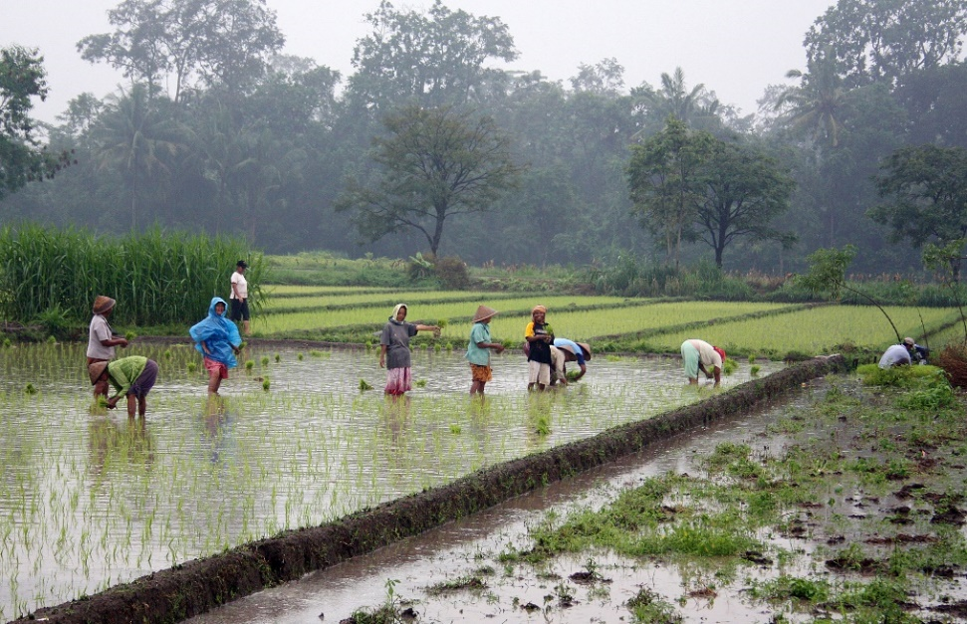
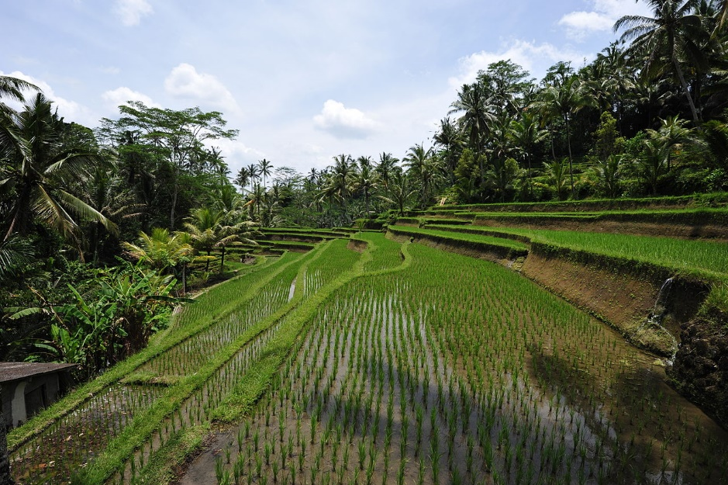
Irrigated rice environments in Southeast Asia
Javanese women planting rice in a rice field near Prambanan, Yogyakarta, Indonesia
Rice terraces in Bali, Indonesia
Source: Gunawan Kartapranata https://en.wikipedia.org/wiki/Rice_production_in_Indonesia#/media/File:Rice_plantation_in_Java.jpg
Source: Chensiyuan, https://en.wikipedia.org/wiki/Bali#/media/File:1_bali_rice_terrace_2011.jpg

Slide 12
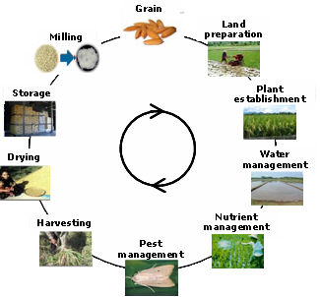
Rice cultivation cycle
Some of the tasks:
Building bunds and embankments
Building and cleaning irrigation systems
Preparing the field
Weeding
Sowing
Transplanting
Manuring
Harvesting
Threshing
Winnowing
Milling.
© IRRI, http://www.knowledgebank.irri.org/ericeproduction/

Slide 13
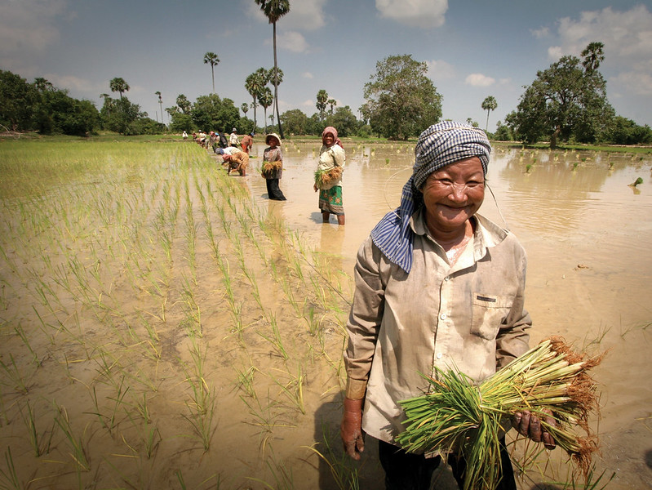
A community effort
Planting rice is a very laborious process. It needs the cooperation and coordination of a community. It unites and binds village communities together in rural South-East Asia.
Source: Jim Homes / AusAID, https://www.flickr.com/photos/dfataustralianaid/10662299483/in/photolist-hfc5aH-7jF5bW-hg466n-7zudoV-hfb2Ks-7Kh9Pa-RQikz-2m8Rqb-79QwH1-8xZXGu-4r1mFU-5GVtMH-2xENH8-4jdGy5-LCWE-79V5RX-adw13H-hg5ZUp-gUpfVP-gUpfJ6-RXcpkz-RXcpdR-hvZdxx-294vkyg-duiJGy-au2QuS-maVpjv-aptRBA-apr9c6-LVRqmA-76jhkN-9jgHfP-9wbnYR-7oYupk-cBtUVC-j29oe8-fmCi7-RQ1Gi-QX2mfY-tvFRQ-QX2mZo-dbbZQ4-fVcay2-gUpfGc-8YtS3Z-27Yb4wW-odAoZY-dukPWY-ducD2a-27cgLHj

Slide 14
Writer Margaret Visser says…
‘Paddy rice requires hard and incessant work, and a fiendishly difficult combination of both flexibility and organization. It succeeds only if it is controlled by a society of people ready to pull together, to synchronize with nature, to obey the rules they have invested, and above all to keep at it: everything must be in good repair and in good supply, always. Large-scale works (canals, terraces, reservoirs) have to be planned with the future in mind and with technological expertise. Then they must be built with labor freed, through the cooperation of everyone, from day-to-day farming. Everything has subsequently to be maintained in good order. Intensive rice cultivation needs many hands’.

Slide 15
Group work
Using the provided sources (movie and document), reflect on the process of rice cultivation.
How would you describe the process of planting rice?
What happens to the rice after harvest?
Does the rice farmer work alone or were there other parties involved in farming rice?
How would you describe the environment where the rice is grown?

