Slide 1
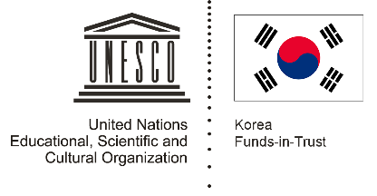

Unit 2: Early Centres of Power
Lesson 5: How did cultures mix in ancient South-East Asia?

Slide 2
A note to users of this presentation
This presentation was developed as complementary materials for teachers running this lesson. It follows the lesson plan.
It includes content from the lesson plans and the introductory essays for teachers’ lectures. It also introduces some of the activities suggested for students.
You are welcome to customize this presentation to adjust the lesson to their curriculum and to your students. You can change images, add/remove activities, and of course delete this slide, etc. The Teacher’s Guide (https://sharedhistories.asia/teacher/) provides guidance on how to adjust the lessons.
We wish you a successful lesson!
The Southeast Asian Shared Histories project was developed by UNESCO Bangkok with funding from the Republic of Korea.

Slide 3
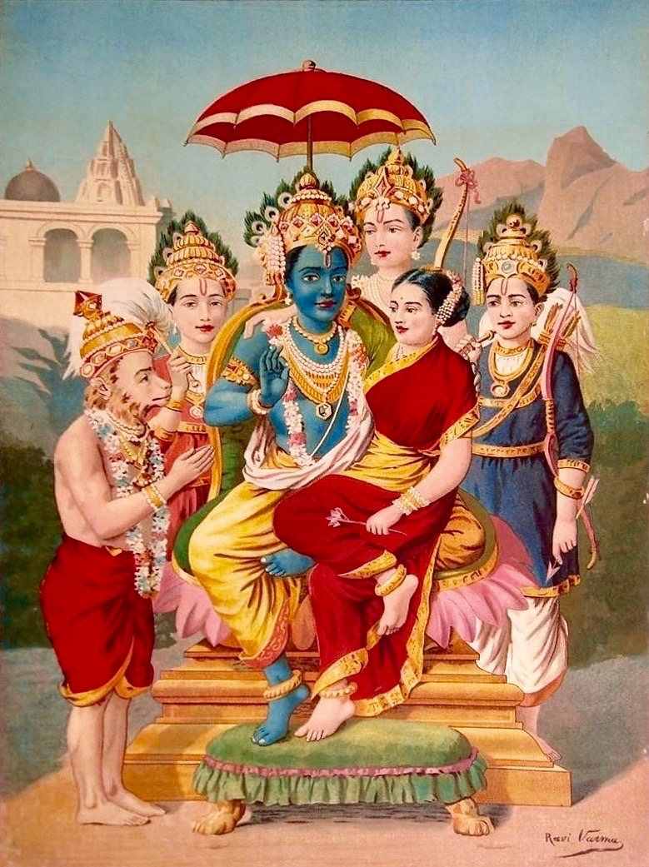
The Ramayana
A Hindu epic poem about King Rama.
In Hinduism, Rama is seen as a god.
The Ramayana tells the story of a legendary prince named Rama, who is said to have lived in the kingdom of Kosala.
His father forces him to leave the kingdom, and he travels through India with his brother and his wife, Sita.
However, his enemies capture Sita.
In order to get her back, Rama has a war with Ravana, the king of the island of Lanka.
He wins the battle of Lanka with the help of Hanuman, a god who appears as half-monkey, half-man.
The victorious Rama returns to the kingdom of Ayodhya to become king.
Source:Ramapanchayan, Raja Ravi Varma
https://en.wikipedia.org/wiki/Geet_Ramayan#/media/File:Ramapanchayan,_Raja_Ravi_Varma_(Lithograph).jpg

Slide 4
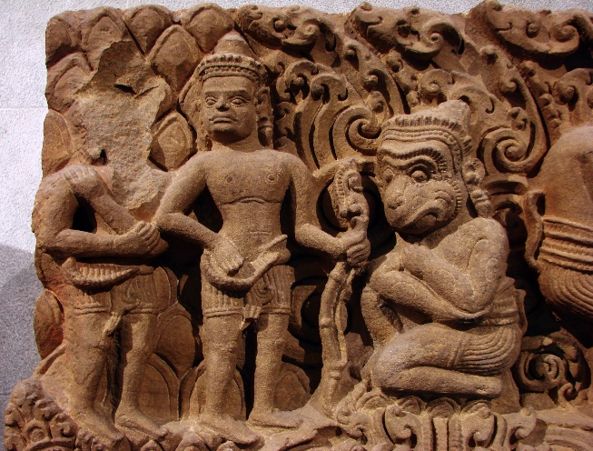
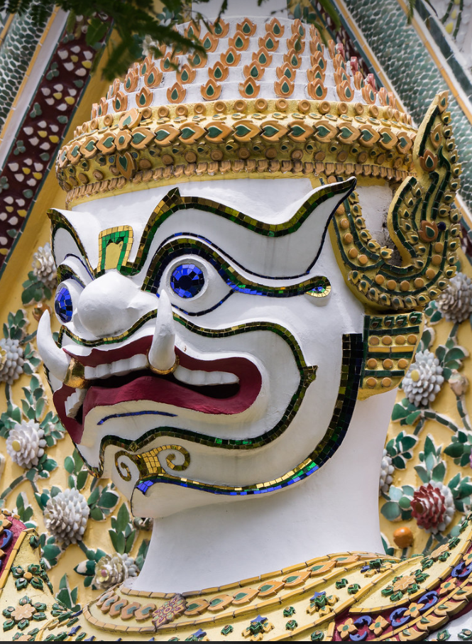
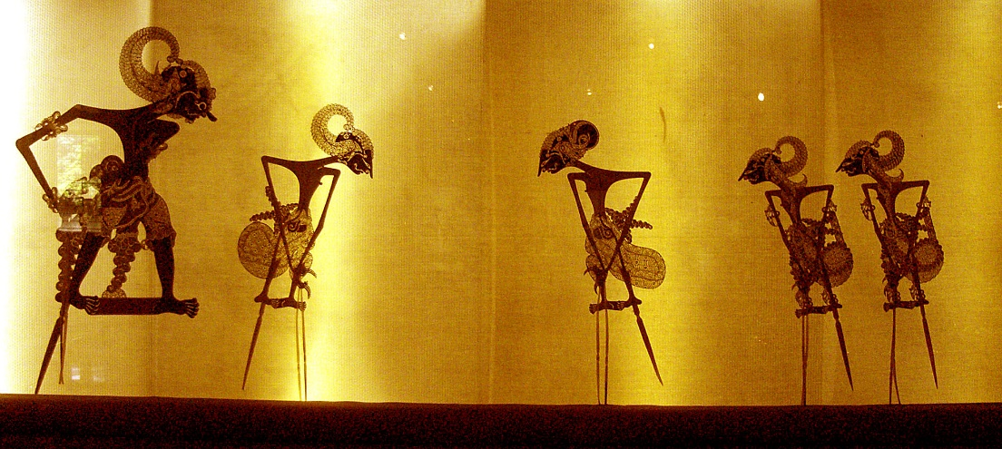
Historians are not sure exactly when the Ramayana was written, but they believe it was written between 500 BCE and 200 CE. It was written in the Sanskrit language, in what is now India.
The story of the Ramayana spread throughout South-East Asia. Today, there are versions of the Ramayana in the languages of Thailand, Indonesia, Lao PDR, Myanmar, the Philippines, and Malaysia.
Have you heard stories from the Ramayana?
Photo sources:
Ramayana episode, stone carving from Vat Basel, Battambang province, Cambodia.
Vassil,https://commons.wikimedia.org/wiki/File:Linteau_Ramayana_Mus%C3%A9e_Guimet_9971.jpg
Ramakien Statue, Wat Arun, Thailand
Edgardo W. Olivera
https://www.flickr.com/photos/ewolivera/36920941262
Wayang Kulit puppet theater, Indonesia
Gunawan Kartapranata
https://en.wikipedia.org/wiki/Wayang

Slide 5
?
How do you think the Ramayana spread from what is now India through South-East Asia?

Slide 6
People travelled and stories traveled with them. For instance:
Merchants shared the stories
Travelling troupes of actors performed the stories
People shared texts or images from the poem
…

Slide 7
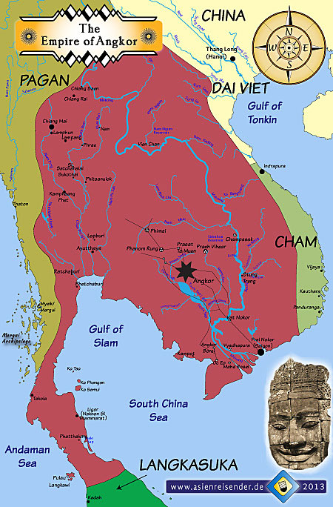
Ramayana and Angkor
One way that the Ramayana spread was through Angkor kingdom.
This kingdom was founded by the Khmer people and was based in what is now Cambodia. Historians believe this kingdom was active from the 9th century to the 15th century.
Indian merchants and rulers visited Angkor, and they brought the Ramayana with them. The Khmer people shared it with others that they ruled or traded with.
Each group adapted the stories to their own culture.

Slide 8
?
How do you think they adapted it to their own cultures?

Slide 9
The many faces of Ramayana
Some examples:
Translation of the Ramayana into local languages
Scenes from the Ramayana in local artistic styles
Incorporation of ideas from their own cultures or religions into the Ramayana
… etc.

Slide 10
Today we will examine how the story of the Ramayana diffused through South-East Asia, and we will see how different cultures adapted and changed it.

Slide 11
Group work
In small groups
Choose a group member to read Source 1 out loud. Other group members should follow along.
Look at Source 2. What characters or actions can you find from the story? Label the picture.
Now look at Source 3. What characters or actions can you find from the story? Label the picture.
How are Source 2 and Source 3 different?
How are Source 2 and Source 3 similar?
What guesses could you make about the cultures that created Source 2 and Source 3?

Slide 12
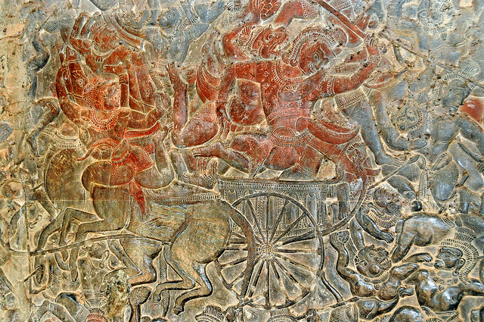
Battle of Lanka, bas relief from Angkor Wat
‘bas-relief’: parts of the image stand out from the background.
from the Angkor Wat temple , Cambodia. Angkor Wat was built in the 12th century, during the reign of King Suryavarman II, who ruled a kingdom called Angkor. Hindu legends such as the Ramayana influenced the kingdom of Angkor, and people there also practiced Buddhism.
Rama with a sword in his hand, jumping into Ravana's chariot.
The face of Hanuman, the Monkey King, next to Rama.
It is difficult to see Ravana in this image.
All around the chariot, Ravana's soldiers are fighting Hanuman's army of monkeys.
Hanuman
Rama
Source: © Dennis Jarvis, under Creative Commons http://tinyurl.com/hvgqwqn

Slide 13
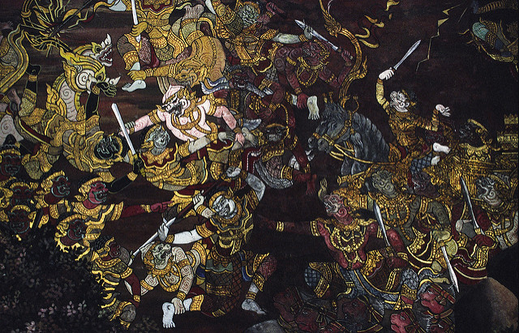
Battle of Lanka, Wat Phra Kaew fresco
This mural painting comes from the Wat Phra Kaew temple in Bangkok, in what is nowadays Thailand.
The temple was built and the fresco was created in the late 18th century, during the reign of King Rama I.
The King supervised the re-writing of the Ramayana as the "Ramakien," the national epic of Thailand. The Ramakien tells a similar story to the Ramayana, but it is set in the Thai kingdom of Ayutthaya.
Ramakien's hero, Phra Ram, fighting the King of the Demons, Thotsakan. Hanuman, King of the Monkeys, is helping Phra Ram fight Thotsakan and his army.
Source: © Thaths, Creative Commons https://www.flickr.com/photos/34816987@N00/1392410389

