Slide 1
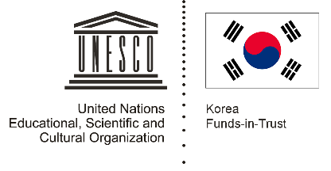

Unit 2: Early Centres of Power
Lesson 4: How big were ancient polities?

Slide 2
A note to users of this presentation
This presentation was developed as complementary materials for teachers running this lesson. It follows the lesson plan.
It includes content from the lesson plans and the introductory essays for teachers’ lectures. It also introduces some of the activities suggested for students.
You are welcome to customize this presentation to adjust the lesson to their curriculum and to your students. You can change images, add/remove activities, and of course delete this slide, etc. The Teacher’s Guide (https://sharedhistories.asia/teacher/) provides guidance on how to adjust the lessons.
We wish you a successful lesson!
The Southeast Asian Shared Histories project was developed by UNESCO Bangkok with funding from the Republic of Korea.

Slide 3
Kingdoms and borders in ancient time
In ancient times, there were not countries with fixed borders like there are today. Instead, there were many kingdoms whose borders changed over time; and there were smaller, independent cities.
How strong these kingdoms were, or how much power they had, depended on:
  how many weapons they had
  how big their networks of followers were
  the amount of money they had
  the number of people in the labour force and the military

Slide 4
The example of Pyu Cities
Many historians believe that the Pyu people formed the earliest kingdom in the region that is now Myanmar.
There are ruins of these cities that we can see today. Archaeologists believe these cities were built between the 1st and the 9th centuries CE.
But historians disagree about how big the Pyu kingdom was, and how long it lasted.

Slide 5
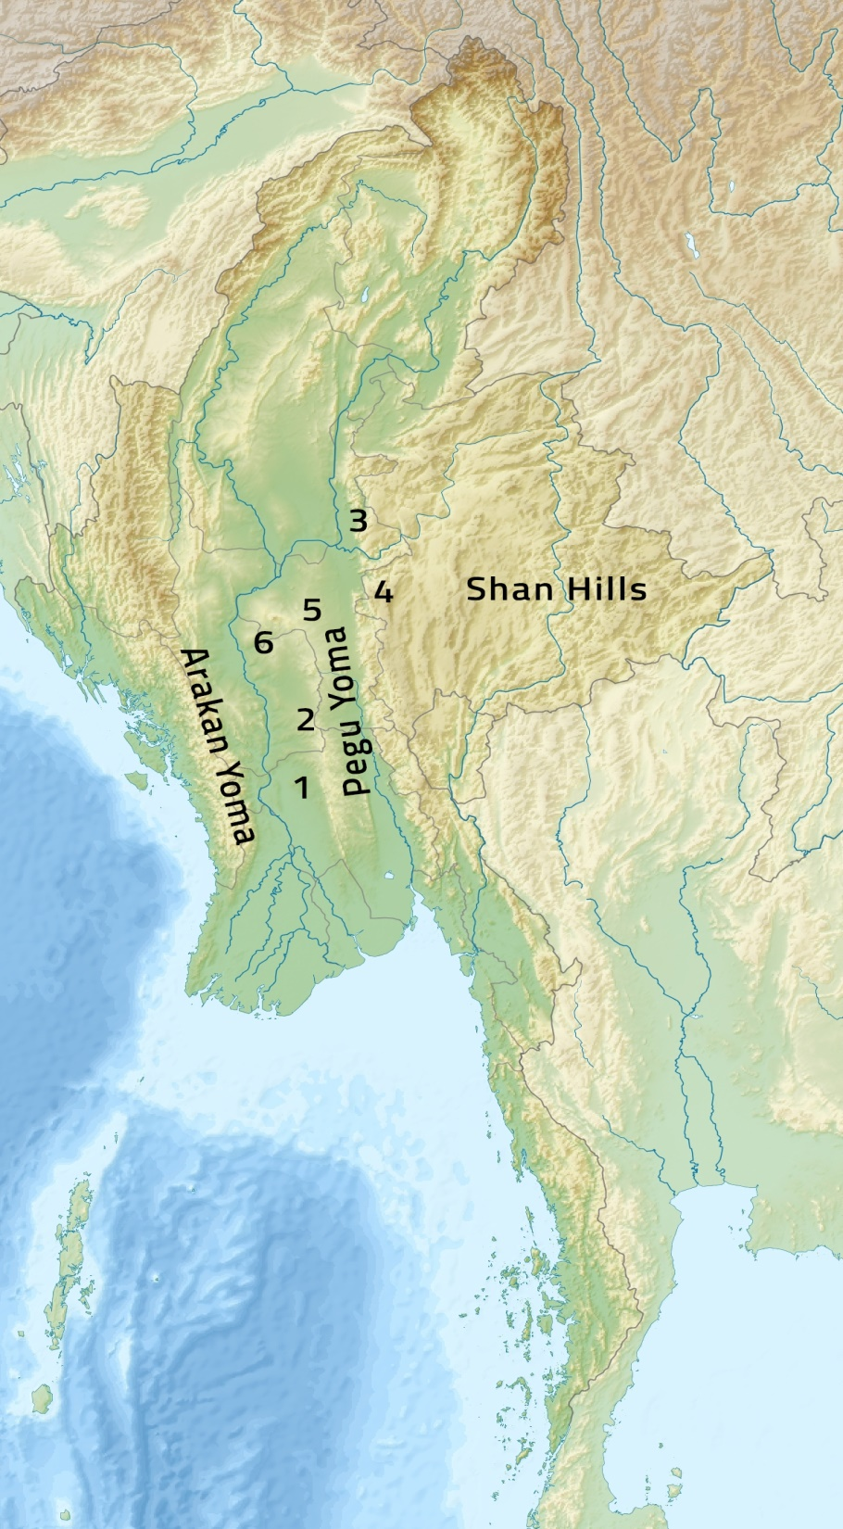
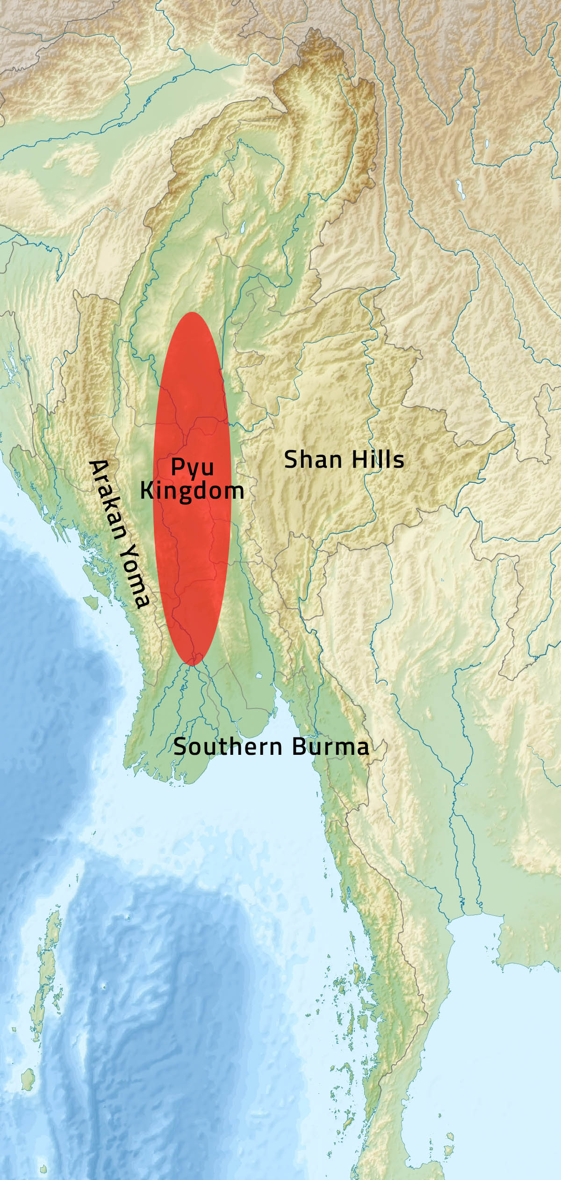
The 2 maps you will see illustrate two different theories about history.
OR

Slide 6
This map shows the walled Pyu sites
1 Thiyikittiya (Sri Ksetra)
2 Beikthano
3 Halin
4 Hmaingmaw (Mongmao)
5 Waddi
6 Bagan
}
}
1-3 Cities listed as a UNESCO World Heritage site
1 – 5 Pyu cities
Theory 1
People in ancient Southeast Asia organized themselves into small, independent cities that existed at different times

Slide 7
This map shows how some historians present the Pyu kingdom instead of individual cities.
Theory 2
People in ancient Southeast Asia organized themselves into large kingdoms containing many cities that lasted for thousands of years

Slide 8
Group work
Analyze some sources
Look for evidence for theory 1 or theory 2:
  Capitals or major cities
  Goods or artefacts found there
  Historians’ opinions
  Geography
  Where the Pyu lived.
Come to your own conclusion.

