Slide 1
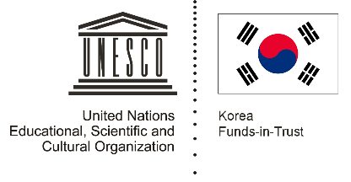
Unit 2: Early Centres of Power Lesson 3: What was the relationship between rulers and their subjects in ancient times?

Slide 2
A note to users of this presentation
This presentation was developed as complementary materials for teachers running this lesson. It follows the lesson plan.
It includes content from the lesson plans and the introductory essays for teachers’ lectures. It also introduces some of the activities suggested for students.
You are welcome to customize this presentation to adjust the lesson to their curriculum and to your students. You can change images, add/remove activities, and of course delete this slide, etc. The Teacher’s Guide (https://sharedhistories.asia/teacher/) provides guidance on how to adjust the lessons.
We wish you a successful lesson!
The Southeast Asian Shared Histories project was developed by UNESCO Bangkok with funding from the Republic of Korea.

Slide 3
PROTECT
PUNISH
?
If you were the ruler of a country, how would you make sure that the people followed your orders? Would you threaten to punish them, or would you promise to protect them?

Slide 4
Kings and queens in ancient times faced this question as well.
Some promised to protect, some threatened to punish, and some did both.

Slide 5
Let’s learn new words
Viceroy
Regent
Treacherous
Skipper
Solemn
Oath
Invert
Covenant, Pact
Subject

Slide 6
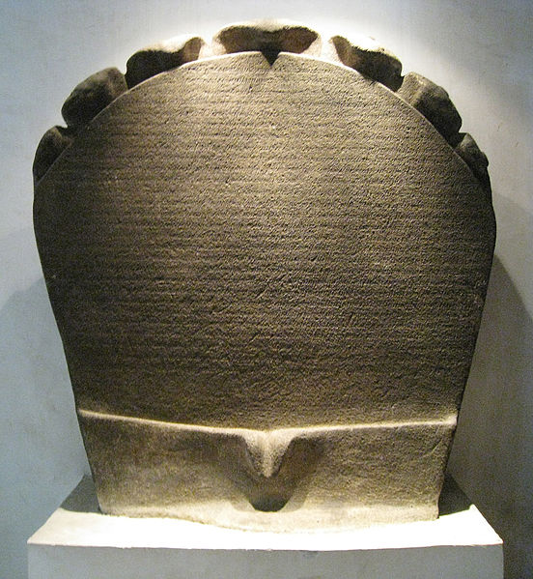
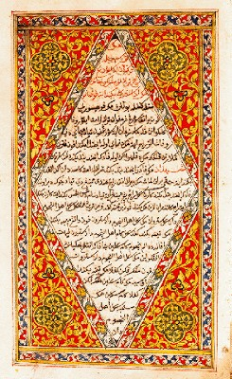
Let’s look at some sources
Telaga Batu inscription, Srivijaya Sidhayatra inscriptions
Jawi edition of the Malay Annals
Source: https://commons.wikimedia.org/wiki/File:Telaga_Batu_inscription.JPG
Source:
https://en.wikipedia.org/wiki/Malay_Annals

Slide 7
Which method—protect or punish—was used in Srivijaya and the Sultanate of Melaka?
PROTECT
PUNISH

