Slide 1


Unit 2: Early Centres of Power
Lesson 2: How were ancient polities organized?

Slide 2
A note to users of this presentation
This presentation was developed as complementary materials for teachers running this lesson. It follows the lesson plan.
It includes content from the lesson plans and the introductory essays for teachers’ lectures. It also introduces some of the activities suggested for students.
You are welcome to customize this presentation to adjust the lesson to their curriculum and to your students. You can change images, add/remove activities, and of course delete this slide, etc. The Teacher’s Guide (https://sharedhistories.asia/teacher/) provides guidance on how to adjust the lessons.
We wish you a successful lesson!
The Southeast Asian Shared Histories project was developed by UNESCO Bangkok with funding from the Republic of Korea.

Slide 3
Think – Pair - Share
?
In ancient times, do you think the same countries existed that exist today?
Why or why not?

Slide 4
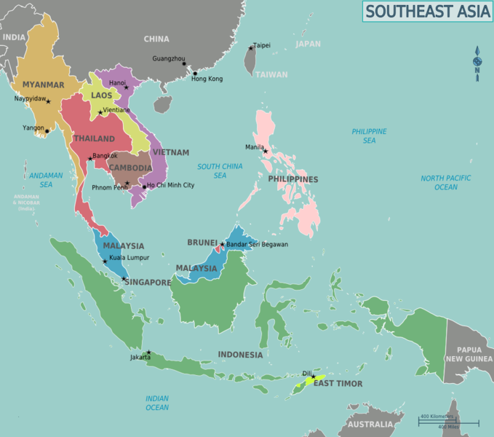
Southeast Asia today

Slide 5
Our country today
Our country has the current borders since …. because….
Replace by map of your country
  Even before that, groups of people with similar cultures and languages lived in the area for a long time, but they organized themselves differently than we do today.

Slide 6
Citizens of ..?
  Cities, villages, or kingdoms instead of countries.
  There were no official borders like we have today.
  People identifies themselves as citizens of a village, a city or followers of a leader, not as citizens of a country.

Slide 7
Citizens of ..?
  Fewer people living in Southeast Asian than today. Most of the land was unoccupied.
  Rulers had to compete with each other to gain the loyalty of the villagers living in surrounding areas.
  They collected "tribute" from the villagers, which they used to run their kingdom. In exchange for tribute, the rulers promised to protect the villagers (or punish them if they didn't give tribute).

Slide 8
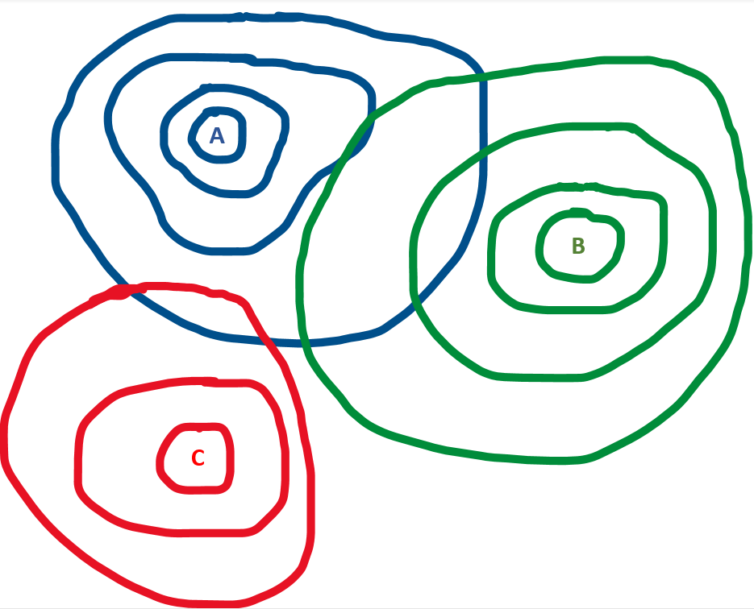
Mandala kingdom
  Historians compare ancient Southeast Asian kingdoms to mandalas.
  King or queen at the centre
  ⬇
  surrounded by ministers
  ⬇
  surrounded by officials
  ⬇
  surrounded by villagers

Slide 9
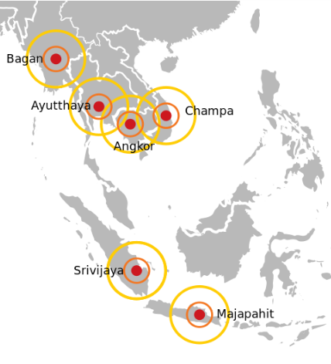
Mandala kingdom
  The size and shape of the kingdom changed depending on how well the king or queen could convince people to pay tribute and be loyal to him or her.

Slide 10
Mandala Kingdom Role Play
  Read your card.
  King/Queen A should sit in a chair in the middle of the left side of the room.
  Soldier A should stand behind the chair.
  King/Queen B should sit in the middle of the right side of the room.
  Soldier B should stand behind the chair.
  Ministers should stand in a circle around their king/queen
  Officials should stand in a circle around the ministers.
  Villagers should fill in the rest of the space in the room.
  Note: at the start of the game, the villagers are not linked to King/Queen A nor to King/Queen B.

Slide 11

Mandala Role Play: initial set-up
Villager
Villager
Official A3
Official A1
Minister A1
King/Queen A
Minister A2
Official A2
Soldier A
Official A4
Villager
Villager
Villager
Villager
Villager
Villager
Official B4
Soldier B
Official B1
Minister B1
King/Queen B
Minister B2
Official B2
Official B3
Villager
Villager

Slide 12
Rules
The goal of each king/queen is to collect the most rice for themselves. But first, they must provide one bag of rice for each of their officials and ministers, and for their soldier. The amount of rice the king/queen has will be counted at the end of the role play.
The king/queen can only speak to the ministers and the soldiers.
The ministers can only speak to the king and the officials.
The officials can only speak to the ministers and the villagers.
The soldiers can only speak to the king/queen and the villagers. The soldiers can protect the villagers, or pretend to punish them. BUT the soldiers cannot move until they have eaten rice.
The officials need to convince the villagers to hand over their rice. They can offer benefits (such as protection from soldiers), or they can threaten the villagers (the soldiers will punish them).
The ministers need to convince the officials to collect rice from the villagers. But they may need to promise to let the officials keep some rice for themselves.
The kings need to convince the ministers to collect rice from the officials. But they may need to promise to let the ministers keep some rice for themselves.
The villagers need to keep at least one bag of rice for themselves, but they can choose to give the other bags as tribute to one king/queen, or to both. They can only speak to each other, to the officials, and to the soldiers.
All players should remain respectful and safe while acting out their roles. Players should only use words (e.g., "I will punish you if you don't give me your rice!") instead of actions (e.g., hitting other students).

Slide 13
Reflection 1
What was your role in the role play? How did you feel in this role?
Were you able to meet the goal that you were assigned? Why or why not?
What interactions did you have with other players? How did you feel about each of the other roles?

Slide 14
Reflection 2
Based on what you learned from the role play, why do you think the borders of the mandala kingdoms changed so frequently?
What strategies for collecting tribute do you think were more effective: promising to offer protection, or threatening punishment? Why?
How were mandala kingdoms different than countries today? How are they similar? Explain.

