Slide 1
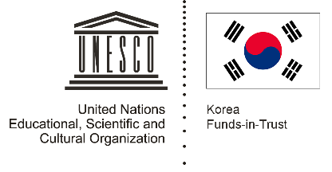

Unit 2: Early Centres of Power
Lesson 1: How did Bronze Age people interact in Asia

Slide 2
A note to users of this presentation
This presentation was developed as complementary materials for teachers running this lesson. It follows the lesson plan.
It includes content from the lesson plans and the introductory essays for teachers’ lectures. It also introduces some of the activities suggested for students.
You are welcome to customize this presentation to adjust the lesson to their curriculum and to your students. You can change images, add/remove activities, and of course delete this slide, etc. The Teacher’s Guide (https://sharedhistories.asia/teacher/) provides guidance on how to adjust the lessons.
We wish you a successful lesson!
The Southeast Asian Shared Histories project was developed by UNESCO Bangkok with funding from the Republic of Korea.

Slide 3
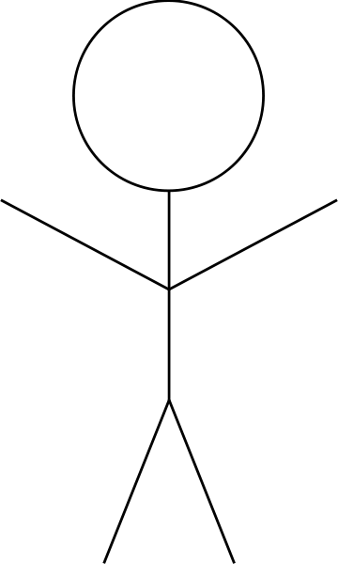
What are your 3 most prized possessions?
Why are these items valuable to you?
1 ?
What is it?
What is it made from?
Where does it come from?
2 ?
3 ?

Slide 4
We collect objects that have special value to us. Ancient people also did so.
?
What objects do you think had value
to ancient people?

Slide 5
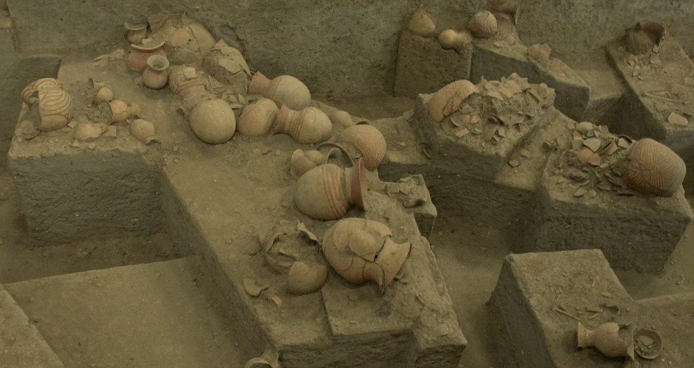
Ancient graves
Archaeologists study which objects ancient people valued partly by examining their graves.
The "grave goods" (goods buried with them) can provide important historical evidence about:
A person’s position in the community
What was important to people in this community
How cultures interacted
Trade
Source: Steve, https://de.wikipedia.org/wiki/Datei:Ban_Chiang_excavations.jpg

Slide 6
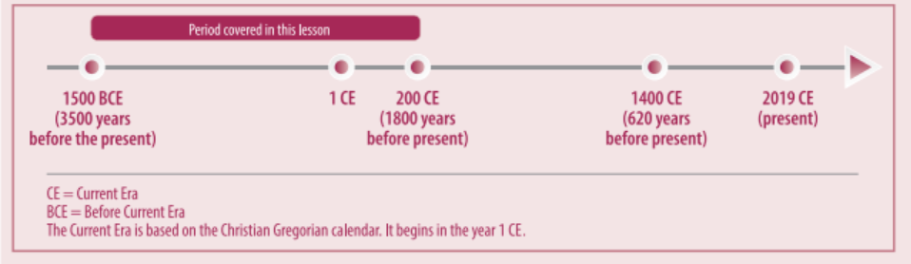
The Bronze Age

Slide 7
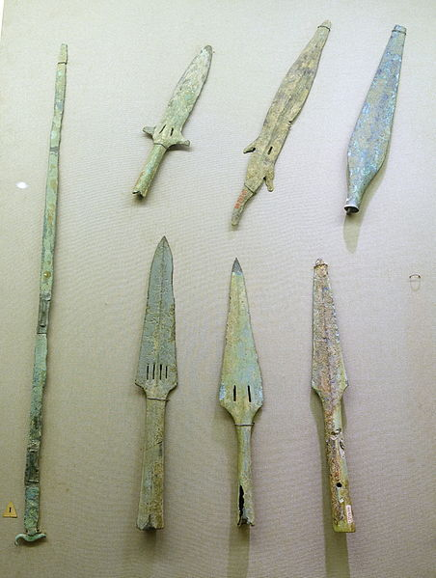
The Bronze Age
Spears and short swords, Dong Son culture
Historians call this time period the Bronze Age because people started making objects out of bronze.
Source: Daderot, https://commons.wikimedia.org/wiki/File:Spears_and_short_swords,_Dong_Son_culture,_bronze_and_iron_-_National_Museum_of_Vietnamese_History_-_Hanoi,_Vietnam_-_DSC05488.JPG

Slide 8
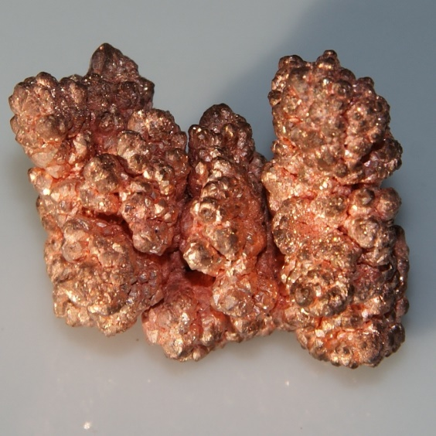
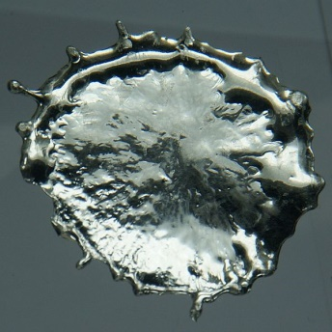
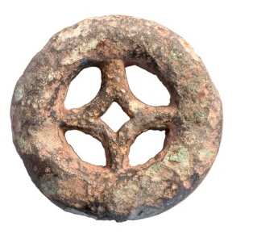
What is bronze?
A metal that is made of copper and tin.
Harder and stronger than copper or tin alone.
Easier to shape than stone.
Some historians believe that Chinese traders taught Southeast Asian people the process for making bronze.
Copper + (up to 25%) tin
Bronze
Sources:
https://commons.wikimedia.org/wiki/File:Copper_crystals.jpg
https://commons.wikimedia.org/wiki/File:Tin-2.jpg
https://upload.wikimedia.org/wikipedia/commons/3/31/Late_Bronze_Age_-_Early_Iron_Age%2C_Miniature_Wheel_Votive_Model_%28FindID_152129%29.jpg

Slide 9
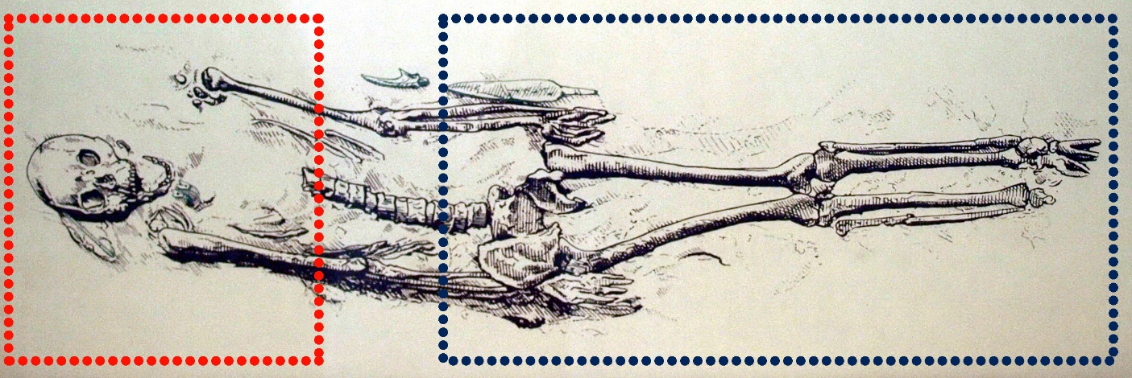
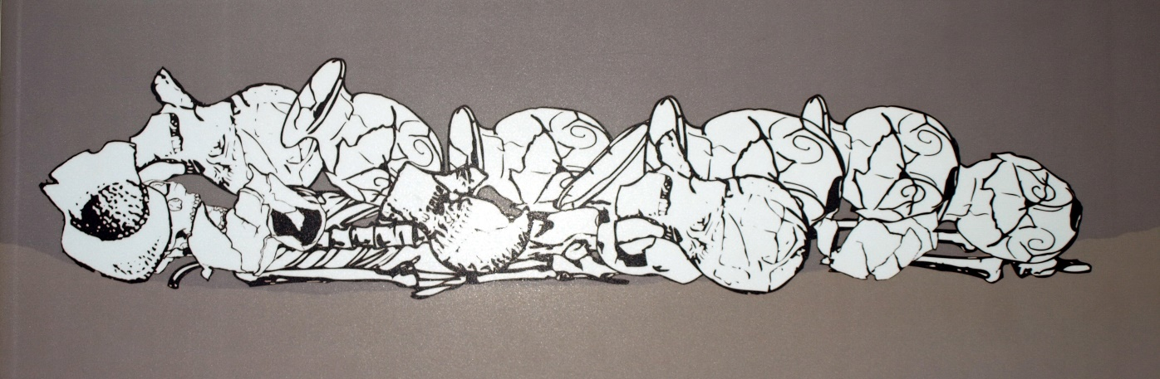
Group work : Analysis of burial sites

Slide 10

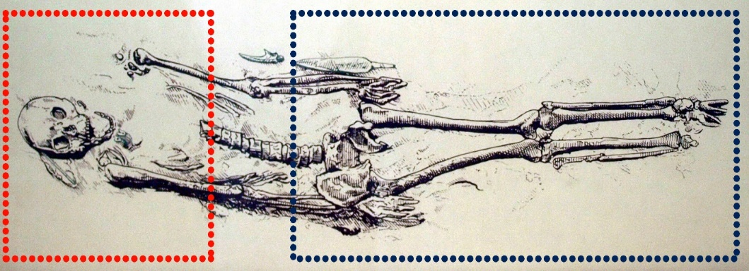
Group work : Analysis of burial sites
What objects are buried with this person?
Why were these objects buried with this person?
What materials did they need to make these objects?
Where did they get these materials?

Slide 11
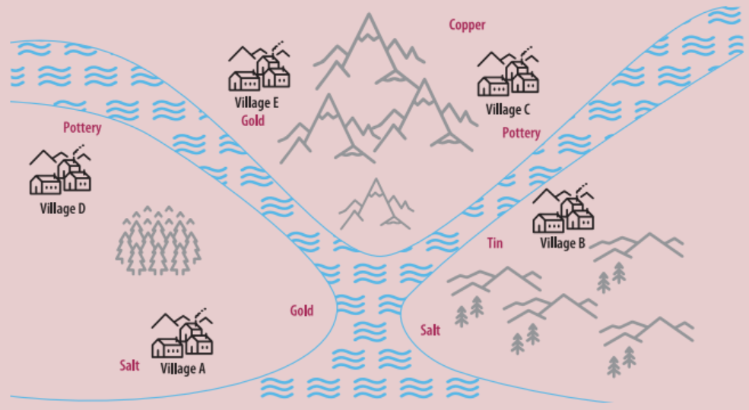
Group work: Mapping activity
What resources do you see on the map?
Identify the resources you have, those you need and how to get them.

Slide 12
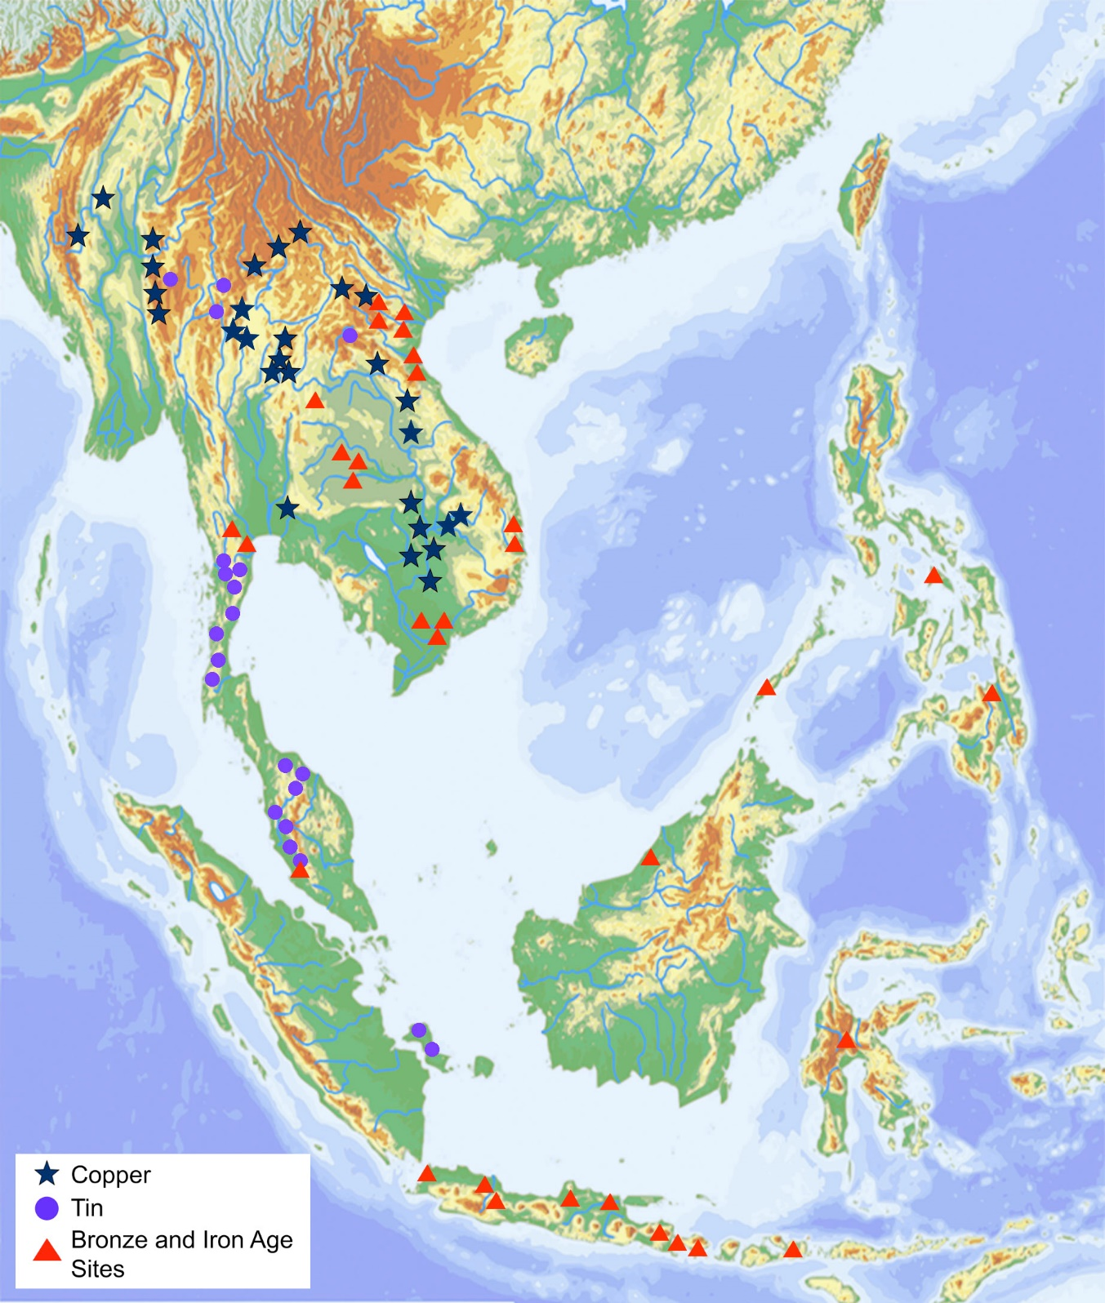
What resources are there?
What is near / far from where we live?
What challenges would we have in getting these resources?

