Slide 1
Unit 1: People and Places
Lesson 6: Living on the coastlands:
The case of the Sama-Bajau in the Coral Triangle

Slide 2
A note to users of this presentation
This presentation was developed as complementary materials for teachers running this lesson. It follows the lesson plan.
It includes content from the lesson plans and the introductory essays for teachers’ lectures. It also introduces some of the activities suggested for students.
You are welcome to customize this presentation to adjust the lesson to their curriculum and to your students. You can change images, add/remove activities, and of course delete this slide, etc. The Teacher’s Guide (https://sharedhistories.asia/teacher/) provides guidance on how to adjust the lessons.
We wish you a successful lesson!
The Southeast Asian Shared Histories project was developed by UNESCO Bangkok with funding from the Republic of Korea.

Slide 3
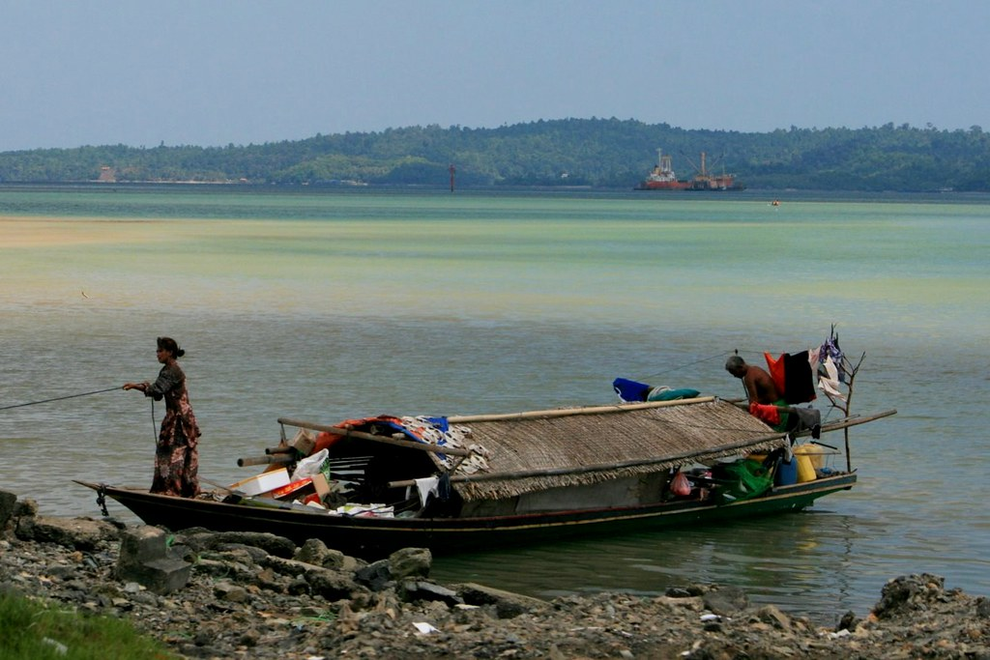
Source: Borneo Child Aid, https://www.flickr.com/photos/borneochildaid-org/4977105666/in/album-72157624799724459/

Slide 4
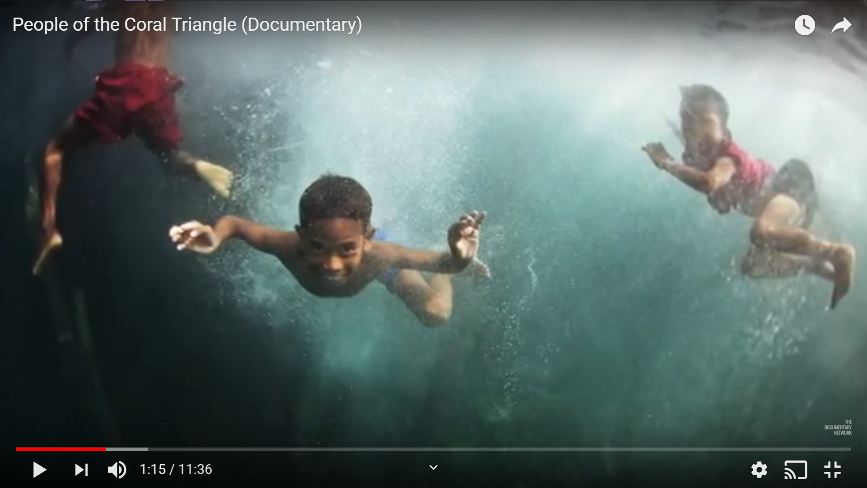
Video: People of the Coral Triangle
Source: © James Morgan, , https://www.youtube.com/watch?v=IwizKx4PCsQ

Slide 5
The Sama-Bajau in history
The Orang Laut (literally ‘sea people’) are a seafaring people who treat the sea as their primary living space.
The Bajau people go by many names – Orang Laut, Sama di Laut, Sea Nomads – yet they share similar languages that allow them to communicate and share a common identity as people of the sea.
16th and 19th centuries: the Orang Laut played a special role in the development of Southeast Asian port cities.
The Straits of Malacca were the most important highway for trade between the Middle East and from China. However, the waters were dangerous.
The Orang Laut knew the sea very well and helped guide ships across the different sections of the Straits, or upriver, in order to get them safely, for a price, to the desired port city.

Slide 6
The Sama-Bajau in history
Different groups of Orang Laut depending on their family relations, their relationships with port-cities, and the spaces within the seas where they came from.
Many served the sultan of a port city connected to their waters and islands. They acted as guides, rowers for a ruler's boat, sea soldiers, or as gatherers of sea products for trade in the ports.
Some groups did not serve a local leader. Some attacked ships for their cargo. Some Malay rulers hired them to raid the ships of competitors.
The success of an entrepôt (port city) depended on having an agreement with local Orang Laut so that ships would come to these ports safely and pay various taxes.

Slide 7
The Sama-Bajau nowadays
Nowadays, the Bajau depend on traditional fishing methods for their food and livelihoods.
The relationship that the Bajau peoples around Southeast Asia have with their various ocean ecosystems has shaped not only their daily practices but also their religious practices.
The Bajau base their fishing practices on their beliefs about the spirits who inhabit the environment around them and their knowledge of ocean ecosystems.
Large-scale overfishing, global warming and other practices are threatening several species in the Coral Triangle. These environmental changes have led to decreases in fish species that the Bajau rely on for their livelihoods

Slide 8
What is the Coral Triangle?
The Coral Triangle is a region located where the Western Pacific and Indian oceans meet.
a triangular shape.
5.5 million square kilometers of ocean
1.5 million square kilometers of land
It includes parts of the countries of Indonesia, Malaysia, the Philippines, Papua New Guinea, Timor Leste and the Solomon Islands.

Slide 9
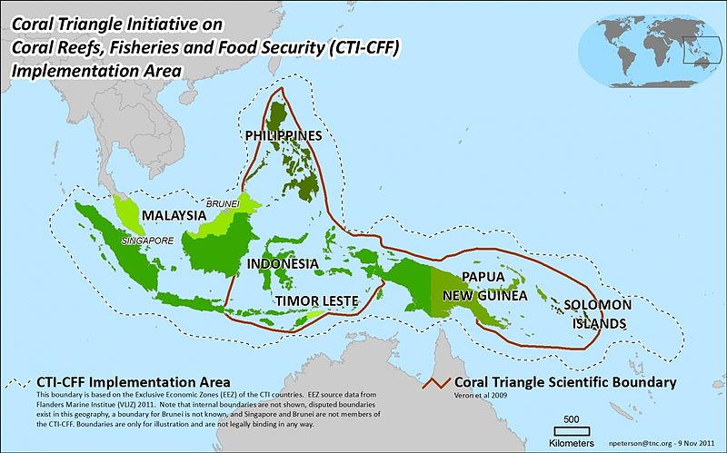
Source: https://commons.wikimedia.org/wiki/File:CT_Boundaries_Map_2011_Nov_9_Final_0.jpg

Slide 10
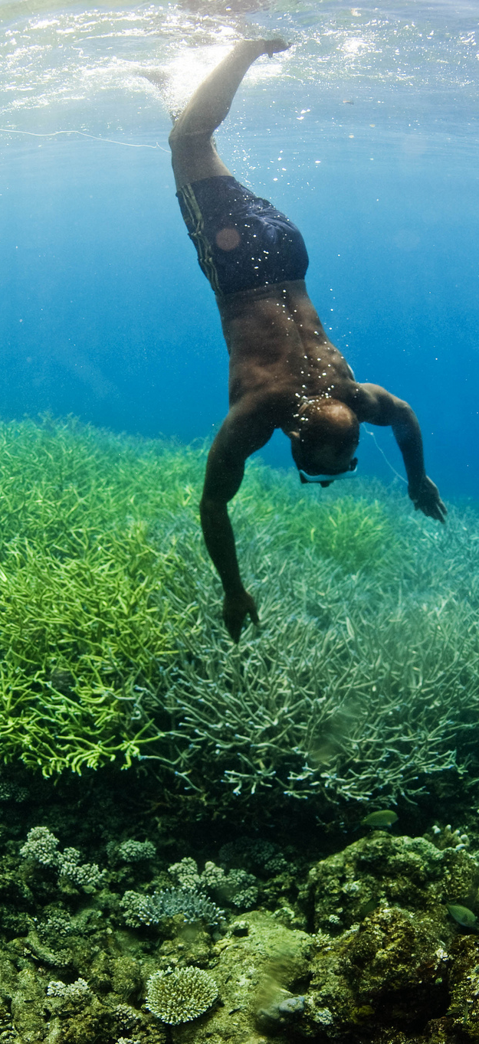
Coral triangle: a very rich biodiversity
600 different species of reef building coral
76% of the world’s coral reef species
2000 species of reef fish
75% of the world’s marine mammal species.
habitat for six of the world’s seven species of sea turtles
largest proportion of mangrove forest on the planet.
It is estimated that over 120 million people today depend on the marine resources in the region for their livelihoods.
© USAID CTSP/James Morgan
https://www.flickr.com/photos/usaidasia/8965496796

Slide 11
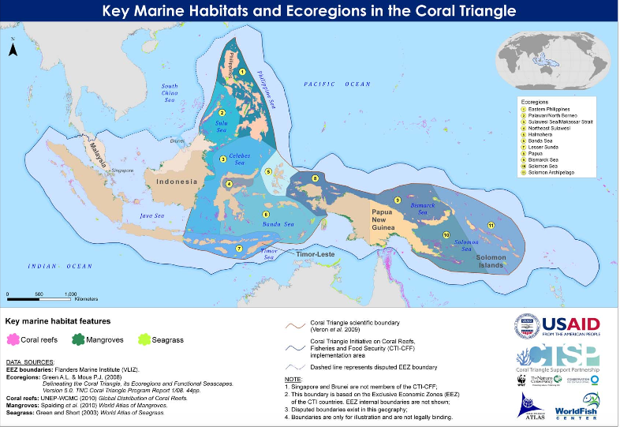
Source: http://ctatlas.reefbase.org

Slide 12
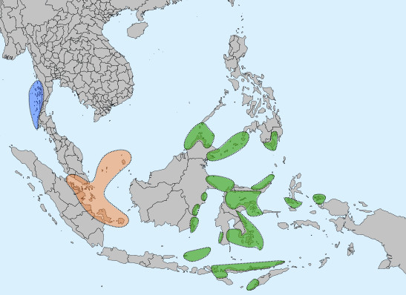
Sea nomads territories
Blue: Moken
Orange: Orang Laut
Green: Sama/Bajau
Source: https://commons.wikimedia.org/wiki/File:Sea_Nomads_distribution_map.jpg

Slide 13
Group activity: Maps comparison
Coral reefs Sea nomads territories Key marine habitats
  Identify the geographical areas where Bajau territories and the Coral Triangle Ecosystems overlap.
  List the oceans that Bajau/Sea Nomad territories cover
  List the countries those ocean territories are bordered by.

Slide 14
Role play: Taking perspectives
Group 1
People who live on the sea, in a boat
Group 2:
People who live on land, in a house
  Where would you want to live: on the coast or at sea?
  What is both similar and different about living in houses and living in houseboats?
  What are the advantages and disadvantages of living in houses along the coast or living in houseboats?

Slide 15
Closure / reflection
Our way of life, including our housing, is shaped by the environment we live in.
There are many commonalities, and some differences, in the way we live in coastlands, highlands and lowlands in the region

