Slide 1
Unit 1: People and Places
Lesson 5: West Coast Malay Peninsula: The case of the Kingdom of Melaka

Slide 2
A note to users of this presentation
This presentation was developed as complementary materials for teachers running this lesson. It follows the lesson plan.
It includes content from the lesson plans and the introductory essays for teachers’ lectures. It also introduces some of the activities suggested for students.
You are welcome to customize this presentation to adjust the lesson to their curriculum and to your students. You can change images, add/remove activities, and of course delete this slide, etc. The Teacher’s Guide (https://sharedhistories.asia/teacher/) provides guidance on how to adjust the lessons.
We wish you a successful lesson!
The Southeast Asian Shared Histories project was developed by UNESCO Bangkok with funding from the Republic of Korea.

Slide 3
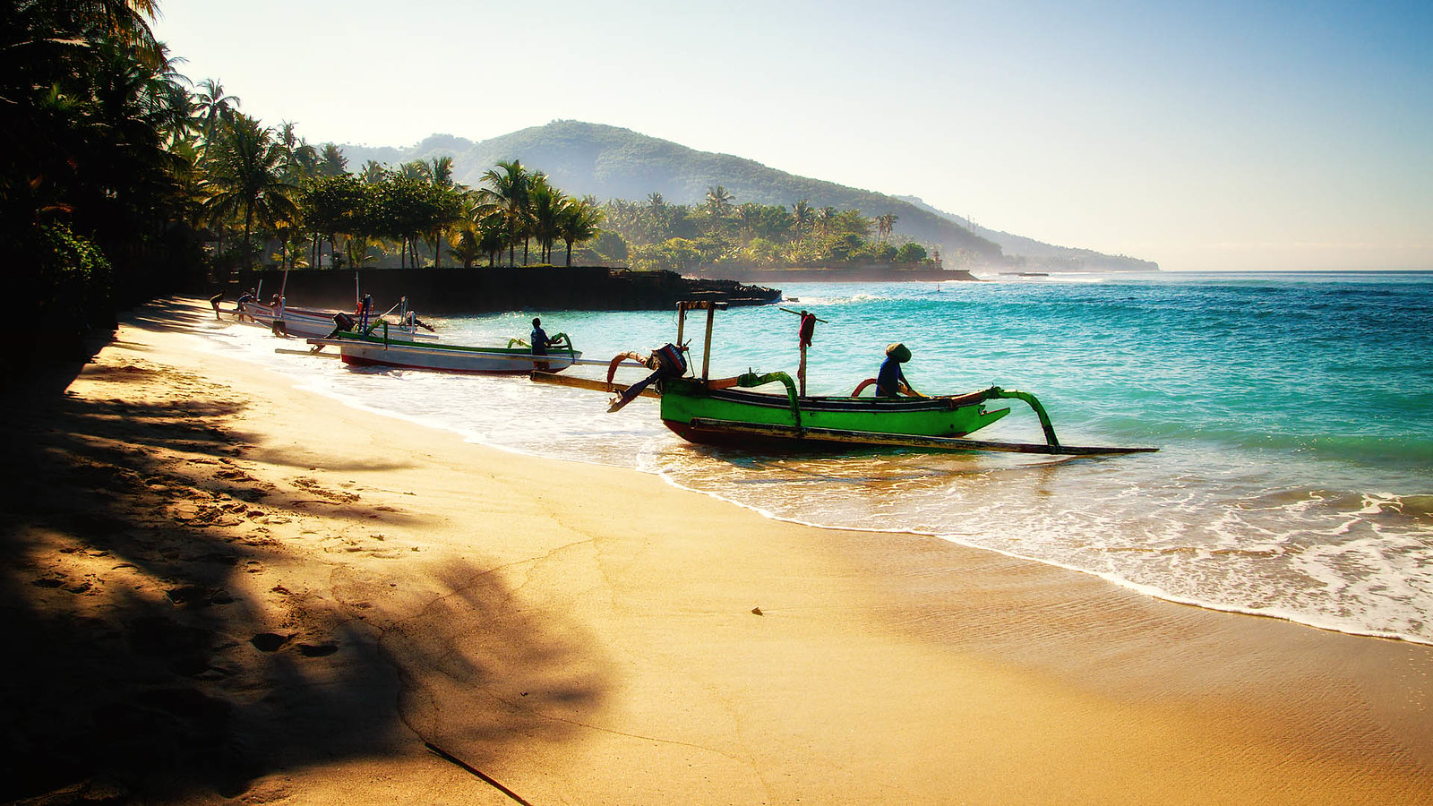
Coastlands
Any expanse of land near the sea
Source: Martin Fuhrmann, https://www.flickr.com/photos/martinfuhrmann/24068107063

Slide 4
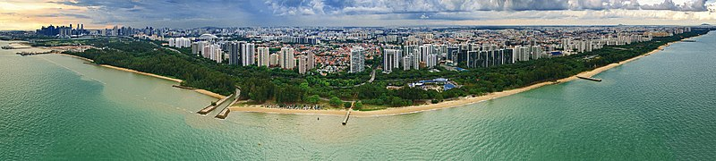
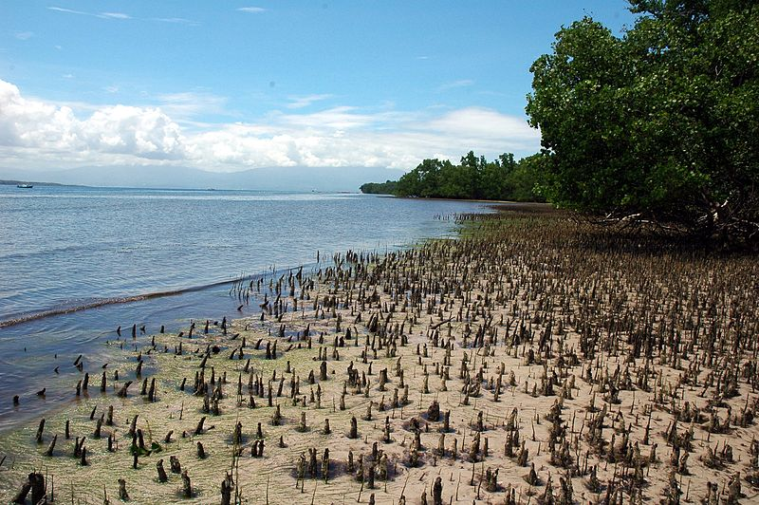
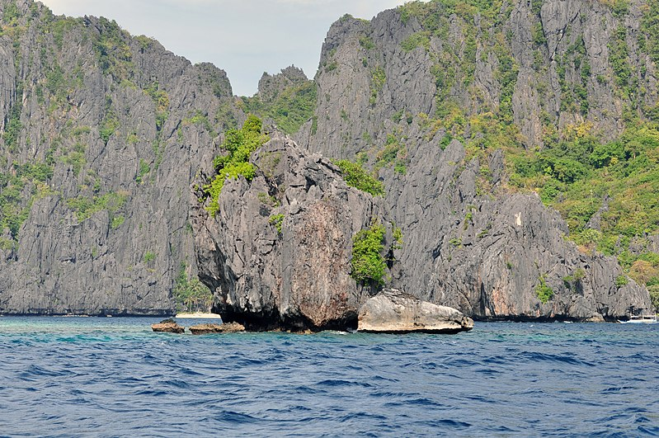
Coastlands in Southeast Asia
Sources:
Singapore's East Coast, wanderingchina, https://commons.wikimedia.org/wiki/File:Singapore%27s_East_Coast_from_the_Sky_-_panoramio.jpg
Bunaken Mangrove Coast, Indonesia, Jpatokal, https://commons.wikimedia.org/wiki/File:Bunaken_Mangrove_Coast.JPG
El Nido, Palawan, Philippines, Андрей Бобровский, https://commons.wikimedia.org/wiki/File:El_Nido,_Palawan,_Philippines_-_panoramio_(41).jpg

Slide 5
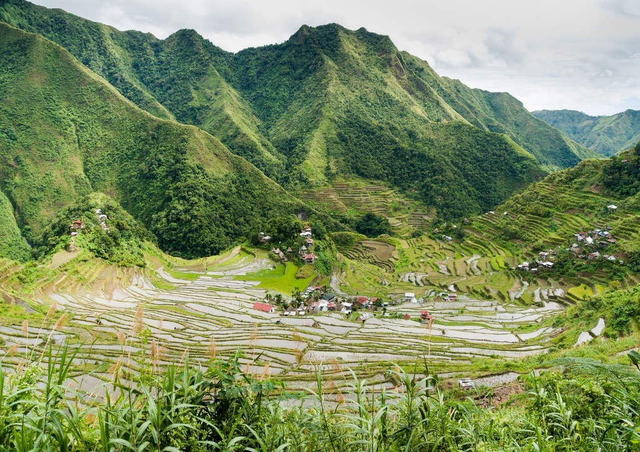

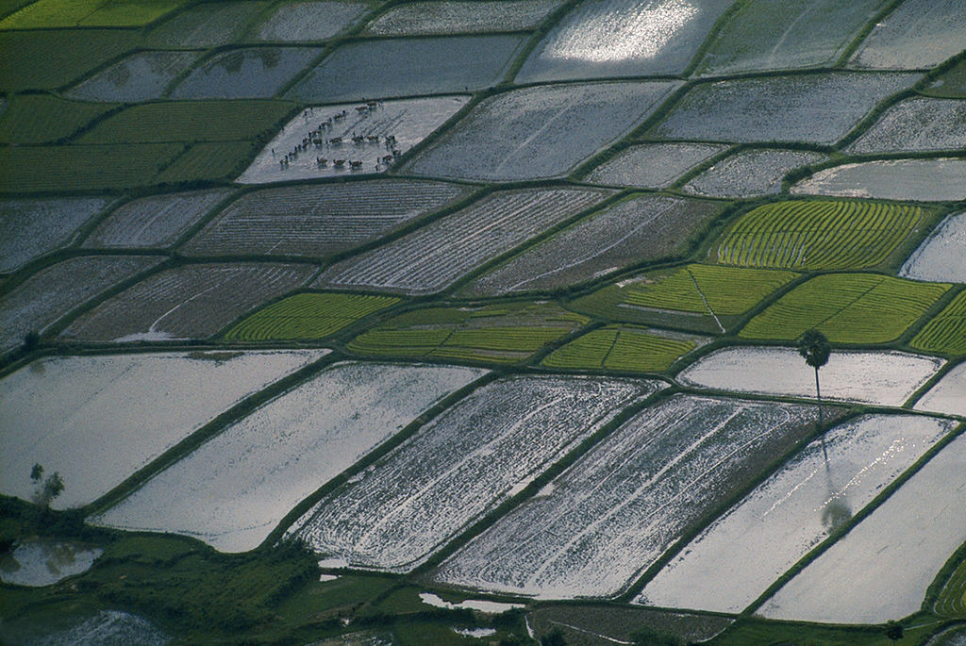
Highland, lowland, coastland
What photo represent coastland?
What do you see on this photo that makes you say it is coastland?
Sources:
Batad, Philippines
Aranas, Uwe, commons.wikimedia.org/wiki/File:Banaue_Philippines_Batad-Rice-Terraces-04.jpg
Mekong Delta, Viet Nam
Wilbur E. Garrett, https://www.flickr.com/photos/13476480@N07/17850359166
Bali, Indonesia
Martin Fuhrmann, https://www.flickr.com/photos/martinfuhrmann/24068107063

Slide 6
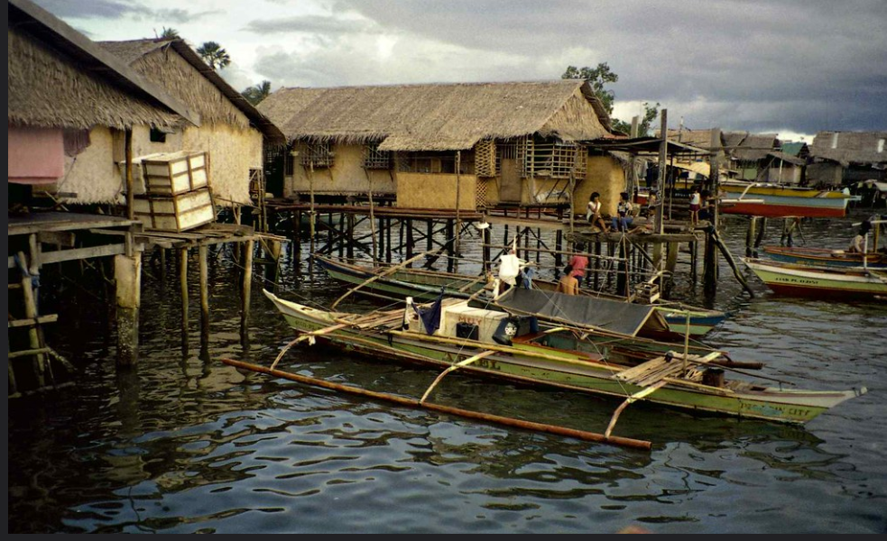
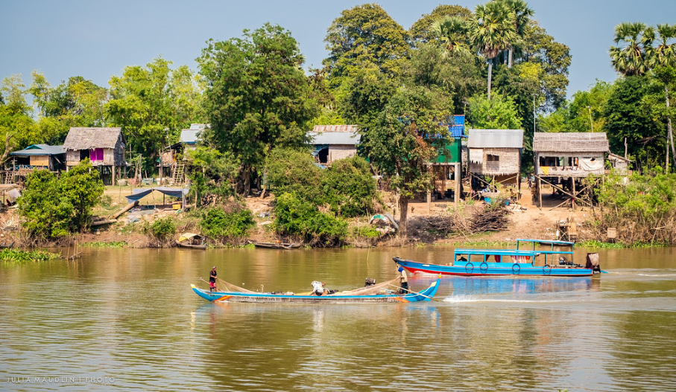
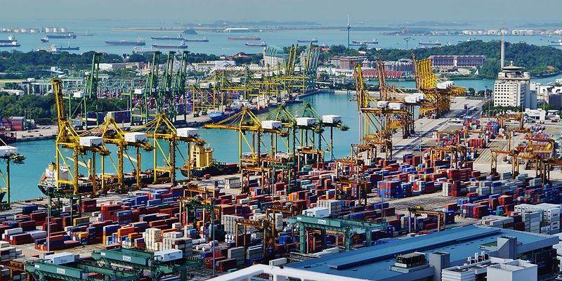
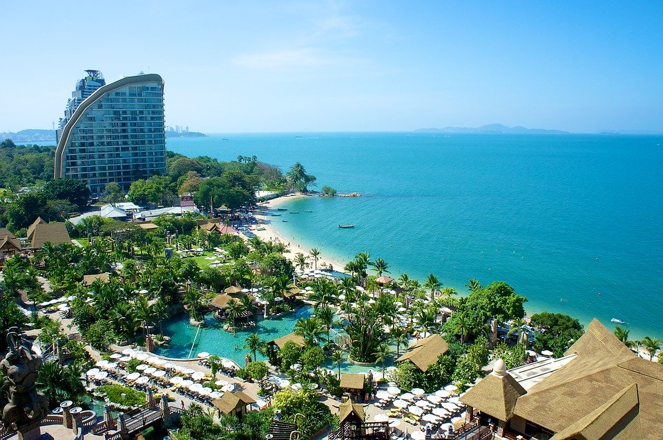
Communities in coastlands
Julia Maudlin
Fishing Village, Cambodia
Houses on Stilts; Puerto Princesa, Palawan, Philippines, Lon&Queta, https://www.flickr.com/photos/lonqueta/4260270482
Fisherman village, Cambodia, Julia Maudlin, https://www.flickr.com/photos/juliamaudlin/15138397311
Singapore port, https://commons.wikimedia.org/wiki/File:Singapore_Port_viewed_from_The_Pinnacle@Duxton_06.jpg
Holiday resort, Pattaya, Thailand, https://pixabay.com/de/photos/thailand-pattaya-3633993/

Slide 7
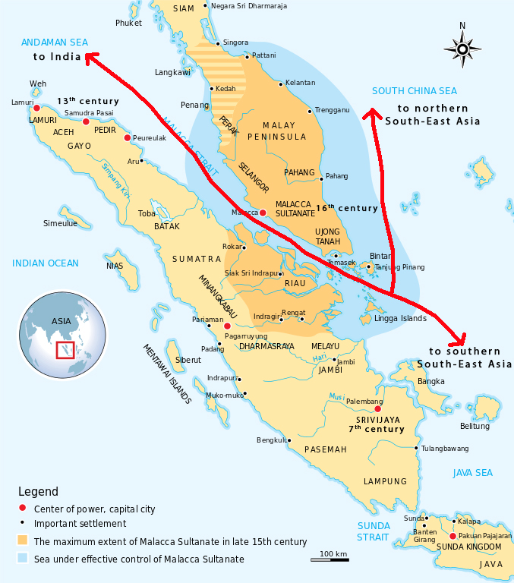
What do you see on the map?
Why did these types of coastal kingdoms come about?
Why do you think people settled along the coasts?
What did they do for a living?

Slide 8
Ancient trade routes through the Straits of Melaka.
This map shows major trading centres between the sixth and sixteenth centuries

Slide 9
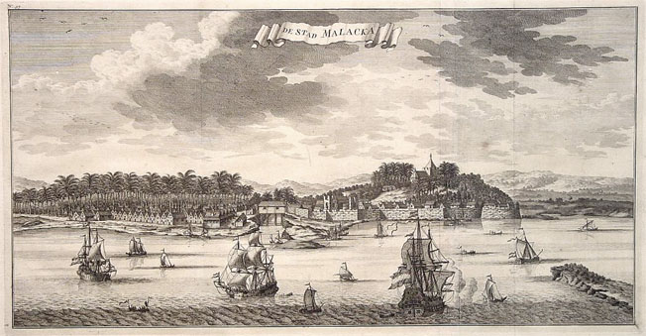
The class is going to focus on the development of one of these types of coastal settlements that would become a major port city in the region, Melaka.
Melaka in the 18th century
Source: https://commons.wikimedia.org/wiki/File:Antique_Map_Valentijn_Melaka.jpg)

Slide 10
Kingdom of Melaka
Located along the western coast of the Straits of Melaka.
Kingdom founded sometime in the early fifteenth century.
Many historians believe that Melaka was founded by a prince from Palembang, probably a descendant of the kings of Srivijaya.
The kingdom of Srivijaya was between the seventh and twelfth centuries one of the most important trading centres in Southeast Asia.
Oneof the major trading centres of the ancient world. → entrepôt.
Melaka Kingdom ended in 1511 when the Portuguese conquered.

Slide 11
The entrepôt
Entrepôt: a port city that grows into a center of political, economic and cultural life.
Products from within the region and from as far as the Middle East, India and China were exchanged.
Some entrepôts controlled other islands or port-cities, forming a type of sea-borne kingdom.
Other entrepôt cities were located at the mouth of a river and controlled what went up into the kingdom and what came out.
These cities were considered ‘global’. People from many different places, with different religions, languages and cultures met there. They exchanged their goods, their skills (shipbuilders, porters, moneylenders) and also ideas.

Slide 12
Trading as a strategy for power
Melaka was founded mainly as a trading centre between India and China.
It was very similar to many coastal trading centres of early Southeast Asia.
In Southeast Asia, population size was small. Rulers consider having followers as a sign of power.
The rulers of Melaka believe that the best way to attract followers was by being wealthy. They chose trading to expand their wealth.
In Melaka the ruler provided merchants with the facilities to conduct trade. Merchants paid a tax to the king.

Slide 13
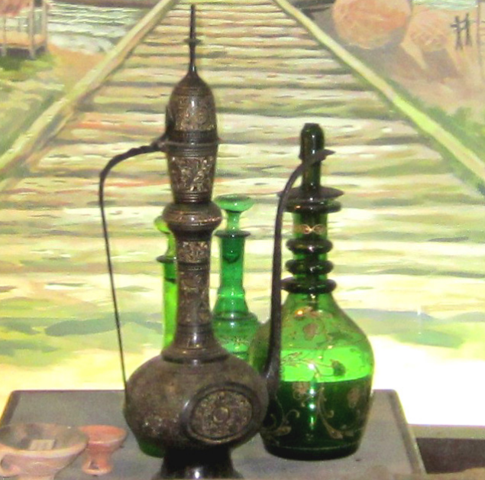
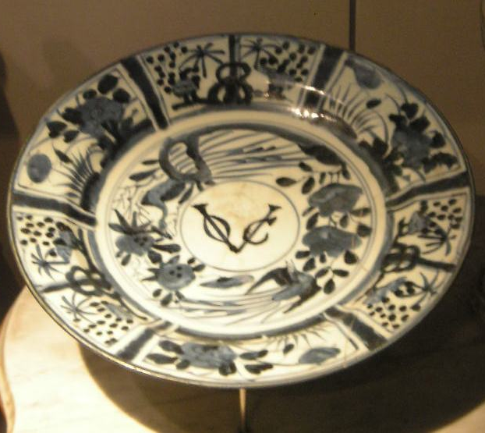
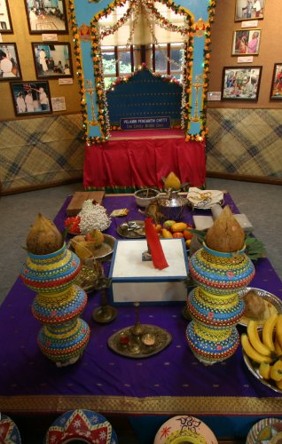
Group work
  Guess where these artefact came from.
  What does it tell us about Melaka and its place in Asian Trade?

Slide 14
Group work
Sources:
Arabic ceramic and glass containers displayed at Melaka Islamic Museum
Achilles, Vanessa
A plate (kraak porcelain) with VOC emblem, a part of Dutch heritage in Melaka
Gryffindor,commons.wikimedia.org/wiki/File:National_Museum_KL_2008_(34).JPG
South Asian containers for offerings displayed at Chitty Museum, Melaka
Tye, Timothy. www.penang-traveltips.com/malaysia/malacca/chitty-museum.htm

Slide 15
Population in Melaka
Goods and people came to Melaka from all parts of the world via these global trade networks.
They came from Europe, China, India and West Asia (Persians and Arabs).
These foreigners were mainly traders who bought and sold their goods in Melaka.
Peoples from other parts of Southeast Asia were probably present in Melaka.

