Slide 1
Unit 1: Peoples and Places
Lesson 4: Highland houses:
The case of honai and tongkonan

Slide 2
A note to users of this presentation
This presentation was developed as complementary materials for teachers running this lesson. It follows the lesson plan.
It includes content from the lesson plans and the introductory essays for teachers’ lectures. It also introduces some of the activities suggested for students.
You are welcome to customize this presentation to adjust the lesson to their curriculum and to your students. You can change images, add/remove activities, and of course delete this slide, etc. The Teacher’s Guide (https://sharedhistories.asia/teacher/) provides guidance on how to adjust the lessons.
We wish you a successful lesson!
The Southeast Asian Shared Histories project was developed by UNESCO Bangkok with funding from the Republic of Korea.

Slide 3
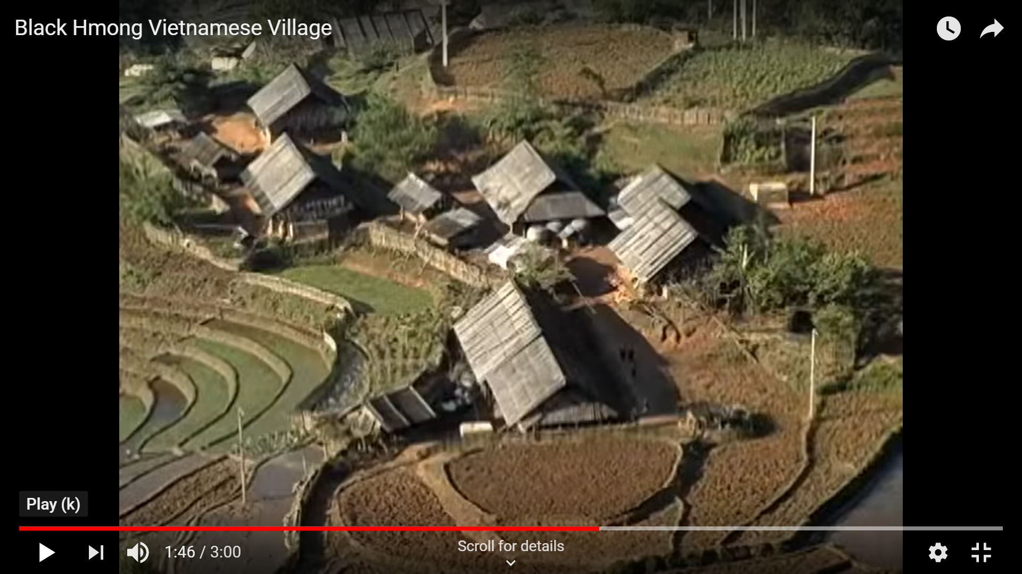
Have you seen such houses before?
Where do you think you can find this type of house?
https://www.youtube.com/watch?v=CYaEhcN7J_U

Slide 4
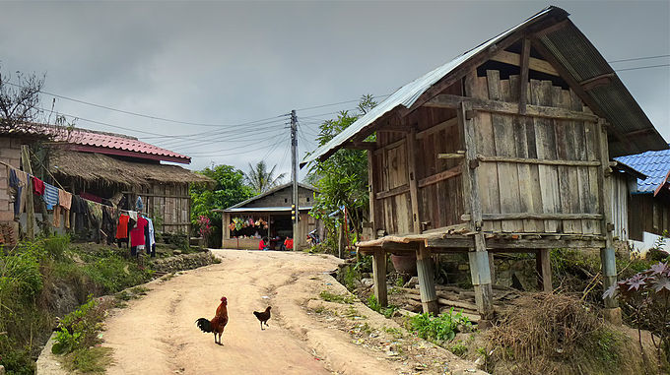
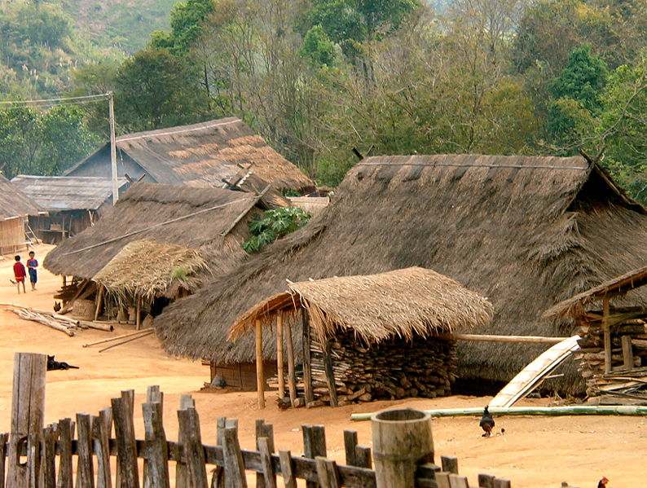
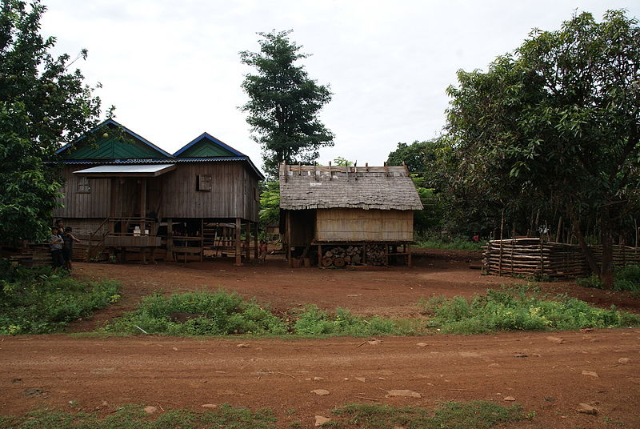
Similar houses are found in highlands across the region.
Muang Sing, Lao PDR
https://en.m.wikipedia.org/wiki/File:MuangSing_BanNamMay1_tango7174.jpg
Northern Thailand
https://commons.wikimedia.org/wiki/File:Akha_village.jpg
Ratanakiri province, Cambodia
https://commons.wikimedia.org/wiki/File:Ratanakiri_village.jpg

Slide 5
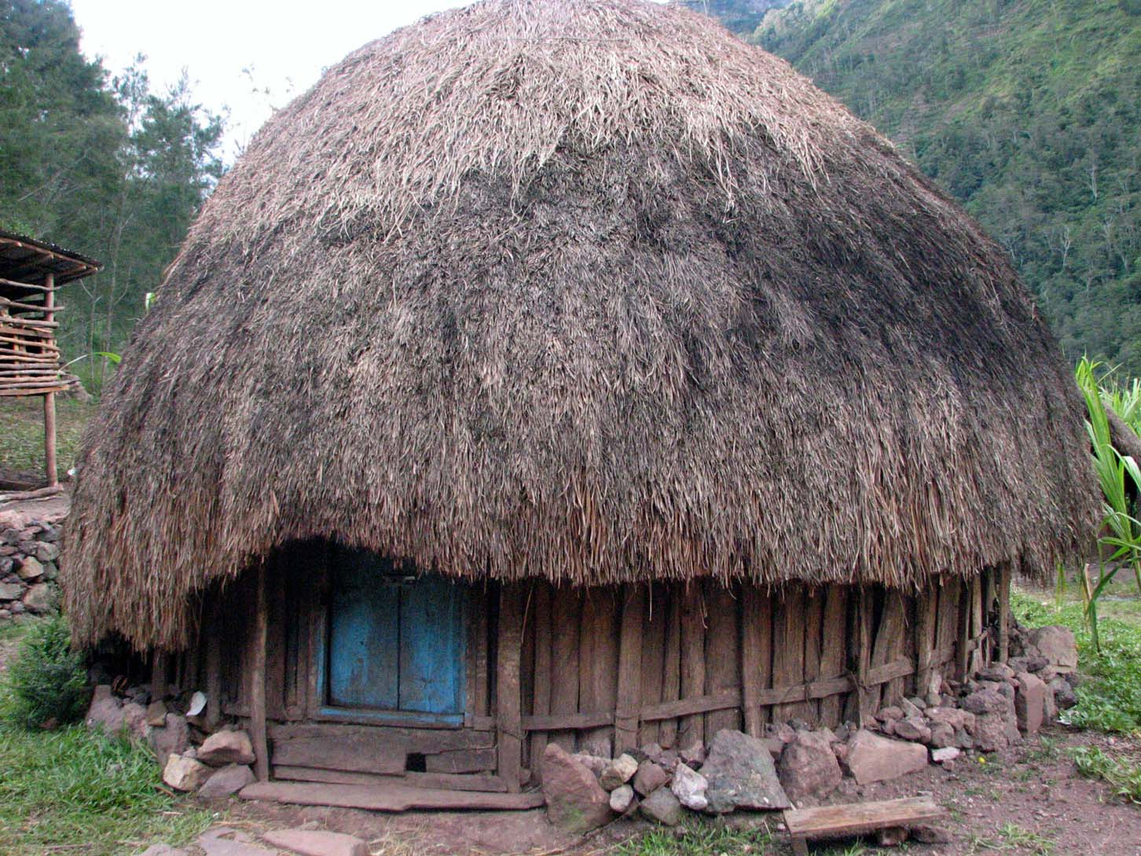
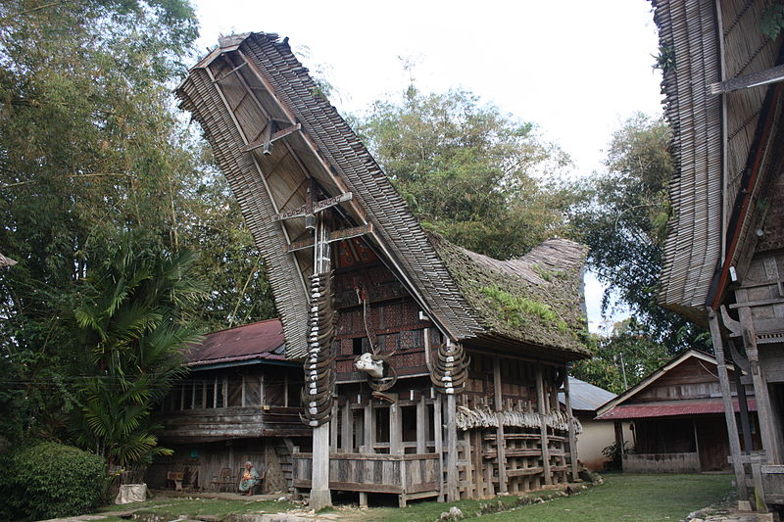
Group work
What do you notice about the structures in the picture?
What kind of characteristics do you notice about these structures?
What kind of materials do you think were used in the construction of these structures?
What do those materials tell you about the place or environment in which these people live in?
Honai
Tongkonan
Source: https://id.wikipedia.org/wiki/Berkas:Honai_Papua.jpg
Source: https://commons.wikimedia.org/wiki/File:Tana_Toraja,_Kete_Kesu,_tongkonan_(6823189476).jpg

Slide 6
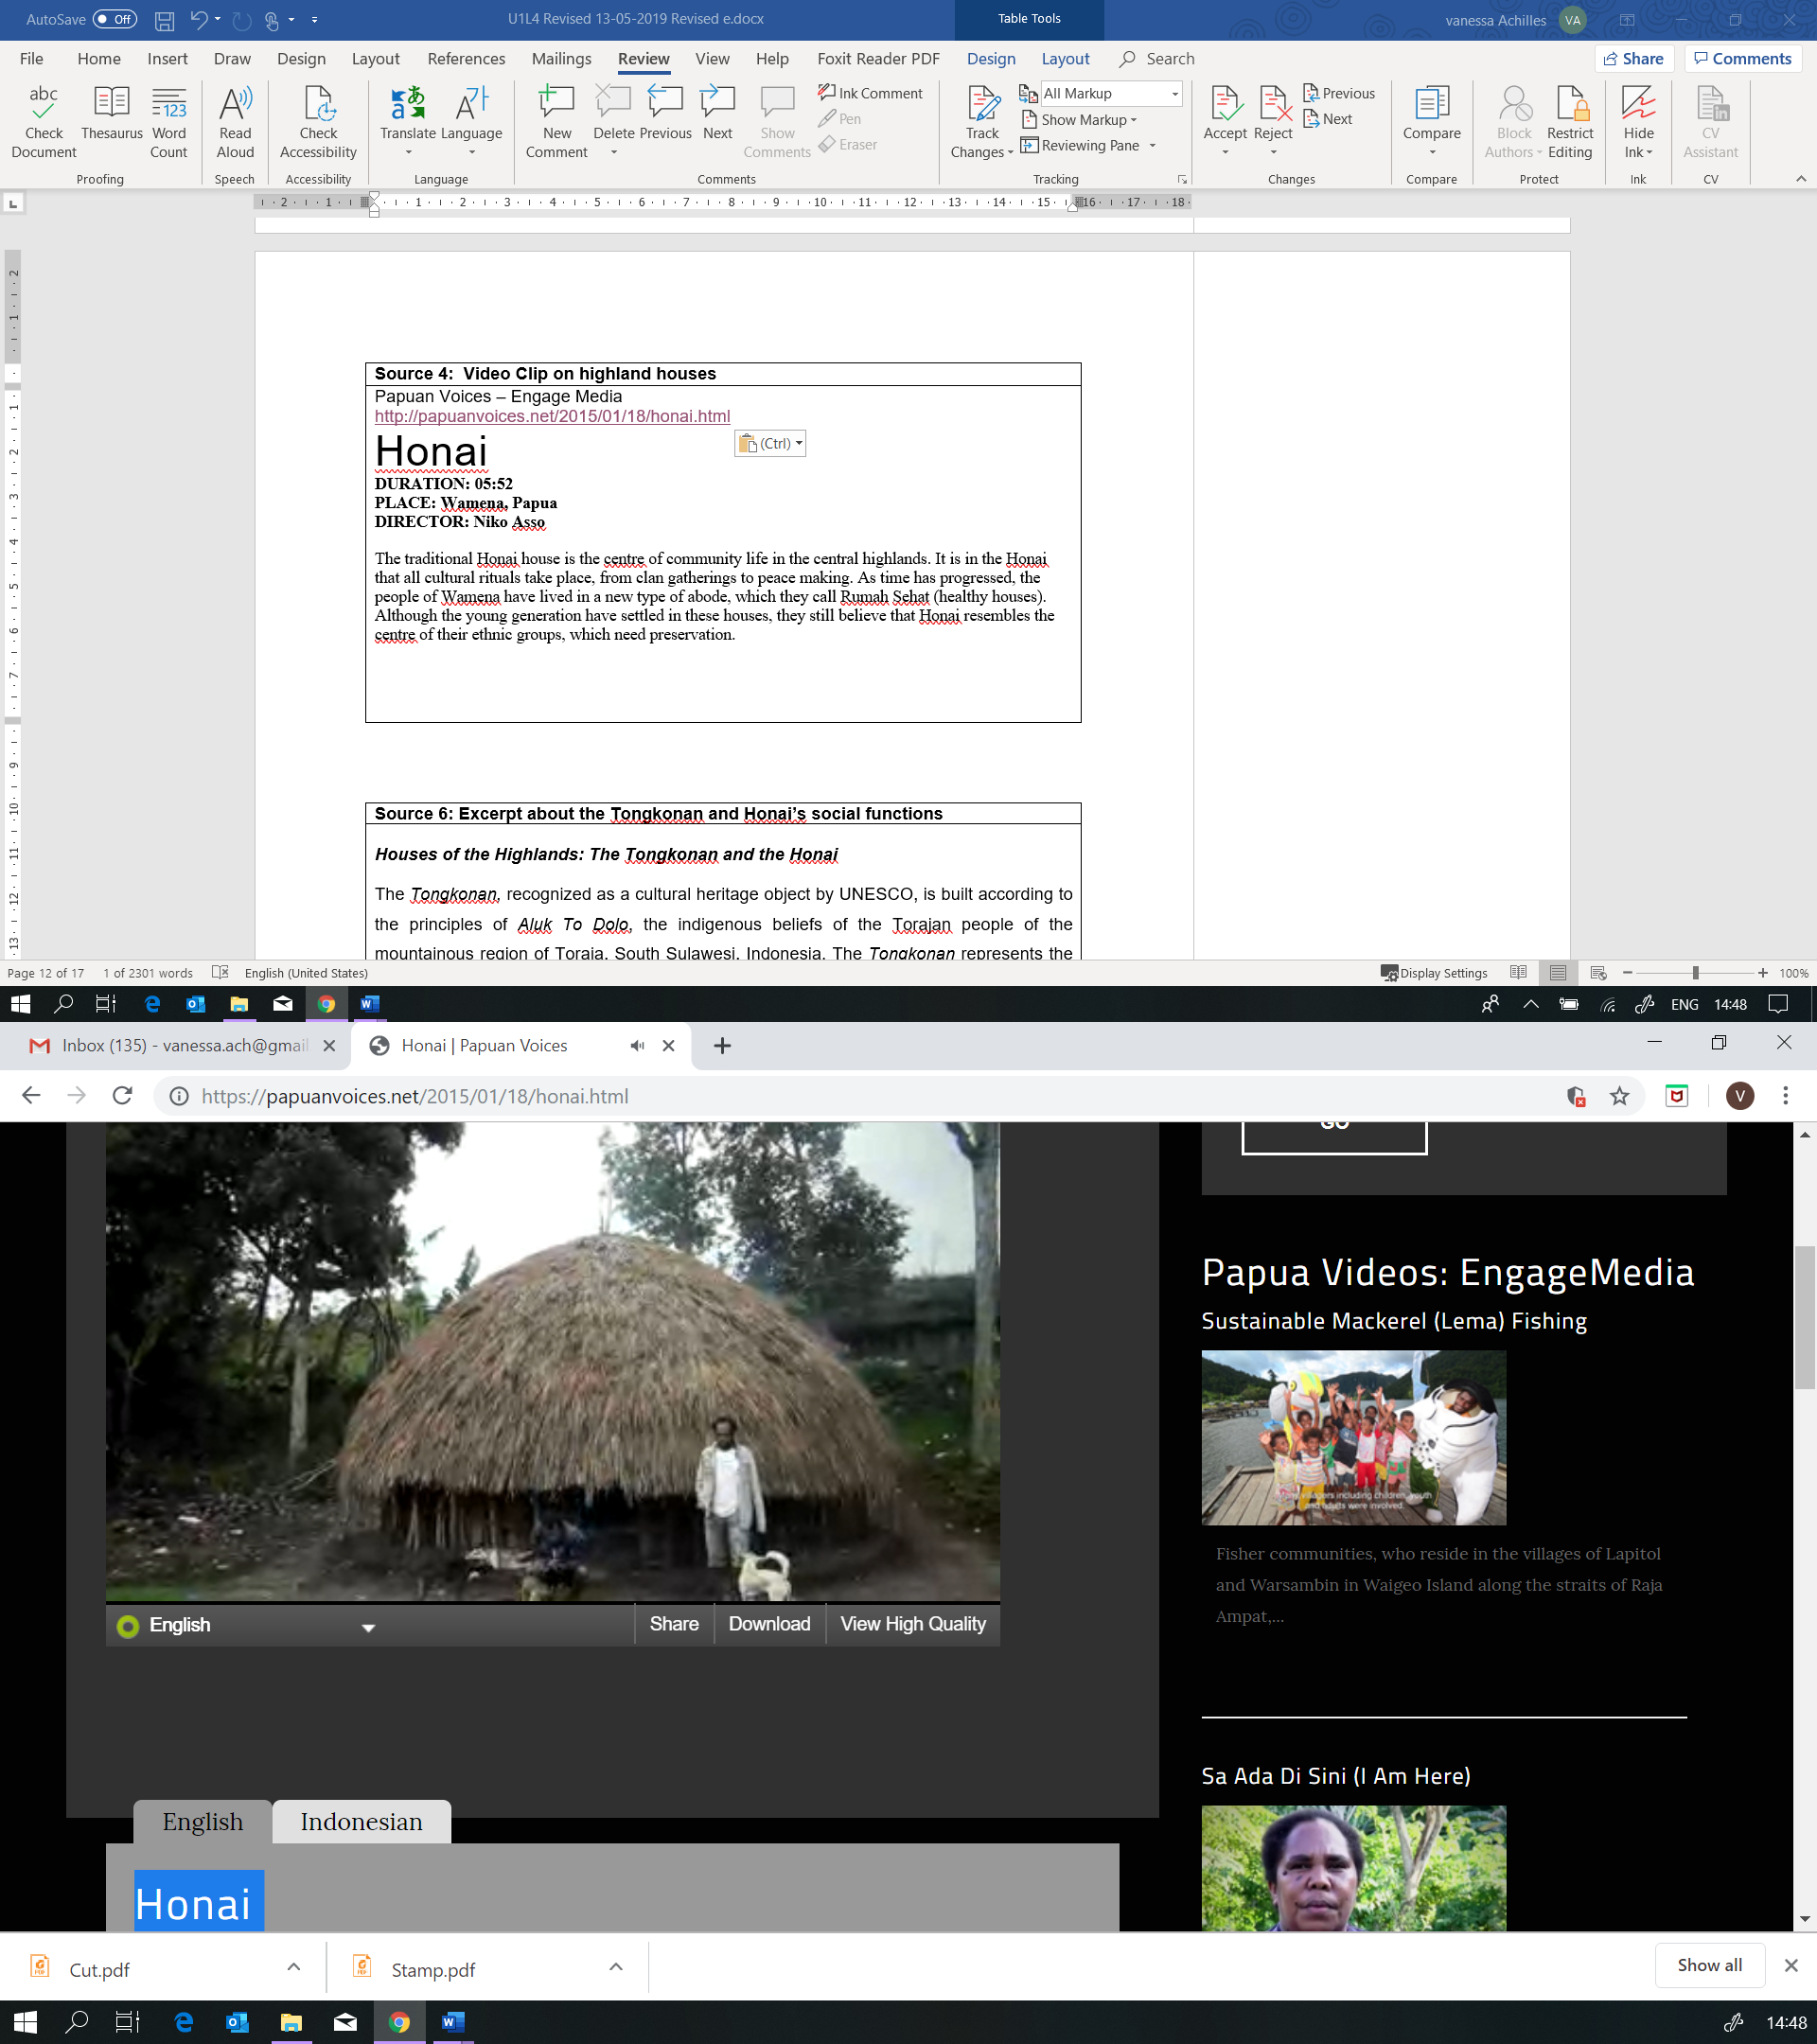
Video analysis: Honai
Watch the video.
Take note on 2 columns
How do the people in the video describe the honai ?
What is your responses, your reactions, to these descriptions.
http://papuanvoices.net/2015/01/18/honai.html

Slide 7
Are the people’s description similar to what you imagined when you watched the photos?
The way of life is similar in many highlands in many parts of the region.
Are the houses in our country’s highlands similar or different from these ones?

Slide 8

My future home
In your environment, what would be the best layout for your future home?
  What is each room in your home used for?
  Who uses the rooms in your house?
  What kind of materials were used to build your home?
  What kind of activities are done in your home or in certain rooms?
  How is your home a response to the environment?
List the rooms in your current homes
  what does each room express about what is important in your community?

Slide 9
Conclusion
Our way of life, including our houses,
are shaped by the environment we live in.

