Slide 1
Unit 1: Peoples and Places
Lesson 2: Way of life and wet rice agriculture in the lowlands:
The case of Java

Slide 2
A note to users of this presentation
This presentation was developed as complementary materials for teachers running this lesson. It follows the lesson plan.
It includes content from the lesson plans and the introductory essays for teachers’ lectures. It also introduces some of the activities suggested for students.
You are welcome to customize this presentation to adjust the lesson to their curriculum and to your students. You can change images, add/remove activities, and of course delete this slide, etc. The Teacher’s Guide (https://sharedhistories.asia/teacher/) provides guidance on how to adjust the lessons.
We wish you a successful lesson!
The Southeast Asian Shared Histories project was developed by UNESCO Bangkok with funding from the Republic of Korea.

Slide 3
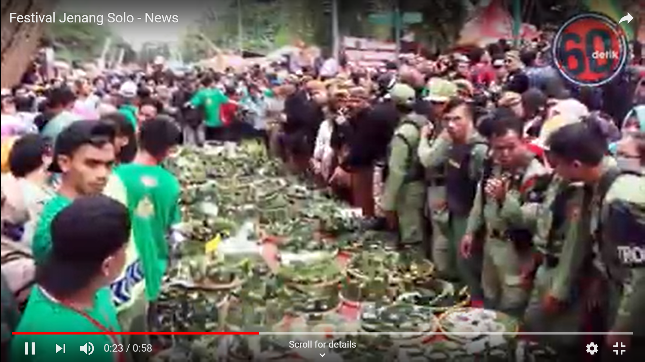
What do you see?
What do you think the festival is about?
Why do you think the festival is important to many communities in Southeast Asia?
Festival Jenang, Solo, Indonesia
Source: https://www.youtube.com/watch?v=6hT-6t-Y3OA

Slide 4
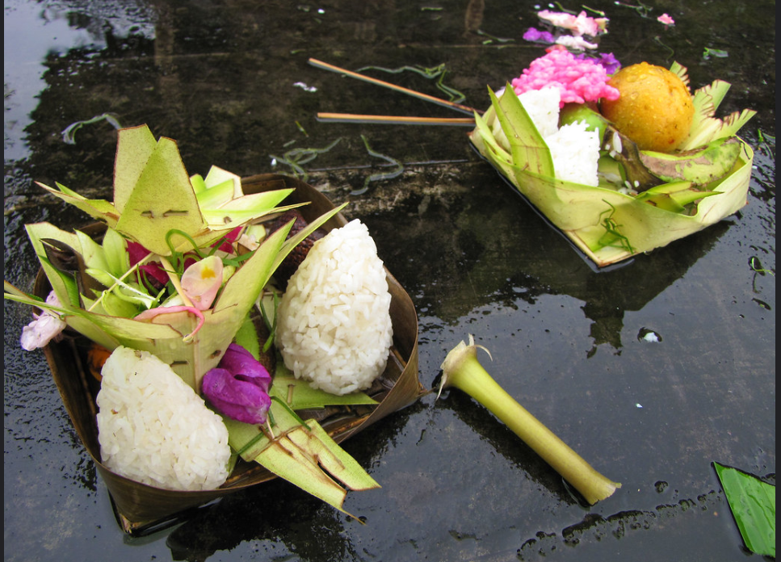
Rice festivals are celebrated in many parts of Southeast Asia.
Many communities in the lowlands are focused on agriculture.
Festivals and rituals associated with this activity have shaped their way of life.
Source: jo.schz, https://www.flickr.com/photos/joschz/4326405986/

Slide 5
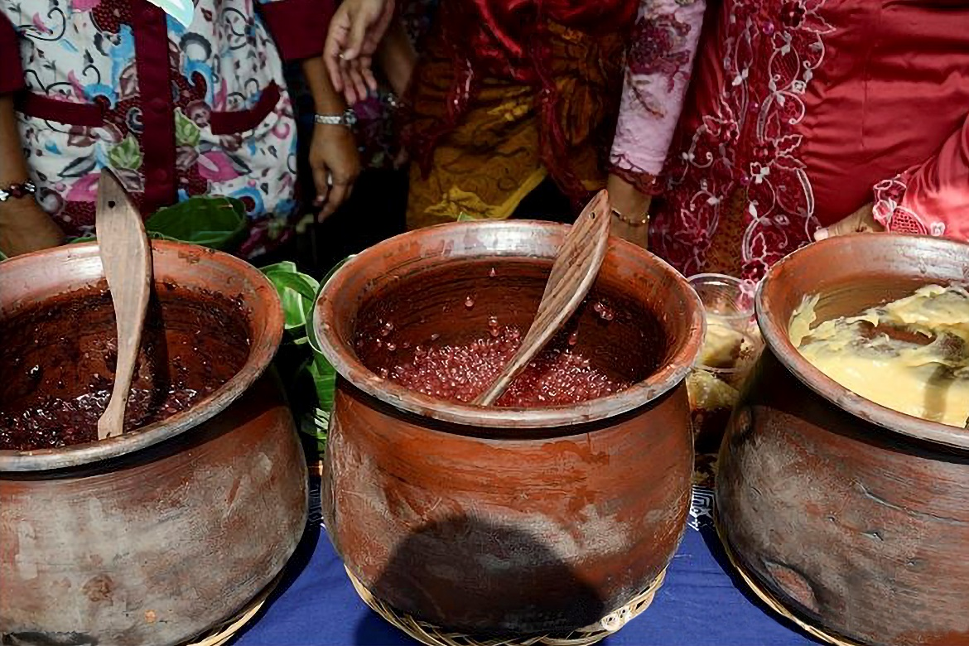
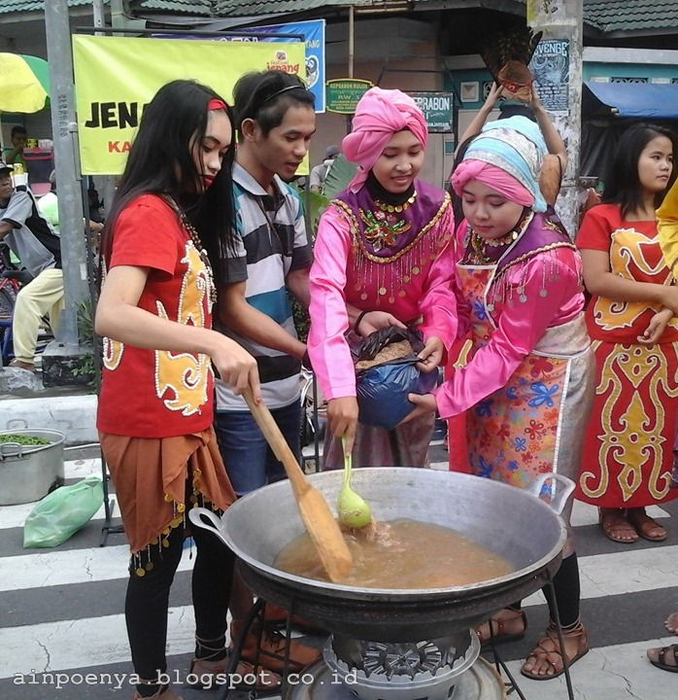
Group work: Artefact analysis
Draw out the artefact
Name the artefact
Jot down what you observe about the artefact
Guess what it is used for during the festival or ritual.
Sources:
RCPhotography, https://www.kompasiana.com/encear/54f33ff3745513a32b6c6d3f/kampretjebul3-festival-jenang-solo-2015#
Coretan Hana, https://www.ainahana.com/2016/02/serunya-festival-jenang-solo-2016.html

Slide 6
Group work: Artefact analysis
Serving pot Cooking pot
Sources:
RCPhotography, https://www.kompasiana.com/encear/54f33ff3745513a32b6c6d3f/kampretjebul3-festival-jenang-solo-2015#
Coretan Hana, https://www.ainahana.com/2016/02/serunya-festival-jenang-solo-2016.html

Slide 7
There are many similarities in the artefacts and rituals carried out during harvest festivals across the region.
Some rituals differ across the region with the influence of religion and other factors over time.

Slide 8
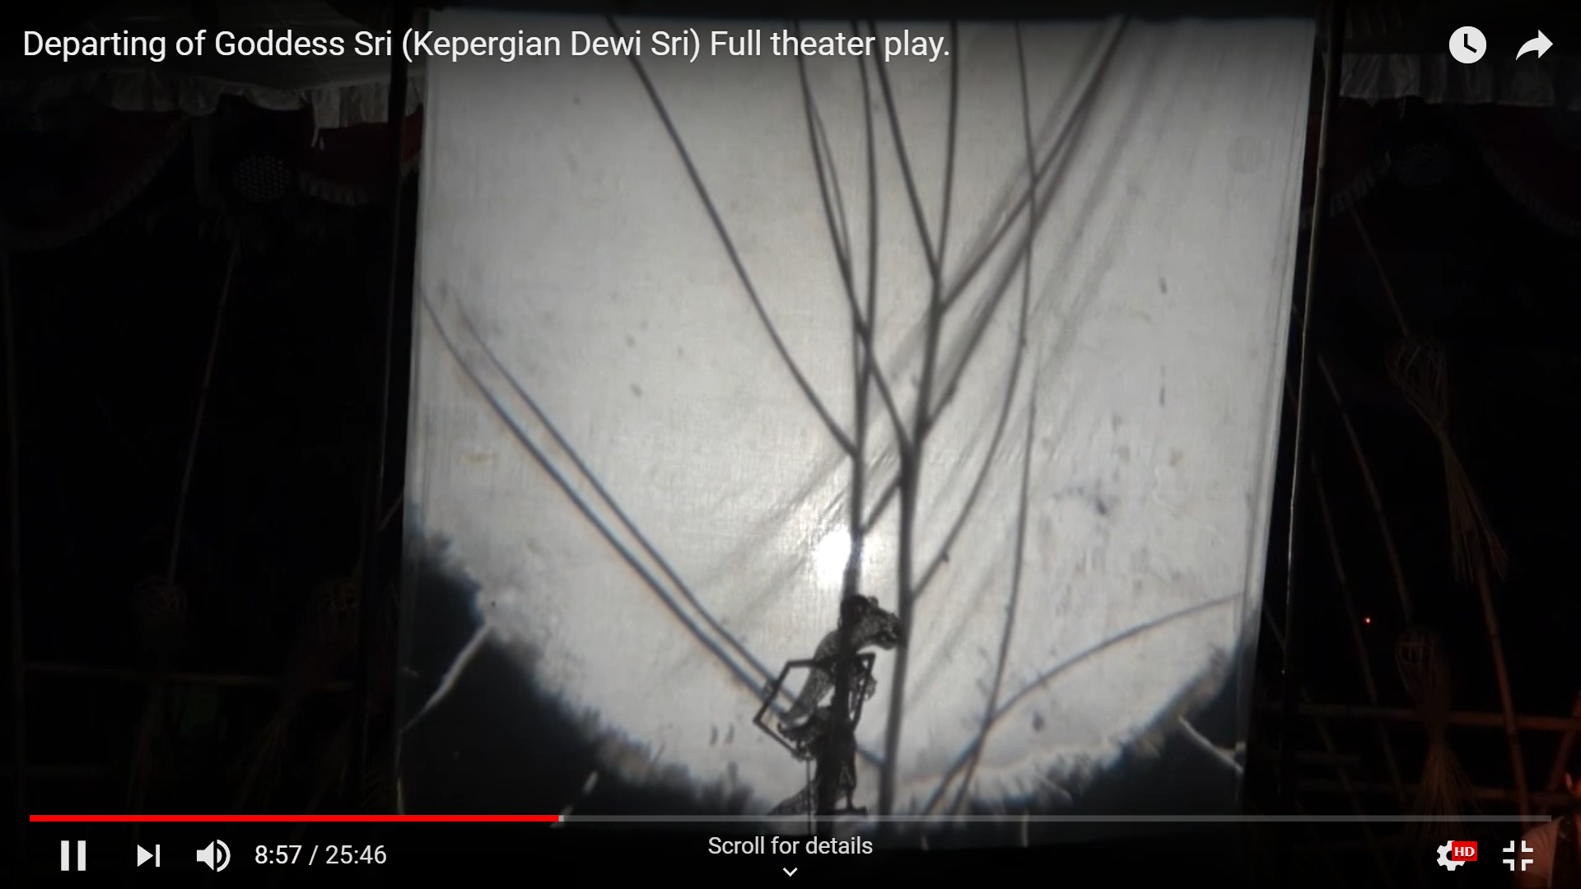
Role play:
The tale of Dewi Sri, the Goddess of rice
Video: https://www.youtube.com/watch?v=CV4krSdeXOs

Slide 9
Similar stories about rice are found beyond Java and in other countries in Southeast Asia, as many of the communities in lowlands depended on agriculture for their livelihood.

Slide 10
Conclusion
Our way of life (festivals/rituals/stories) is shaped by the environment we live in.
Lowlands in Southeast Asia focus on agriculture, which has shaped their way of life
Consequently, many festivals, rituals and stories are common in lowlands across Southeast Asia.
At times, they differ due to the influences of religion and the time period.

