Slide 1
Unit 1: Lesson 1
Irrawaddy Flood Plains:
The Kingdom of Bagan

Slide 2
A note to users of this presentation
This presentation was developed as complementary materials for teachers running this lesson. It follows the lesson plan.
It includes content from the lesson plans and the introductory essays for teachers’ lectures. It also introduces some of the activities suggested for students.
You are welcome to customize this presentation to adjust the lesson to their curriculum and to your students. You can change images, add/remove activities, and of course delete this slide, etc. The Teacher’s Guide (https://sharedhistories.asia/teacher/) provides guidance on how to adjust the lessons.
We wish you a successful lesson!
The Southeast Asian Shared Histories project was developed by UNESCO Bangkok with funding from the Republic of Korea.

Slide 3
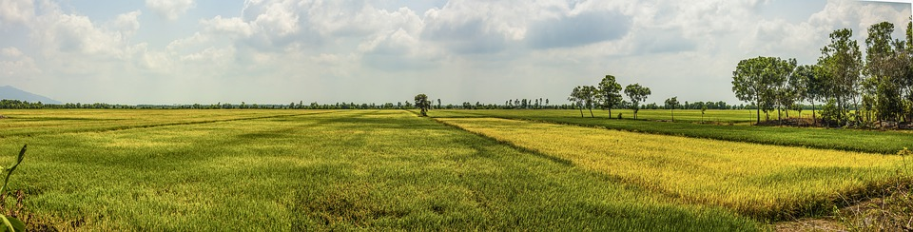
Lowland
A portion of a plain that has a low elevation,
usually not higher than 200m above sea level
Mekong Delta Countryside Rice Field, Cambodia
Source: https://www.maxpixels.net/Rice-Field-Countryside-Mekong-Delta-4193220

Slide 4
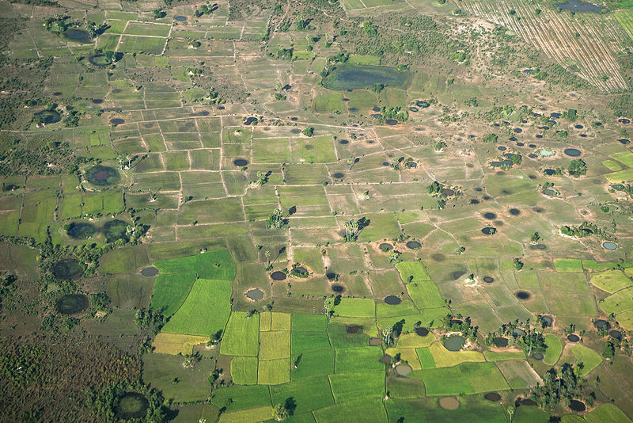
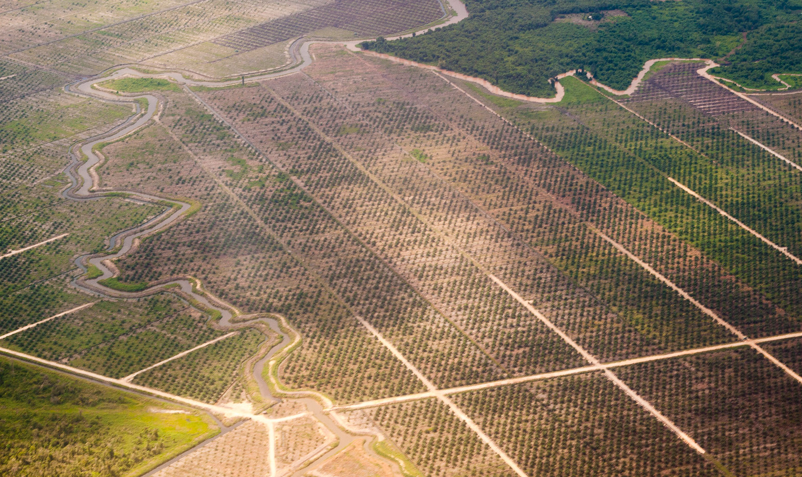
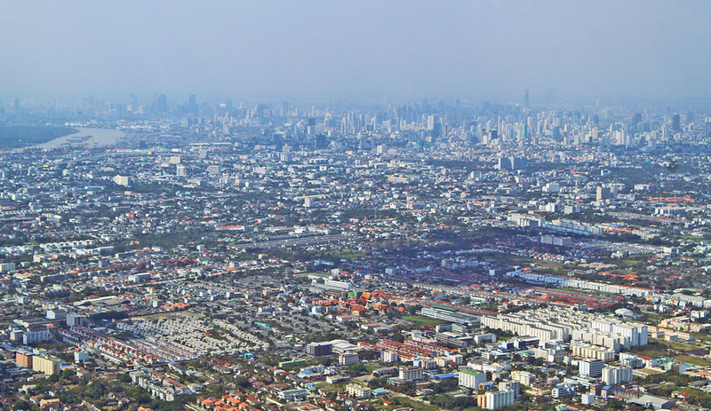
Lowlands in Southeast Asia
Source:
Kandal province, Cambodia, Kimlong Meng, https://commons.wikimedia.org/wiki/File:Bomb_craters_in_Cambodia.jpg
Palm Oil Plantation, Indonesia, Vonk, Edgar, https://www.flickr.com/photos/bananeman/7462515010
Bangkok, Thailand, Schwarzbach, https://www.flickr.com/photos/uwebkk/3754299323

Slide 5
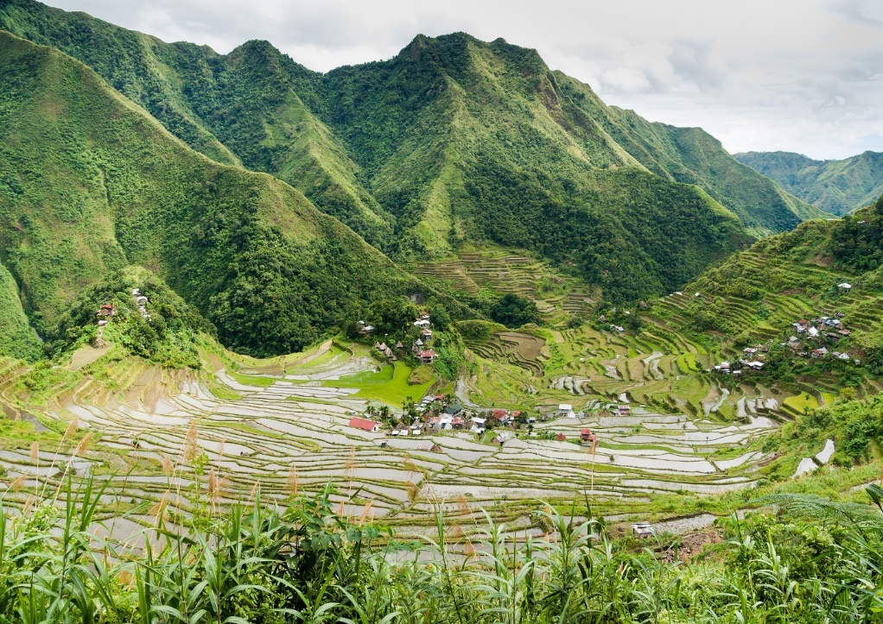
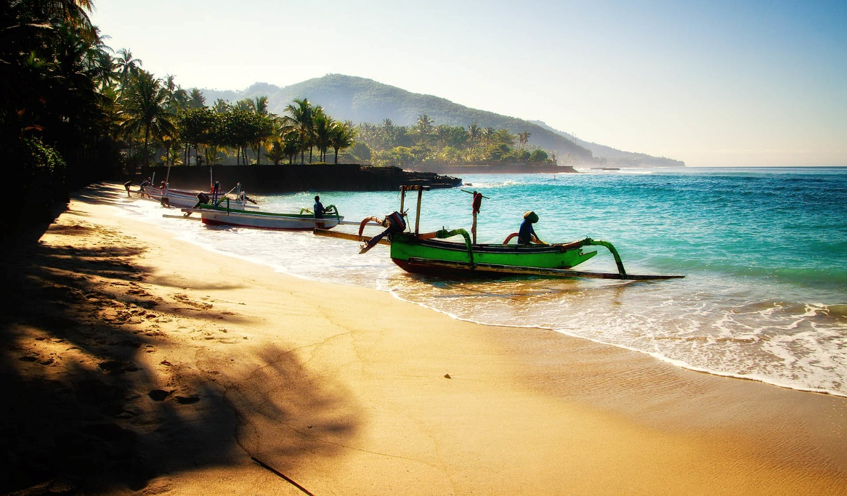
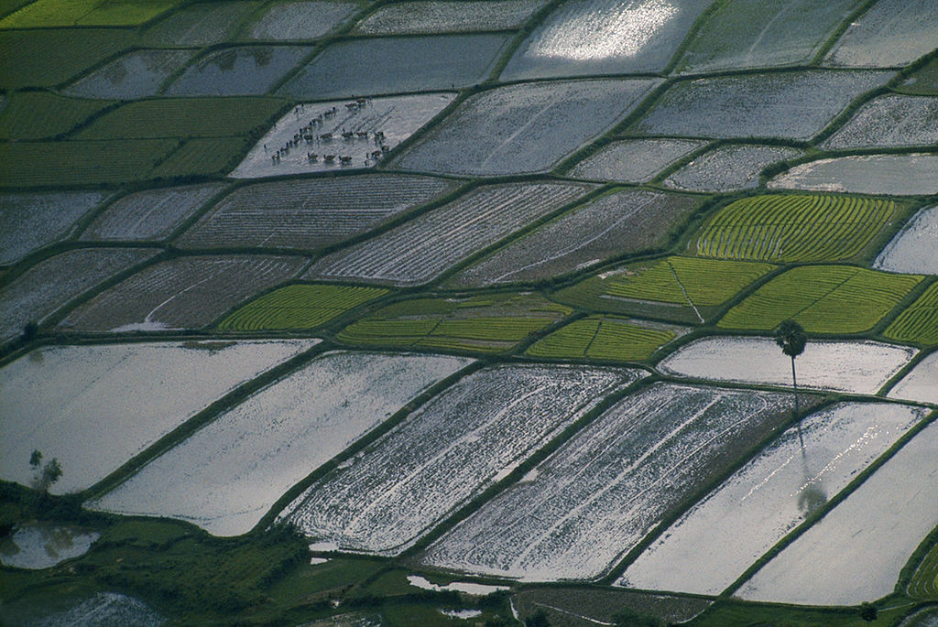
Highland, lowland, coastland
What photo represent lowland?
What do you see on this photo that makes you say it is lowland?
Sources:
Batad, Philippines
Aranas, Uwe, commons.wikimedia.org/wiki/File:Banaue_Philippines_Batad-Rice-Terraces-04.jpg
Mekong Delta, Viet Nam
Wilbur E. Garrett, https://www.flickr.com/photos/13476480@N07/17850359166
Bali, Indonesia
Martin Fuhrmann, https://www.flickr.com/photos/martinfuhrmann/24068107063

Slide 6
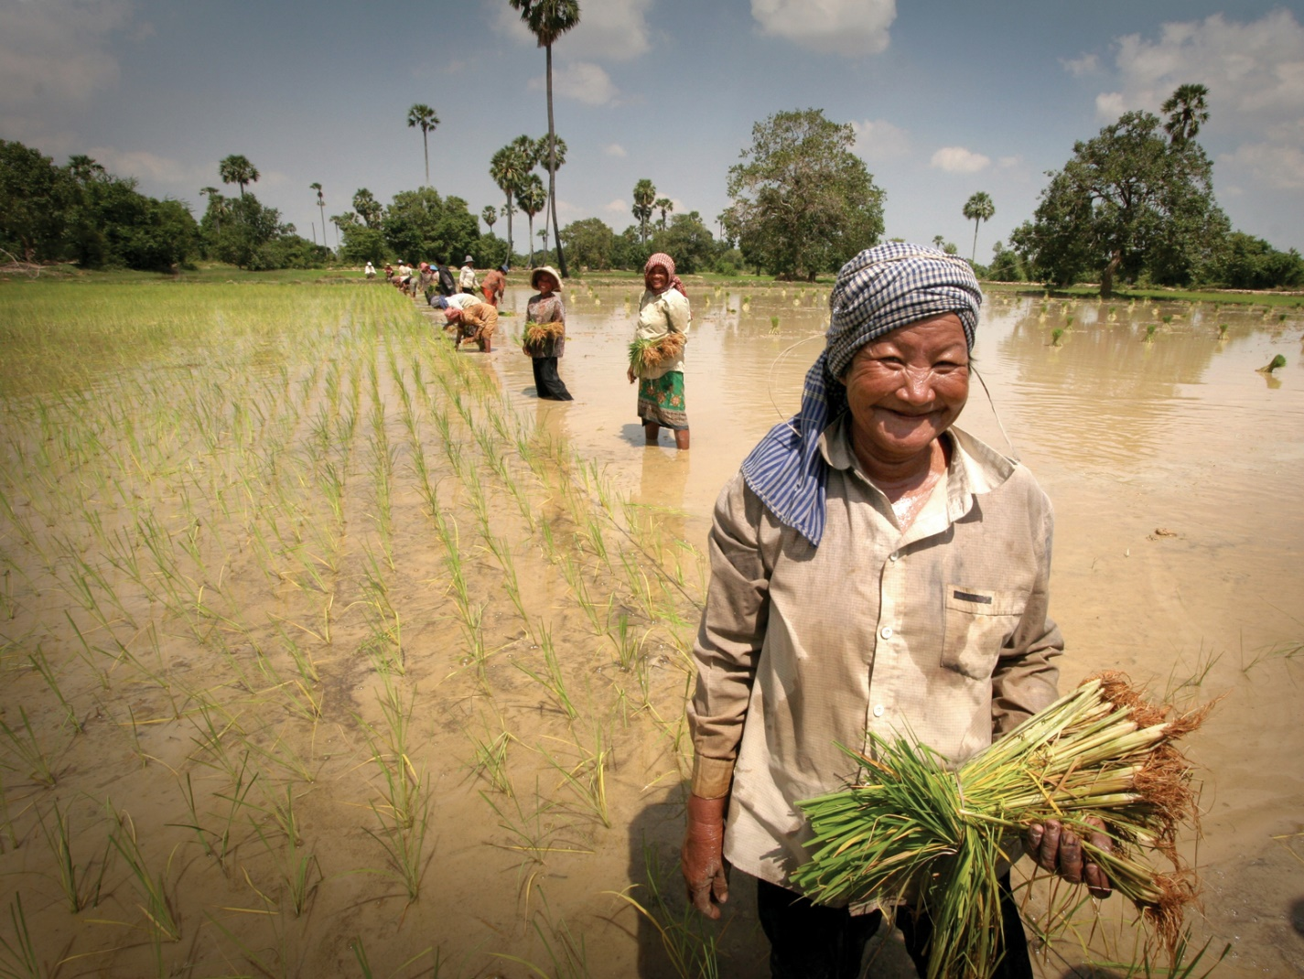
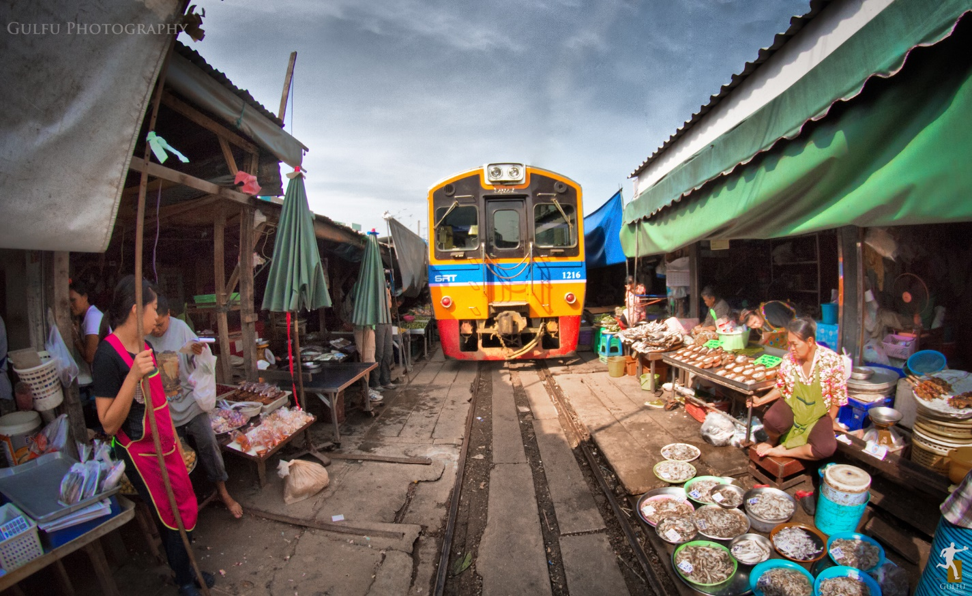
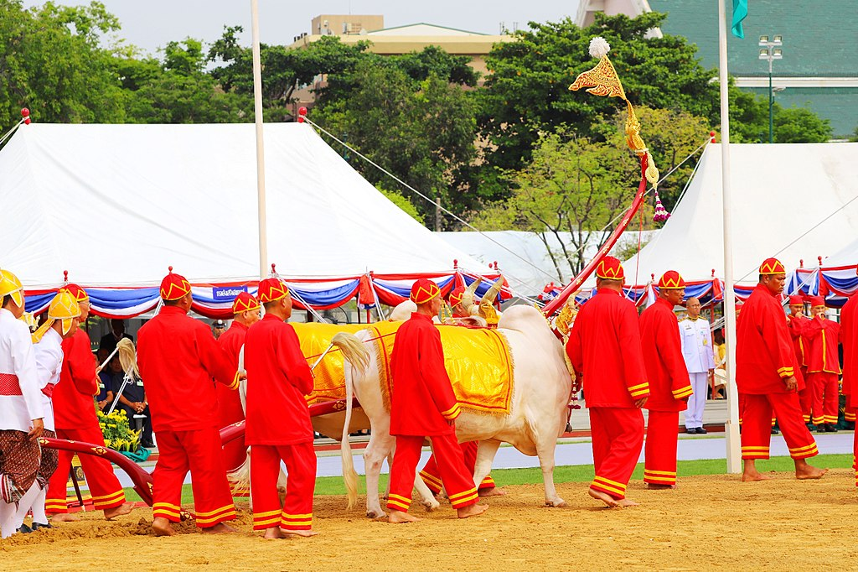
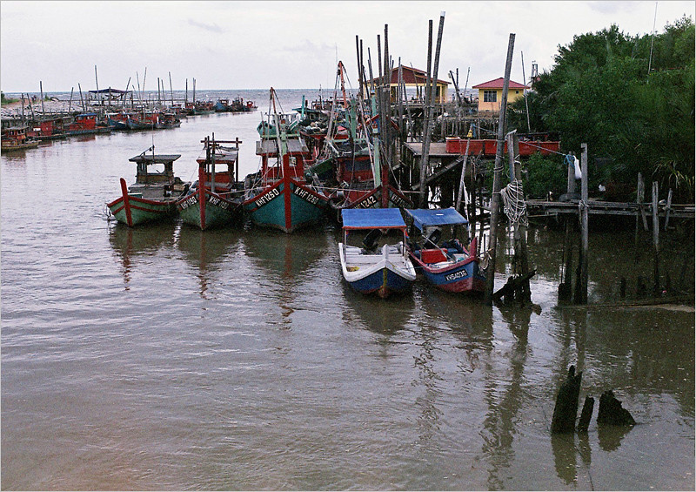
Communities in the lowlands
Julia Maudlin
Fishing Village, Cambodia
Sources:
Farming community, Lao PDR, Jim Homes / AusAID
Railway Towns: Maeklong Railway Market, Thailand, Prasanth Chandran, https://www.flickr.com/photos/gulfu/12771746633
Royal Centres: Ploughing Ceremony, Phnom Penh, Cambodia, https://www.maxpixel.net/Maritime-Fishing-Boats-Boats-Fishing-Cambodia-4081388
Fishing community: Kuala Sala, Yan, Malaysia, Jusni Nasirun, https://www.flickr.com/photos/wickedfilm/4788638476

Slide 7
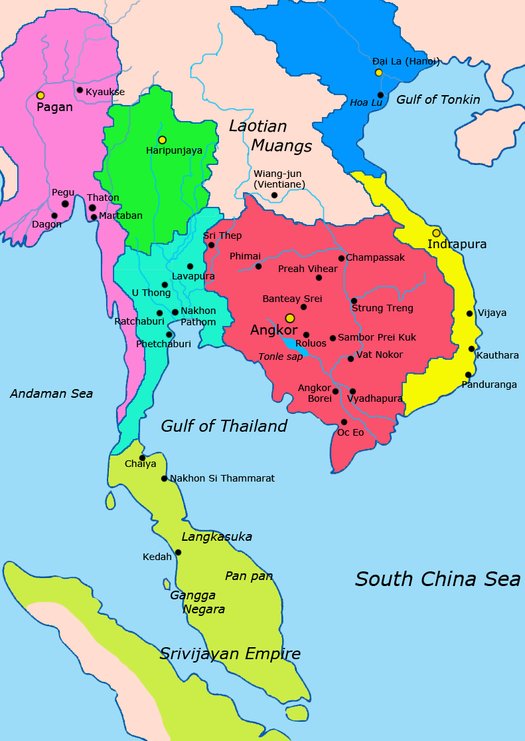
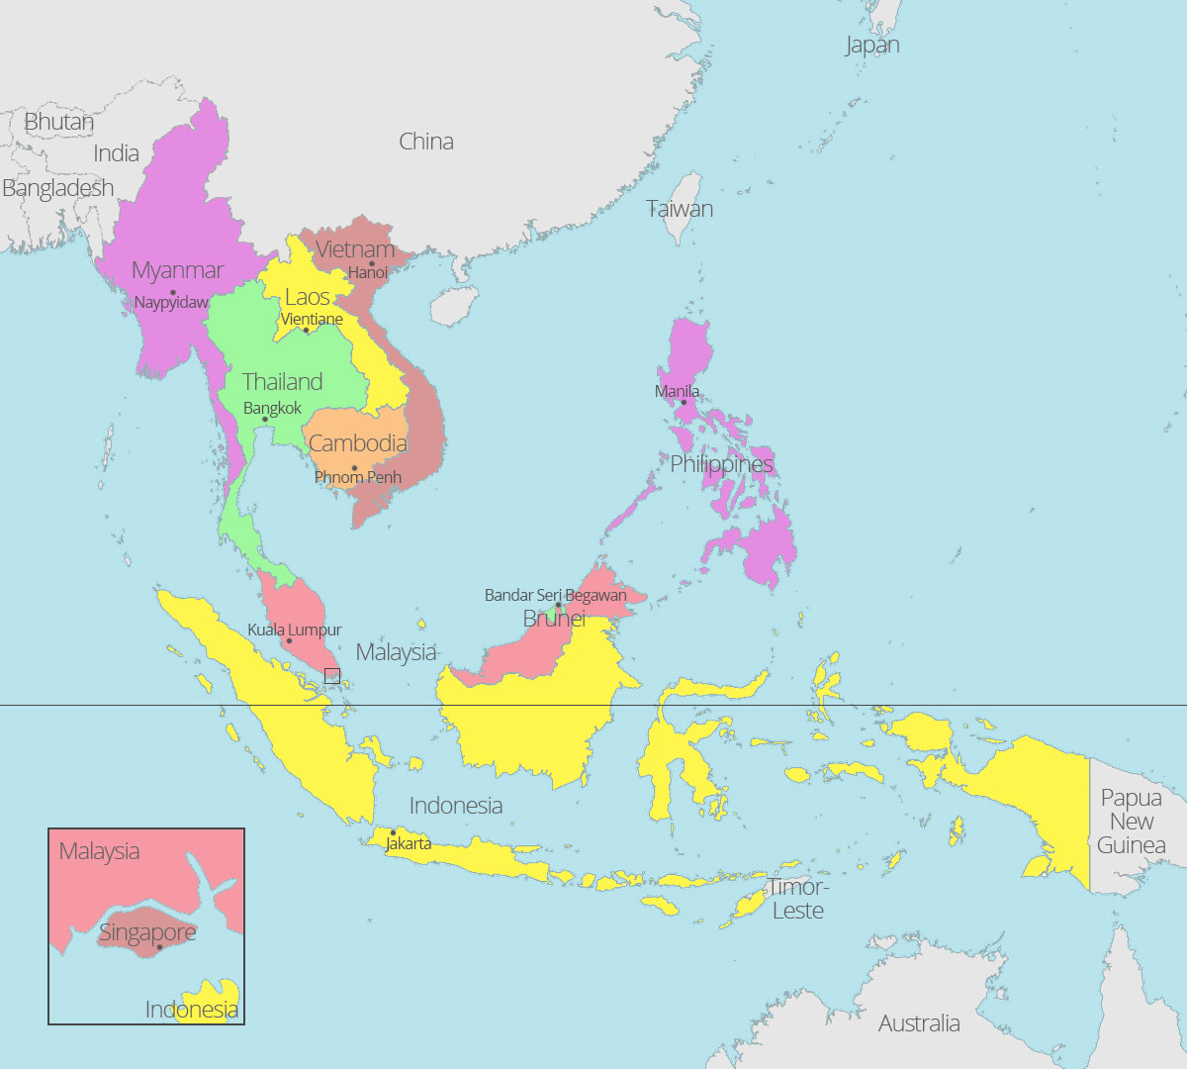
Think – Pair – Share: Southeast Asia
Compare both maps: Classical kingdoms (9th – 14th centuries) and nowadays
Sources: en.wikipedia.org/wiki/Lavo_Kingdom#/media/File:Map-of-southeast-asia_1000_-_1100_CE.png
https://aseanup.com/wp-content/uploads/2016/11/ASEAN-map.jpg

Slide 8
Discussion
?
Early civilizations began in lowlands near water bodies.
Why do you think these early civilizations were located in lowlands near water bodies?
What do rivers provide that could support the population of an early kingdom?

Slide 9
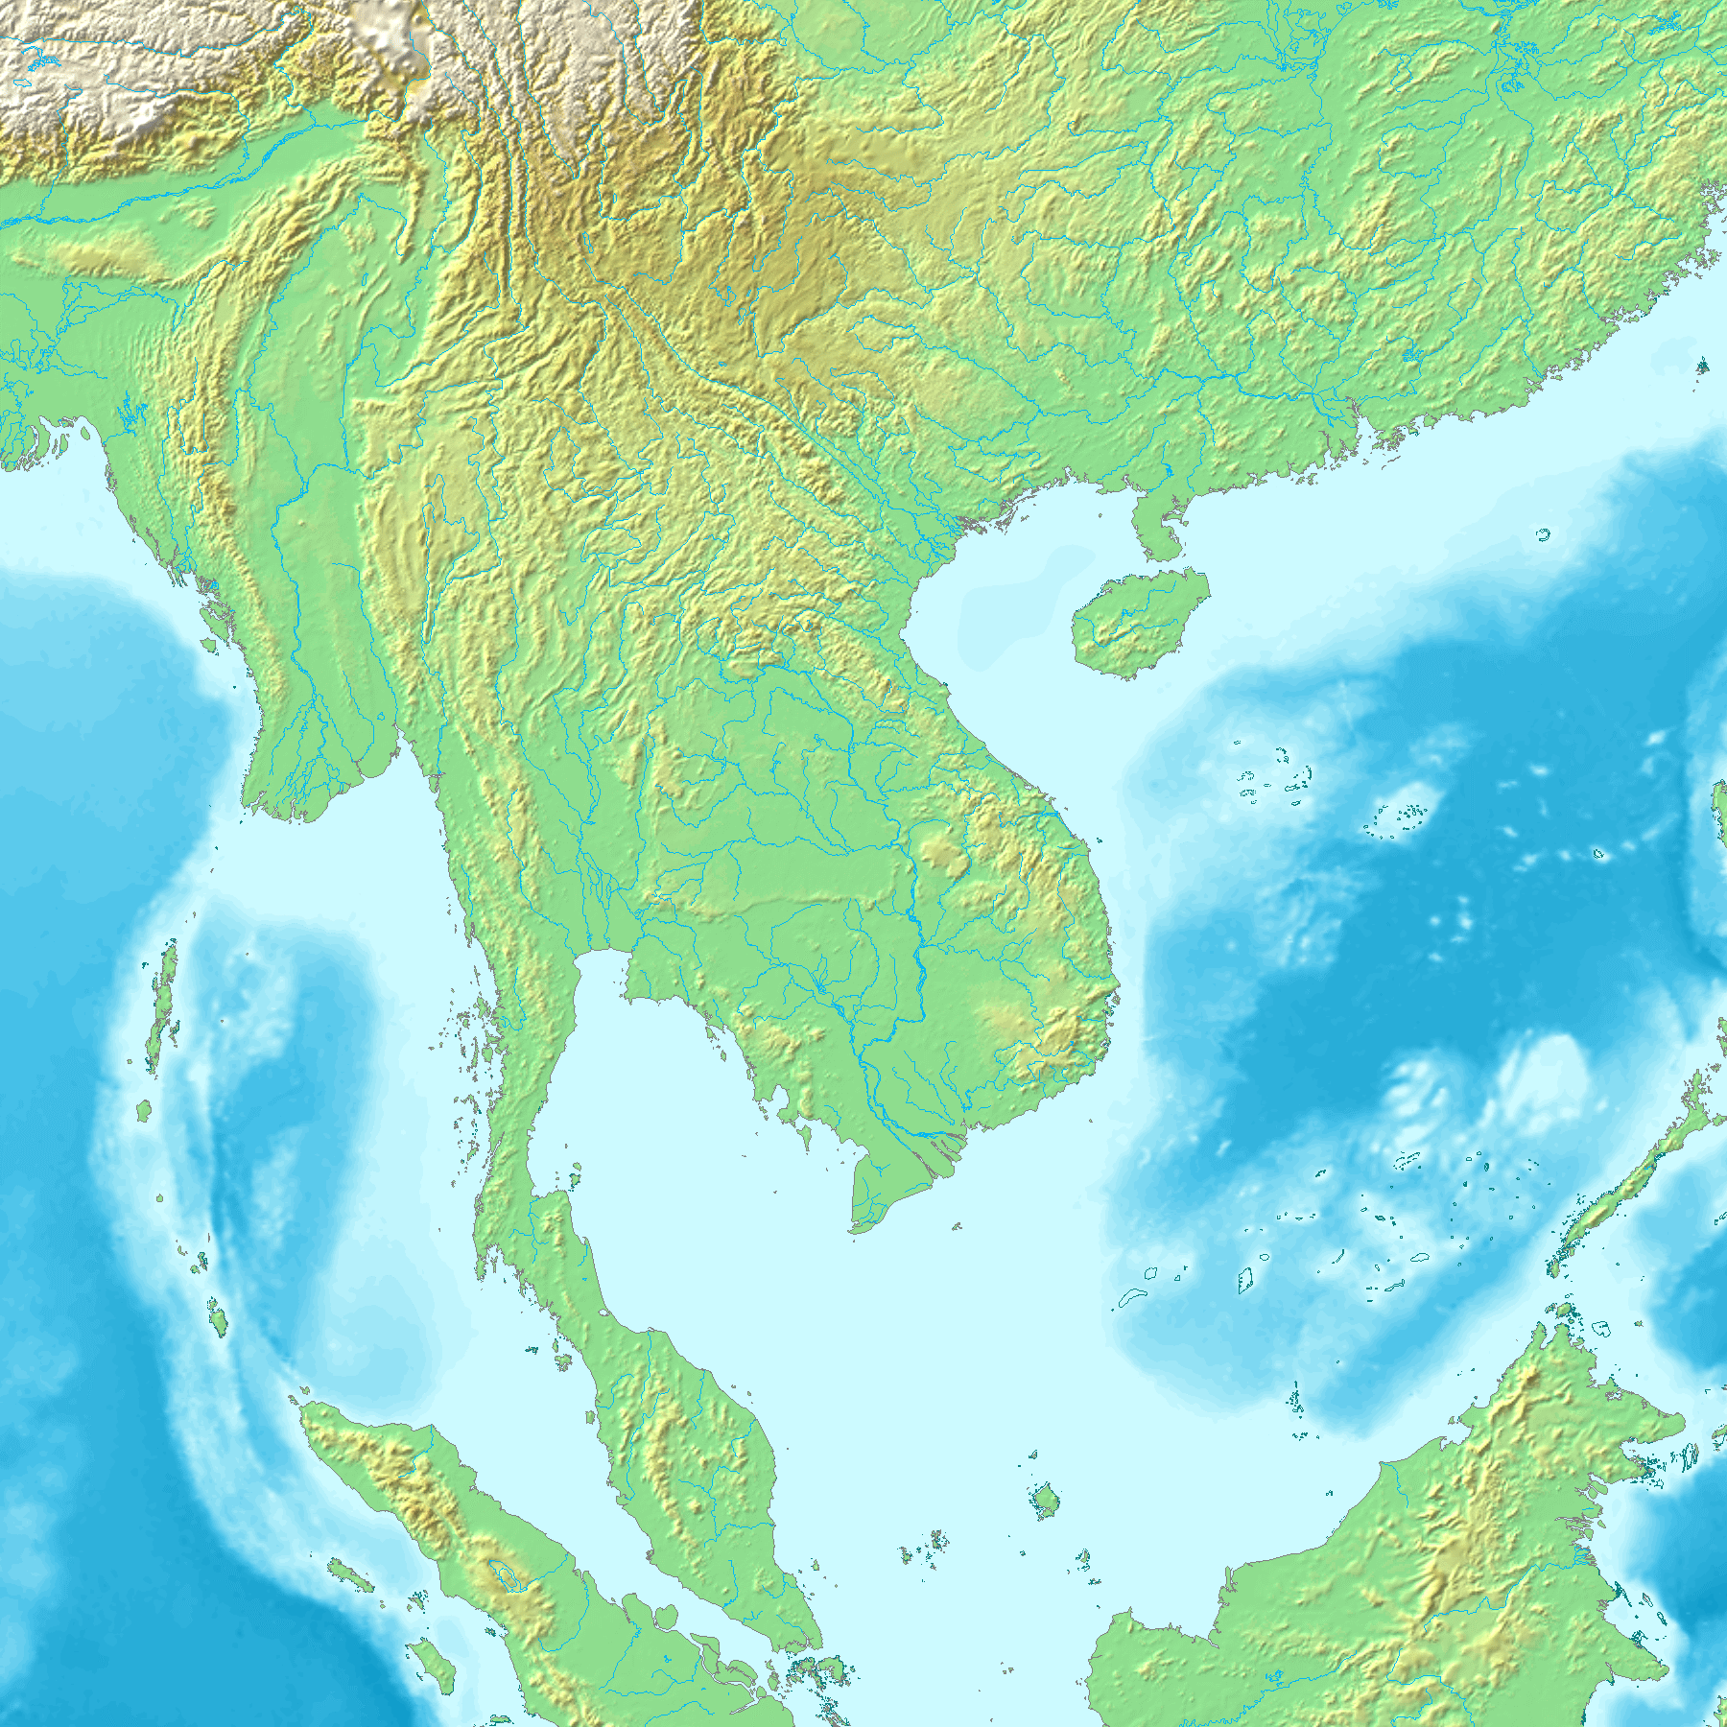
The Kingdom of Bagan
Some of the earliest kingdoms in Southeast Asia emerged in the Dry Zone of Myanmar around the 1st to 5th century A.D.
By the 11th century, Bagan had emerged as the most powerful kingdom in the Dry Zone.
Source: https://commons.wikimedia.org/wiki/File:Topographic30deg_N0E90.png with addition by the author.)

Slide 10
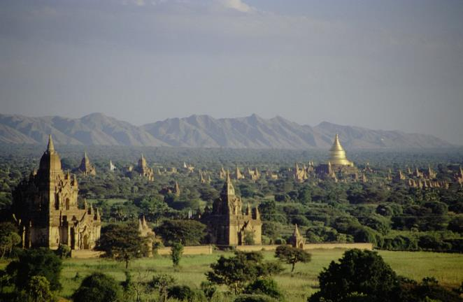
The Kingdom of Bagan
The kingdom was based on agriculture and rice production.
Annual flooding of the Irrawaddy river provided water for rice farming.
The kings of Bagan were entitled to a portion of the rice produced in the kingdom.
Historians and archaeologists suggest that the culture of Bagan spread from its capital to other areas in the kingdom.
Source: https://commons.wikimedia.org/wiki/File:Bagan,_Burma.jpg

Slide 11
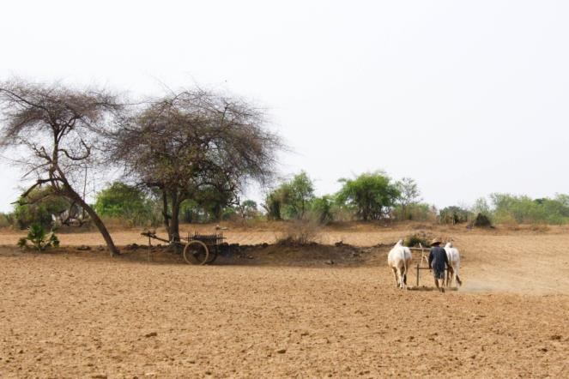
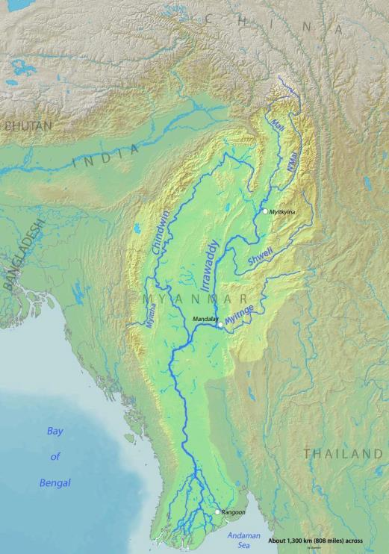
The Dry Zone of Myanmar and the Irrawady river
The Dry Zone of Myanmar is a relatively flat region that has been described by geographers as a semi-desert.
Irrawaddy is one of the rivers crossing the plain.
Rice farmers construct canals to direct water to their fields and also construct ponds to store water.
Sources: https://geoffboeing.com/
https://commons.wikimedia.org/wiki/File:Irrawaddyrivermap.jpg

Slide 12
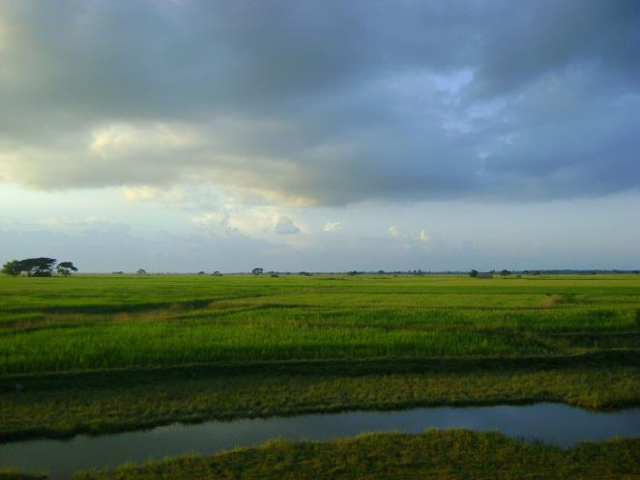
Irrigation and water technology in Ancient kingdoms
The example of Bagan
  What can you observe in the pictures of Angkor and Bagan about old irrigation canals and water technology?
Source: https://commons.wikimedia.org/wiki/File:Burmarice.JPG

Slide 13
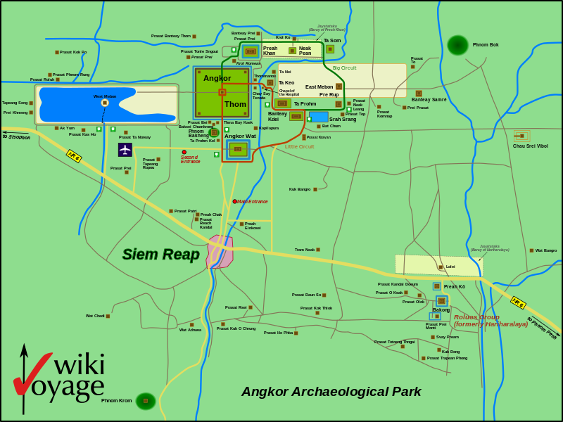
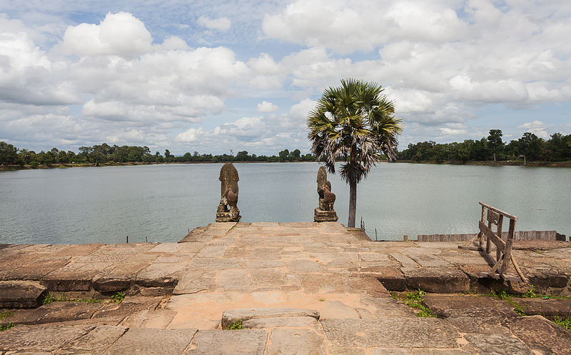
Irrigation and water technology in ancient kingdoms
The example of Angkor Vat, Cambodia
  What can you observe in the pictures of Angkor and Bagan about old irrigation canals and water technology?
Sources:
https://la.wikipedia.org/wiki/Fasciculus:Map_of_Angkor_Archaeological_Park.svg
Srah Srang, Angkor, Cambodia, Delso, Diego. commons.wikimedia.org/wiki/File:Srah_Srang,_Angkor,_Camboya,_2013-08-16,_DD_08.JPG

Slide 14
The Dry Zone is a region that cannot support large-scale agriculture.
People managed to engage in large-scale rice agriculture by the use of irrigation canals → They built canals to move water from the major rivers of the Dry Zone to be used for rice farming.
Irrigation technology was similar in several early Southeast Asian kingdoms located near rivers and other bodies of water.

Slide 15
Source analysis
Analysis of two inscriptions
from the Bagan period.
from another Southeast Asian kingdom: Sukhothai
Who produced the source?
When was it produced?
What does it say about agriculture in the ancient times?

Slide 16
Conclusion
Early civilizations in Southeast Asia began around water bodies.
Many of the early peoples of Southeast Asia focused on agriculture and adapted their environment to fit their needs and priorities.
Across the region the kings and queens had responsibilities related to agriculture. They had to support the livelihoods of the people through the maintenance of irrigation works.

